Slide 1
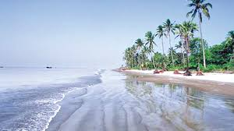
to multimedia class
Notes:
Say greeting to the students.

Slide 2
Identity
Md. Jakirul Islam
BA (Hons’), MA in English, B.Ed, LL.B
Lecturer of English
Shaitshala Adarsha High School & College
Brahmanpara, Cumilla.
Contact- jakir.oy@gmail.com (01811285175)
Notes:
Introduce yourself.

Slide 3
Class Identity
Class- XI-XII
Subject- English For Today
Unit- 8
Lesson- 5
Time- 45 min
Notes:
Introduce Subject-Lesson.

Slide 4
Let’s enjoy a video
Notes:
Play a video of Kuakata sea beach.

Slide 5
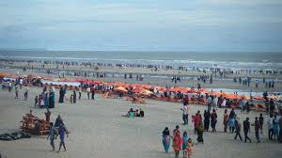
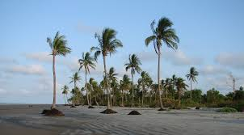
Have you visited any sea beach in Bangladesh?
Can you tell the major two places of Bangladesh where we have sea beaches?
Cox’s bazar
2. Kuakata
What is Kuakata called?
Daughter of the sea
Notes:
Ask the students some questions to infer today’s lesson.

Slide 6
Today’s lesson is on
Kuakata: Daughter of the sea
Notes:
Declare the lesson.

Slide 7
Learning Outcomes
By the end of the lesson, students will be able
To tell the meanings of several words.
To give answer to some questions about Kuakata.
To write the unique features of Kuakata sea beach.
Notes:
Proclaim the learning outcomes.

Slide 8
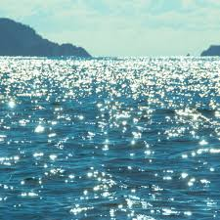
expanse
An large area of land, water or sky
unique
Single, solitary, incomparable
shimmering
Reflecting a gentle light moving slightly; glimmer
Notes:
Demonstrate several words along with showing pictures and tell students to infer meaning.

Slide 9
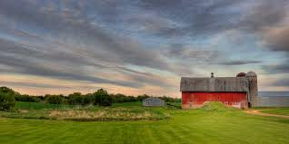
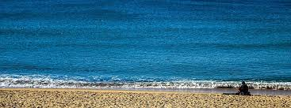
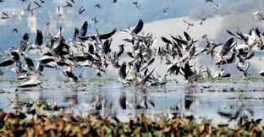
homestead
A house and a surrounding area of land
virgin
Fresh; new; unmarried
sanctuary
Protection or a safe place
Notes:
Demonstrate several words along with showing pictures and tell students to infer meaning.

Slide 10
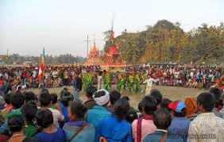
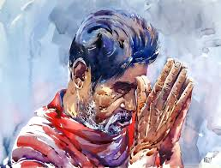
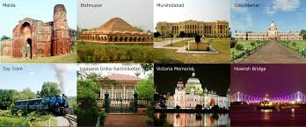
indigenous
Existing naturally; native
devotee
Worshipper; admirer; disciple
inherent features belonging to the culture of a particular society such as traditions, languages or buildings
heritage
Notes:
Demonstrate several words along with showing pictures and tell students to infer meaning.

Slide 11
Read the passage silently. 5 min
Kuakata, locally known as Sagar Kannya (Daughter of the sea) is a rare scenic spot located on the southernmost tip of Bangladesh. Kuakata in Latachapli union under Kalapara Police Station of Patuakhali district is about 30 km in length and 6 km in breadth. It is 70 km from Patuakhali district headquarters and 320 km from Dhaka. An excellent combination of the picturesque natural beauty, sandy beaches, blue sky and the shimmering expanse of water of the Bay of Bengal and the evergreen forest makes Kuakata a much sought after tourist destination.
The name Kuakata takes its origin from the story of a ‘Kua’ or well-dug on the sea shore by the early Rakhaines settlers for collecting drinking water. The Rakhaines had landed on Kuakata coast after being expelled from Arakan by the Mughals. Following the first well, it became a tradition to dig wells in the neighborhood of Rakhaine homesteads for fresh water supply.
Kuakata is one of the unique spots which allow a visitor to watch both the sunrise and the sunset from the beach. That perhaps makes Kuakata one if the world’s most attractive beaches. The long and wide beach at Kuakata has a typical natural setting. This sandy beach slopes gently into the Bay and bathing there is as pleasant as is swimming of diving.
Kuakata is truly a virgin beach and a sanctuary for migratory winter birds. Fishing boats plying in the Bay of Bengal with colourful sails, surfing waves and the lines of coconut trees add to the vibrant Kuakata. The indigenous culture of the Rakhaine Community and hundred years old Buddhist temples indicate the age-old tradition and cultural heritage of this area.
Kuakata is also a holy land for the Hindus and Buddhists. Each year thousands of devotees come here to attend the festivals Rash Purnima and Maghi Purnima. On these two days, pilgrims take holy bath and enjoy going to the traditional fairs.
Notes:
Tell students to read the text silently.

Slide 12
Let’s watch a video.
Notes:
Let them see a video about Kuakata.

Slide 13
Time
10 minutes
Group Work
Write the answer of the following questions.
12
1
10
11
2
3
4
5
6
7
8
9
Where is Kuakata located?
Where does the name ‘Kuakata’ come from?
What is most unique feature of Kuakata beach?
What are the some traditional events that take
in Kuakata?
5. Would you like to visit Kuakata? Make a list of
3 things you’d like to do while in Kuakata.
Notes:
Arrange a group work, monitor their work and give feedback.

Slide 14
Enjoy a short video.
Notes:
Let them knows some facts about Kuakata through a short video.

Slide 15
The features of Kuakata
Kuakata, locally known as Sagar Kannya (Daughter of the sea) is a rare scenic spot located on the southernmost tip of Bangladesh. Kuakata in Latachapli union under Kalapara Police Station of Patuakhali district is about 30 km in length and 6 km in breadth. It is 70 km from Patuakhali district headquarters and 320 km from Dhaka. An excellent combination of the picturesque natural beauty, sandy beaches, blue sky and the shimmering expanse of water of the Bay of Bengal and the evergreen forest makes Kuakata a much sought after tourist destination.
The name Kuakata takes its origin from the story of a ‘Kua’ or well-dug on the sea shore by the early Rakhaines settlers for collecting drinking water. The Rakhaines had landed on Kuakata coast after being expelled from Arakan by the Mughals. Following the first well, it became a tradition to dig wells in the neighborhood of Rakhaine homesteads for fresh water supply.
Kuakata is one of the unique spots which allow a visitor to watch both the sunrise and the sunset from the beach. That perhaps makes Kuakata one if the world’s most attractive beaches. The long and wide beach at Kuakata has a typical natural setting. This sandy beach slopes gently into the Bay and bathing there is as pleasant as is swimming of diving.
Kuakata is truly a virgin beach and a sanctuary for migratory winter birds. Fishing boats plying in the Bay of Bengal with colourful sails, surfing waves and the lines of coconut trees add to the vibrant Kuakata. The indigenous culture of the Rakhaine Community and hundred years old Buddhist temples indicate the age-old tradition and cultural heritage of this area.
Kuakata is also a holy land for the Hindus and Buddhists. Each year thousands of devotees come here to attend the festivals Rash Purnima and Maghi Purnima. On these two days, pilgrims take holy bath and enjoy going to the traditional fairs.
Notes:
Demonstrate the features of Kuakata by underline.

Slide 16
The features
of Kuakata
the shimmering expanse of water of the Bay of Bengal
the evergreen forest
to watch both the sunrise and the sunset from the beach
sandy beach sloping gently into the Bay
a sanctuary for migratory winter birds
Fishing boats plying in the Bay of Bengal with colourful sails
indigenous culture of the Rakhaine Community
Notes:
Demonstrate the features of Kuakata though a smart art.

Slide 17
Time
12
1
2
3
4
5
6
7
8
9
10
11
5 min
Pair Work
Write down 5 features of Kuakata.
Kuakata is one of the unique spots which allow a visitor to watch both the sunrise and the sunset from the beach. That perhaps makes Kuakata one if the world’s most attractive beaches. The long and wide beach at Kuakata has a typical natural setting. This sandy beach slopes gently into the Bay and bathing there is as pleasant as is swimming of diving.
Kuakata is truly a virgin beach and a sanctuary for migratory winter birds. Fishing boats plying in the Bay of Bengal with colourful sails, surfing waves and the lines of coconut trees add to the vibrant Kuakata. The indigenous culture of the Rakhaine Community and hundred years old Buddhist temples indicate the age-old tradition and cultural heritage of this area.
Kuakata is also a holy land for the Hindus and Buddhists. Each year thousands of devotees come here to attend the festivals Rash Purnima and Maghi Purnima. On these two days, pilgrims take holy bath and enjoy going to the traditional fairs.
Notes:
Arrange a pair work, monitor them and give feedback.

Slide 18
Evaluation
3 minutes
What is called Kuakata?
1. Daughter of the sea
2. What is main attraction of Kuakata?
2. Watching the sunrise
& the sunset
3. Why kua was dug?
3. For collecting drinking water
4. Who dug kua?
4. Early Rakhaine settlers
5. In which police station is Kuakata situated?
5. Kalapara
Notes:
Evaluate the students by asking some short questions.

Slide 19
Write down a short letter about visiting Kuakata.
Notes:
Give them Home Work.

Slide 20
Thank you all
for enjoying
the class.
Notes:
End the class with thanks-giving.

