Slide 1
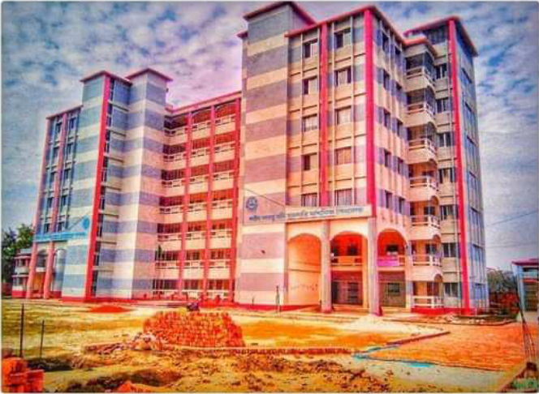
My dear
Students
Welcome
To TKS English Grammar Class

Slide 2
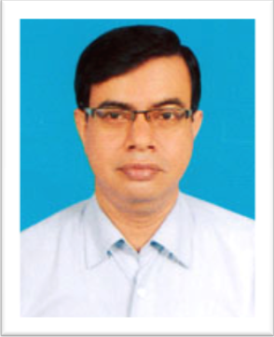
Introduction
Tapash Kumar Shil
English Teacher
Shahid Arju Moni Government Secondary School, Barishal.
Cell: 01733422388/01915017386
Email: teachertapash@gmail.com
YouTube channel: Tapash Kumar
Class-VI-X
Subject: English 2nd Paper
Grammar Part: Transformations (Affirmative to Negative)
Lesson-01
Notes:
Introduction of the teacher and the class.

Slide 3
What we have already learnt
We have learnt –
1. Definition of Transformation.
2. Types of Transformation
3. Sentence and its classifications
4. Details of Assertive, Interrogative, Imperative, Optative and Exclamatory Sentences.
So, what will we learn today?

Slide 4
Today’s Lesson
Rules of transformations
Specifically, we will learn how to transform sentences
into Negative from-
Affirmative Sentences with Only/Alone
Affirmative Sentences with Every + Noun
Affirmative Sentences with All + Noun/ (A/an) + Noun
Affirmative Sentences with Both—and
Affirmative Sentences with As soon as-----,(comma)
Affirmative Sentences with Scarcely/hardly—when
Affirmative Sentences with Too—to
Affirmative Sentences with Must/(Am/is/are/have/
has/need/needs)+ to +Verb

Slide 5
Rules Of Transforming sentences from Affirmative to Negative & vice-versa
Sl. | Affirmative | Negative | Comments
01 | Only/Alone | None but | In the case of Person/God etc.
 |  | Nothing but | In other cases

Slide 6
Rules Of Transforming sentences from Affirmative to Negative & vice-versa
Sl. | Affirmative | Negative | Comments
02 | Only (If it indicates ‘age, number or amount’) | Not more than
 |  | Not less than

Slide 7
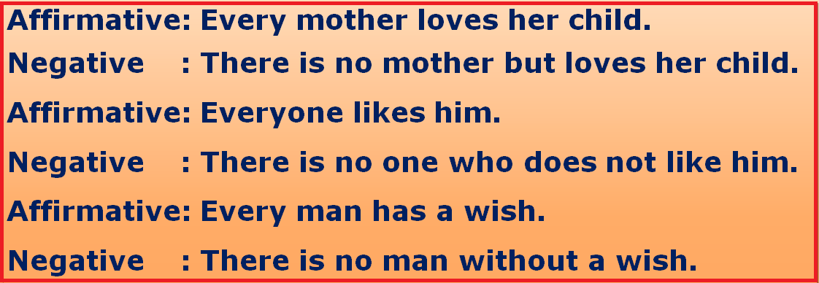
Rules Of Transforming sentences from Affirmative to Negative & vice-versa
Sl. | Affirmative | Negative | Comments
03 | Every + Noun | There is no---but
 |  | There is no---who
 |  | There is no ---without

Slide 8
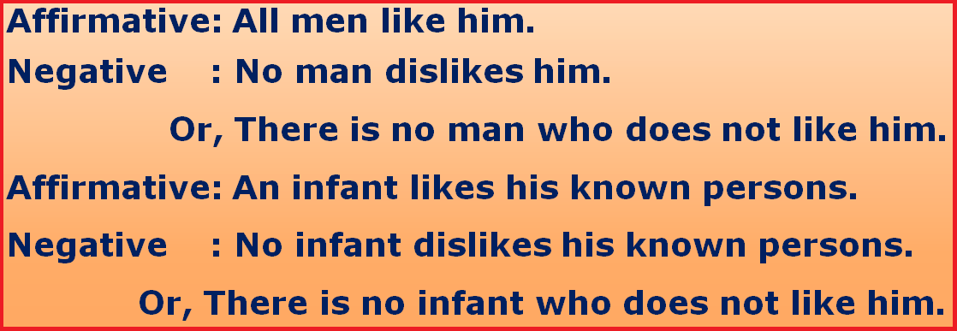
Rules Of Transforming sentences from Affirmative to Negative & vice-versa
Sl. | Affirmative | Negative | Comments
04 | All + Noun A/An+ Noun | No + Noun | Use according to sentence pattern
 |  | There is no

Slide 9
Rules Of Transforming sentences from Affirmative to Negative & vice-versa
Sl. | Affirmative | Negative | Comments
05 | Both----and/ And | Not only----but also | Use according to sentence pattern

Slide 10
Rules Of Transforming sentences from Affirmative to Negative & vice-versa
Sl. | Affirmative | Negative | Comments
06 | As soon as----, (comma) | No sooner had/did/ do/does----than | Use according to the tense of the clauses.

Slide 11
Rules Of Transforming sentences from Affirmative to Negative & vice-versa
Sl. | Affirmative | Negative | Comments
07 | Scarcely—when Hardly—-when | No sooner had--than

Slide 12
Rules Of Transforming sentences from Affirmative to Negative & vice-versa
Sl. | Affirmative | Negative | Comments
08 | Only (If it indicates Place) | Nowhere but

Slide 13
Rules Of Transforming sentences from Affirmative to Negative & vice-versa
Sl. | Affirmative | Negative | Comments
09 | Too--to | So--that

Slide 14
Rules Of Transforming sentences from Affirmative to Negative & vice-versa
Sl. | Affirmative | Negative | Comments
10 | Am to, is to, Are to, have to, Has to, have to, Need to/ must | Cannot but + Root form of Verb | To indicate ‘Obligation’, ‘cannot but/help’ is used
 |  | Cannot help + Ing-form of Verb

Slide 15
Rules Of Transforming sentences from Affirmative to Negative & vice-versa

Slide 16
Class work
Take your writing pad and transform the following Affirmative sentences into Negative:
01. Scarcely had we seen the guests when we welcomed them.
02. Every student respects his teachers.
03. They need to go there.
04. It lives only in this cave.
05. The room is only 10 meters long.

Slide 17
Class work
Now check your answers:
01. No sooner had we seen the guests than we welcomed them.
02. There is no student but respects his teachers.
03. They cannot but go there.
04. It lives nowhere but in this cave.
05. The room is not more than 10 meters long.

Slide 18
No more today
God bless you.

Slide 19
THE END

Slide 20
D`vniY I Qovq Q‡›` Rule-02 Gi e¨vL¨vt
Only যদি বুঝায় বয়স, সংখ্যা, পরিমাপ, পরিমান
বসাও not more than বা not less than.
Complex: I knew that they were horribly expensive.
Simple : I knew them to be horribly expensive.
Compound: They were horribly expensive and I knew them.

Slide 21
Affirmative : He is only ten years old.
Negative : He is not more than ten years old.
Or, He is not more than ten years old.
Affirmative : He has only five toys.
Negative : He does not have more than five toys.
Or, He does not have less than five toys.
Affirmative : As soon as he reached here, the students stood up.
Negative: No sooner had he reached here than the students stood up.
Or, No sooner did he reach here than the students stood up.
Affirmative: As soon as the students see the Headmaster, they enter the room.
Negative: No sooner do the students see the Headmaster than they enter the room.

