Slide 1
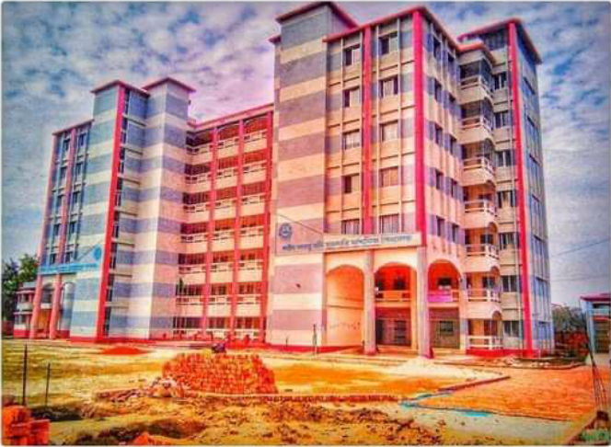
My dear
Students
Welcome
To TKS English Grammar Class

Slide 2
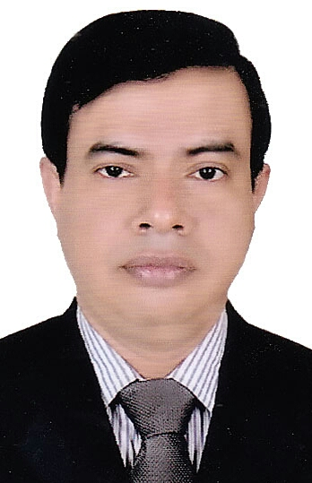
Introduction
Tapash Kumar Shil
English Teacher
Shahid Arju Moni Government Secondary School, Barishal.
Cell: 01733422388/01915017386
Email: teachertapash@gmail.com
YouTube channel: Tapash Kumar
Class-VIII
Subject: English 2nd Paper
Grammar Part: Transformations (Affirmative to Negative)
Lesson-02
Notes:
Introduction of the teacher and the class.

Slide 3
What we have already learnt
We have learnt –
1. Definition of Transformation.
2. Types of Transformation
3. Details of Assertive, Interrogative, Imperative, Optative and Exclamatory Sentences.
4. We have also learnt 10 rules to transform the Assertive Sentences to Negative.
So, what will we learn new today?

Slide 4
Today’s Lesson
Rules of transformations
Specifically, we will learn another 11 new rules to transform sentences into Negative from-
Affirmative Sentences with As----as
Affirmative Sentences with Less----than
Affirmative Sentences with Superlative degree
Affirmative Sentences with Comparative degree
Affirmative Sentences with Always
Affirmative Sentences with Sometimes
Affirmative Sentences with Universal truth

Slide 5
Rules Of Transforming sentences from Affirmative to Negative & vice-versa
Sl. | Affirmative | Negative
11 | As---as | not less ---than
12 | Less---than | not as ---as

Slide 6
Rules Of Transforming sentences from Affirmative to Negative & vice-versa
Sl. | Affirmative | Negative
13-16 | One of wenxb Superlative | No other ev Nothing hy³ Comparative

Slide 7
Rules Of Transforming sentences from Affirmative to Negative & vice-versa
Sl. | Affirmative | Negative
17 | Than anyone else/ Than anything else | No one else/ Nothing else

Slide 8
Rules Of Transforming sentences from Affirmative to Negative & vice-versa
Sl. | Affirmative | Negative
18 | Than any other hy³ Comparative | No other hy³ Positive

Slide 9
Rules Of Transforming sentences from Affirmative to Negative & vice-versa
Sl. | Affirmative | Negative
19 | Always hy³ Sentence | Never hy³ Sentence

Slide 10
Rules Of Transforming sentences from Affirmative to Negative & vice-versa
Sl. | Affirmative | Negative
20 | Universal Truth (Sentence-wPišÍb mZ¨ n‡j) | Negative-interrogative

Slide 11
Rules Of Transforming sentences from Affirmative to Negative & vice-versa
Sl. | Affirmative | Negative
21 | Sometimes | Not always

Slide 12
Class work
Take your writing pad and transform the following Affirmative sentences into Negative:
01. Iron is the most useful of all metals.
02. He sometimes behaves rough.
03. He is always cooperative.
04. The moon gives us light.
05. She is as old as I.

Slide 13
Class work
Now check your answers:
01. No other metal is as useful as iron.
02. He does not behave rough always.
03. He is never uncooperative.
04. Doesn’t the moon give us light?
05. She is not less old than I.

Slide 14
No more today
God bless you.

Slide 15
THE END

