Slide 1
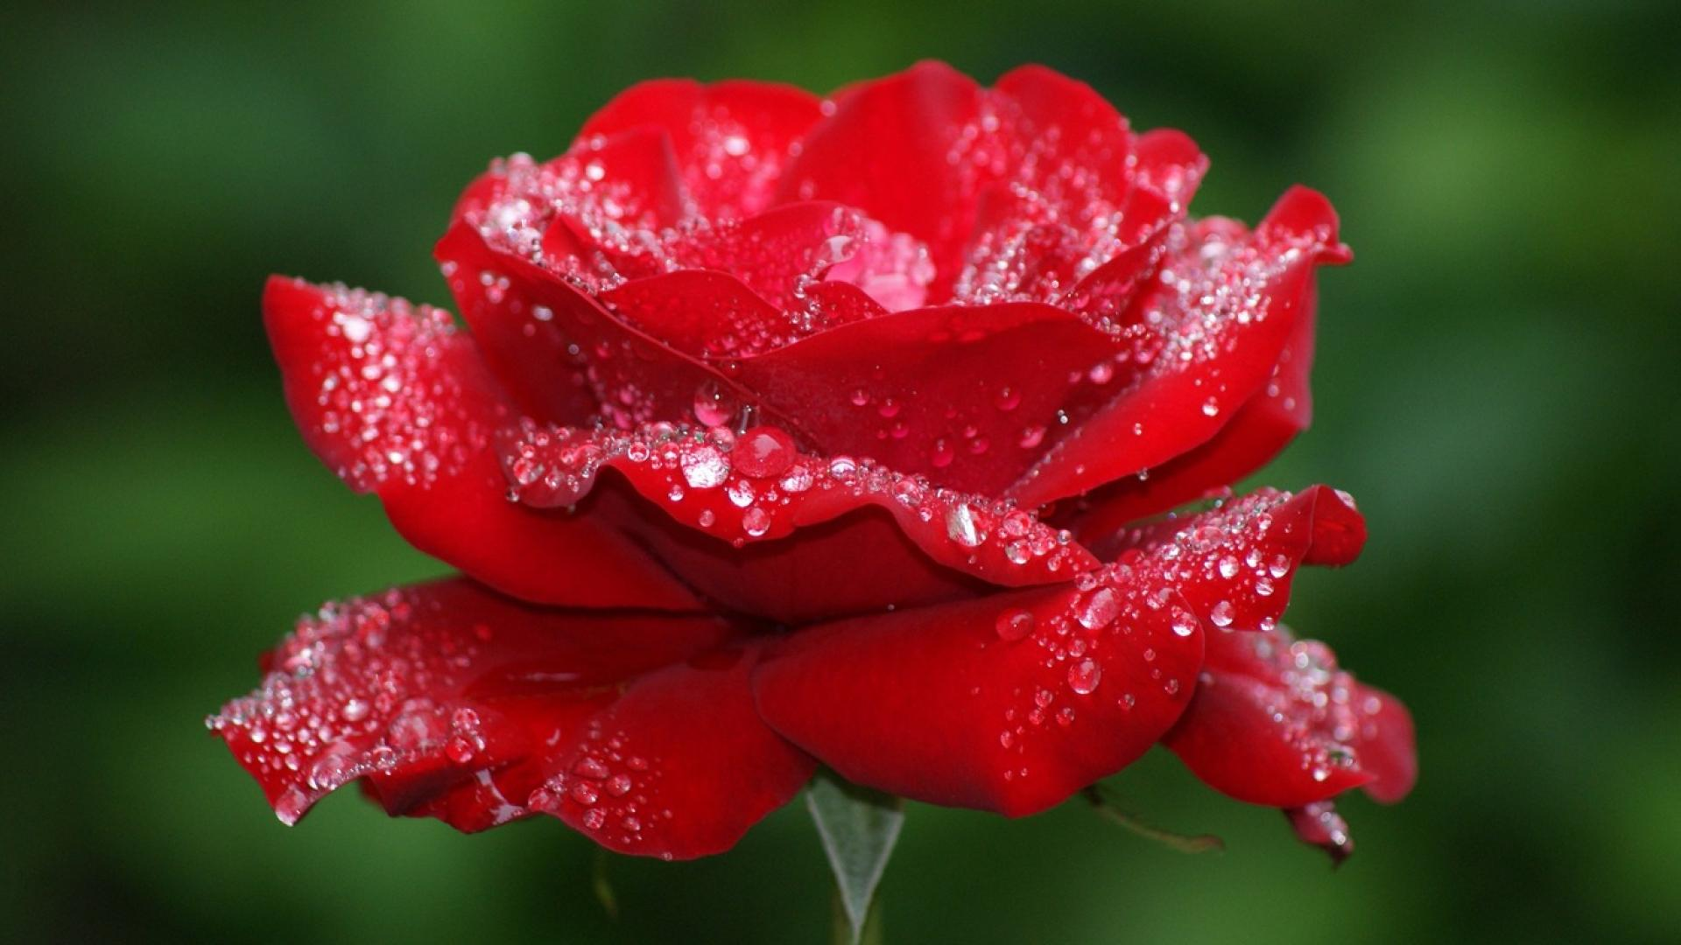


Slide 2

INTRODUCTION
Md Amir Hossain
AssistantTeacher(English)
Madinatul Ulum Dakhil Madrasah
79hossainamir@gmail.com
Mobil No: 01714-315772

Slide 3

English Ist Paper
Class- Nine
Unit-10
Lesson-4
Date:02/03/2019

Slide 4
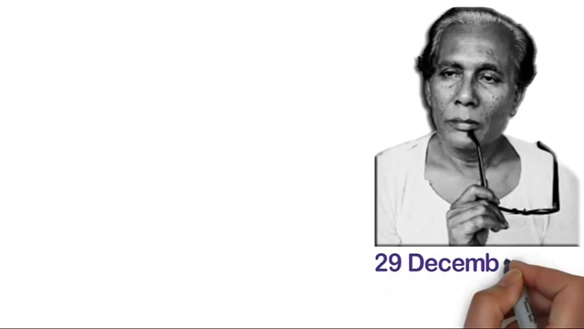
Let us enjoy a video

Slide 5
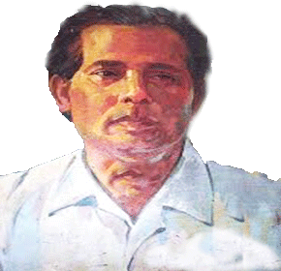
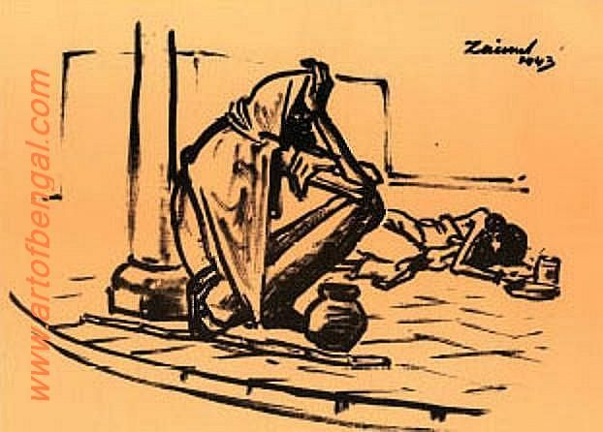
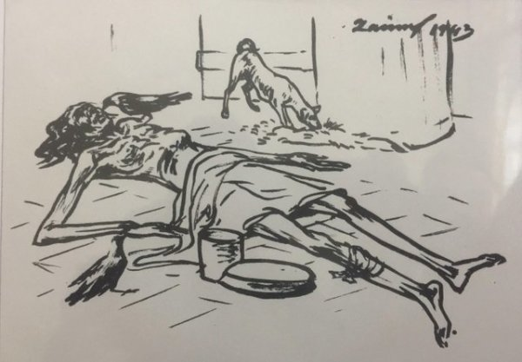
Look at the picture . He is a great son of our country.
Why is he famous?
Who is the person?

Slide 6
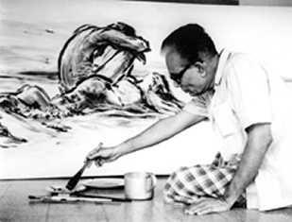
Our todays topic is
Jainul abedin,
the great artist

Slide 7
Learning outcomes:
After completing the lesson students will be able to---------
Ask and answer question about a great person
Read and answer questions.
Complete the grid using appropriate information from the text.

Slide 8
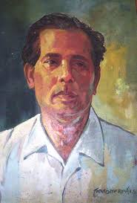
Short descriptions of Zainul Abedin
Gratuated from Culcutta art school in1938.
Born-29/12/1914
kishorgong
Famous picture
Famine sketch.
Achieve gold medal 1938
Death-29/05/1976
The first principal of the art school in Dhaka

Slide 9
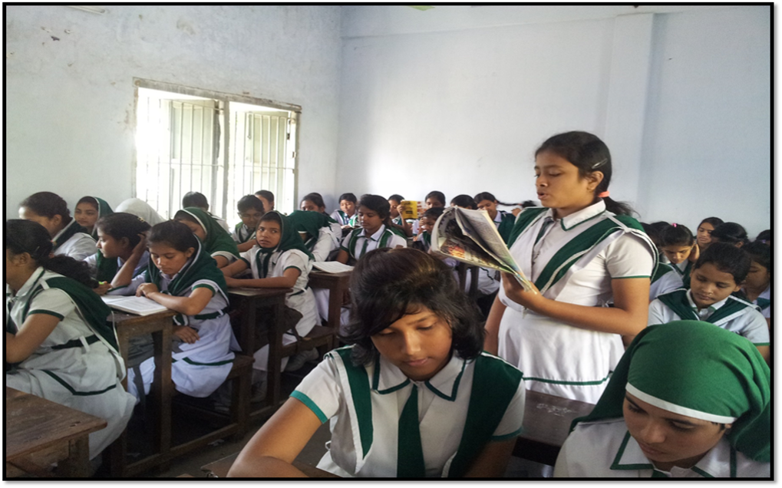
Silent Reading

Slide 10
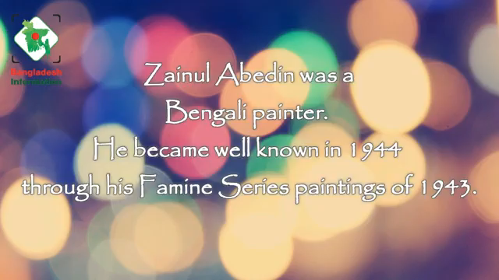

Slide 11
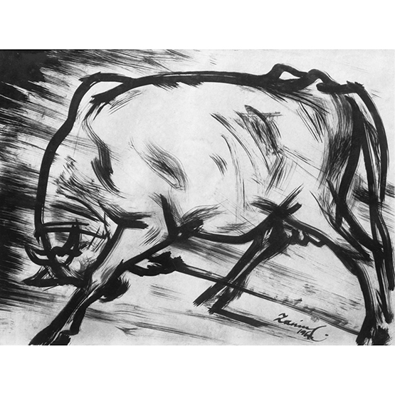
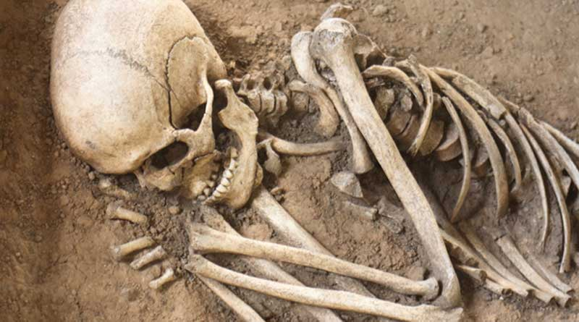
Sketch
Figure

Slide 12
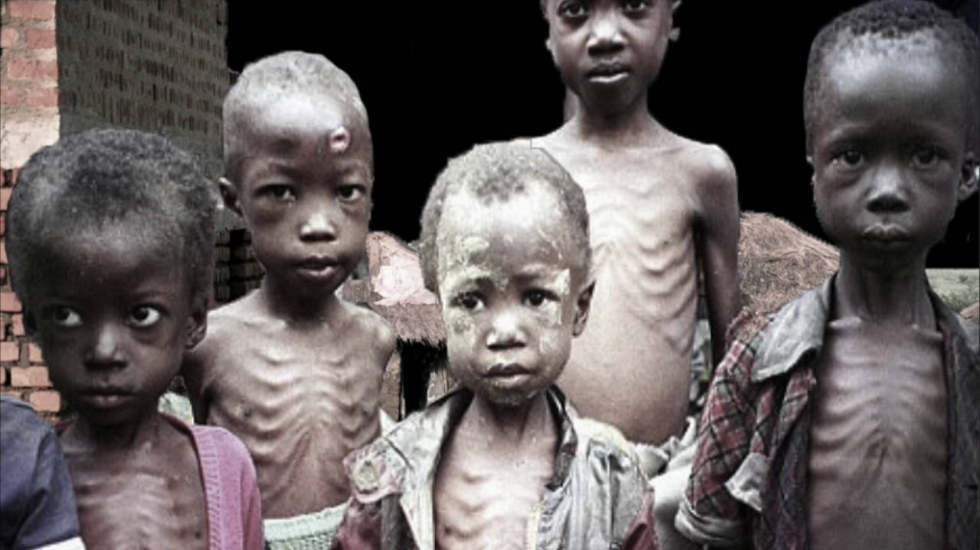
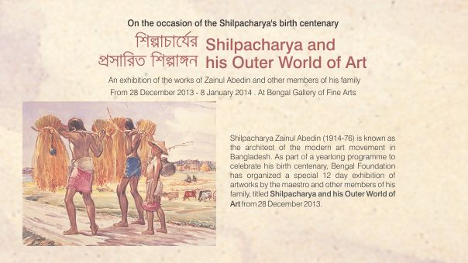
starvation
Documentn

Slide 13
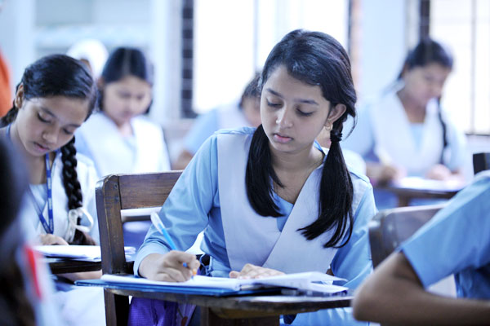
Individual Work
Where is Zainul’s art gallery situated?

Slide 14
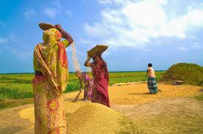
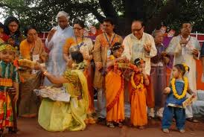
He organized the Nabanna exhibition in 1969.

Slide 15
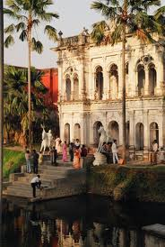
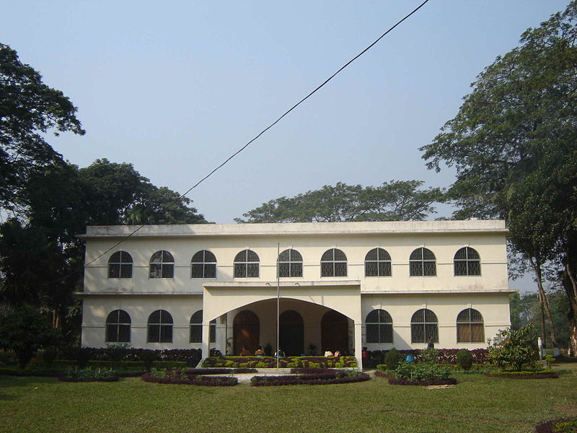
He founded the Folk Art Museum at Sonargoan.
He founded Zainul Abedin Shangrahasala in Mymensing in 1975

Slide 16
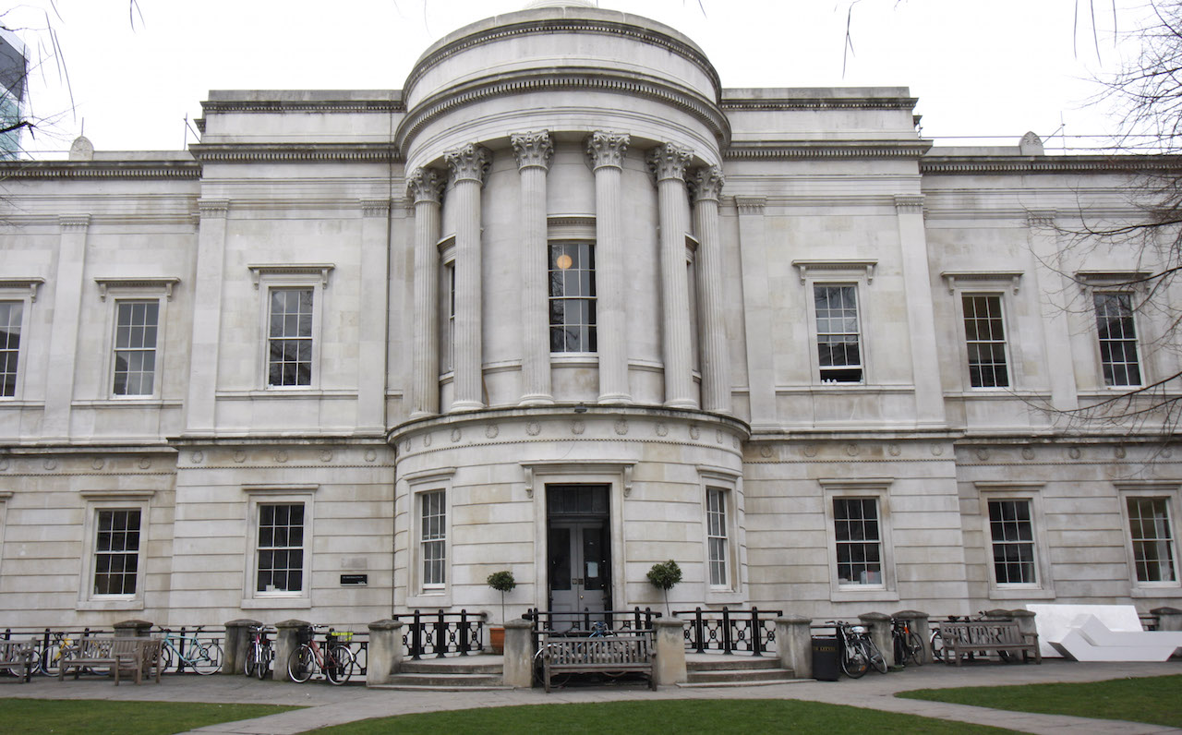
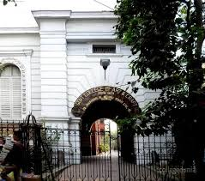
Zainul Abedin attended Slade School of Arts, London in 1951-52.
He studied in the Govt. School of Art, Calcutta.(Kolkata)

Slide 17
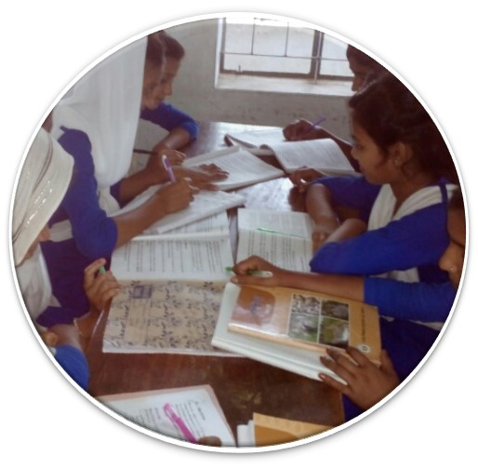
Group Work
When did he get Gold Medal??
What influence did the river Brahmaputra have on Zainul Abedin?
Where is Slade School of Arts situated?
How did Moneza feel after visiting the gallery?

Slide 18
Evaluation
Who was Zainul Abedin?
Where was Zainul Abedin born?
What is the name of his famous picture?
What did these works earn him later in his life?

Slide 19

Home work
Write in details about Jainul abedin,the great artist.

Slide 20

Thank You

