Slide 1
W
E
L
C
O
M
E
Mahia
Rahman
Assistant Teacher
English
Silam P.L High School
B.A Hons
M.A (English)

Slide 2
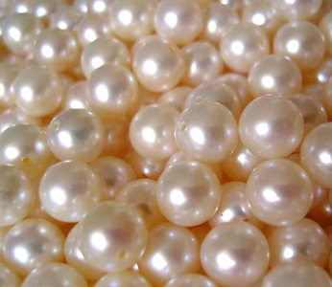
Look at the Picture and discuss in pairs

Slide 3
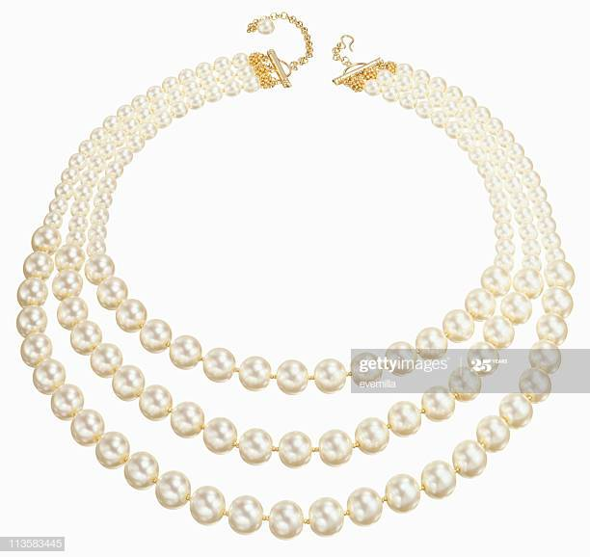
Subtitle

Slide 5
Pearls ! Pearls ! Pearls !

Slide 6
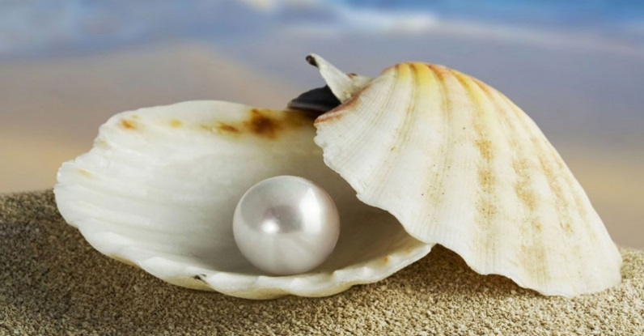
Unit-7, Lesson-1

Slide 7
After we have studied this unit ,we will be able to
Ask and answer question
Write down the main ideas in our own words
Write short paragraphs

Slide 8
New-word
Mythology-
Ancient-
Dissolved-
Status-
Delicate-

Slide 9
Ask and answer question in pairs
When the first pearl was probably discovered?
What was one of the most highly valued gems?
Who thought of pearls as a sign of wealth and social position ?
What good luck the knights thought would pearls bring them ?

