Slide 1
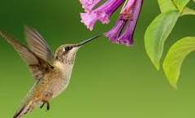
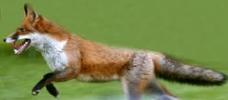
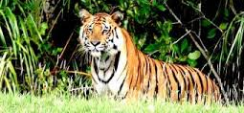
welcome

Slide 2
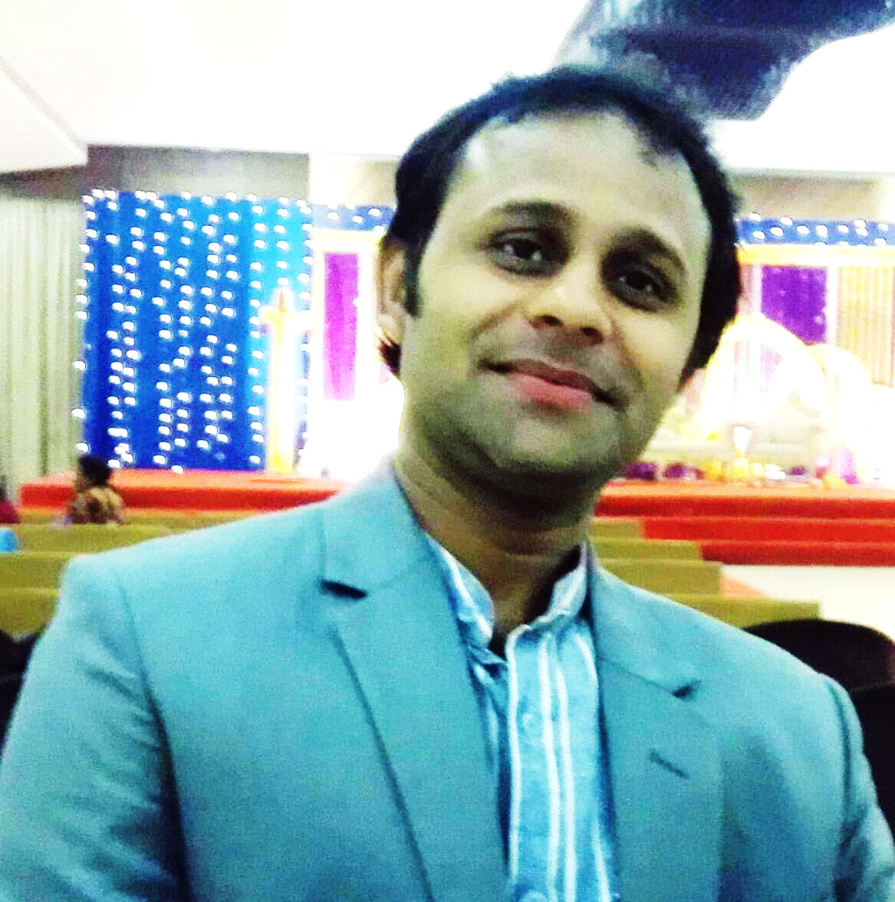
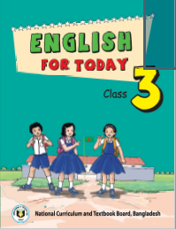
Teachers Identity:
Introduction of the lesson
Class: Three
Sub:English
Unit:21
Lesson:1
Lesson title:Occupation
Today’s lesson:A (Look and match )
Pintu Chakraborty(Govindo)
ASISSTANT TEACHER
PURBO GUROKCI GOVT. PRIMARY SCHOOL
GOWAINGHAT-SYLHET.
pintuchy20@gmail.com

Slide 3
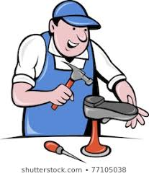
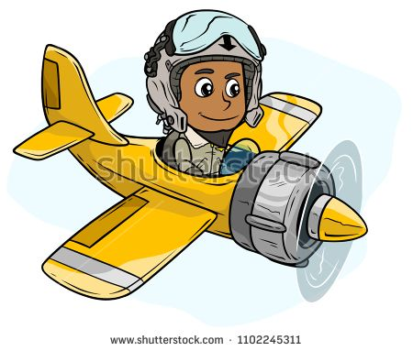
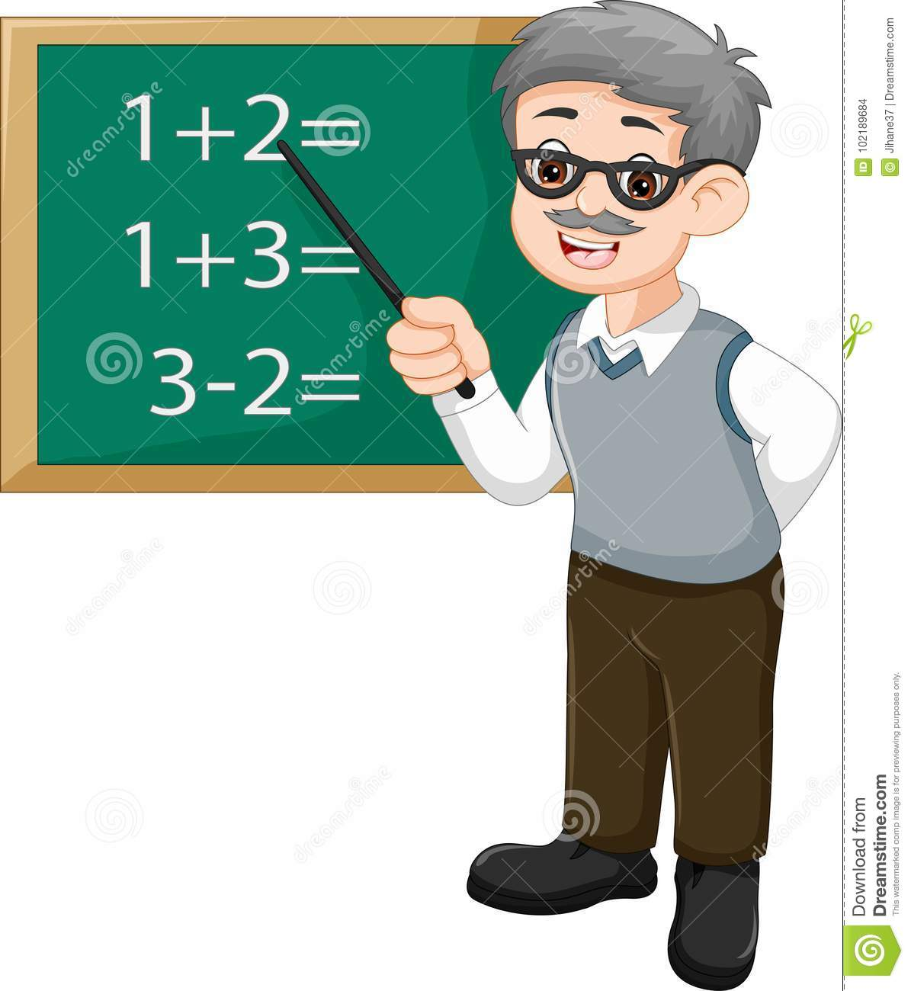
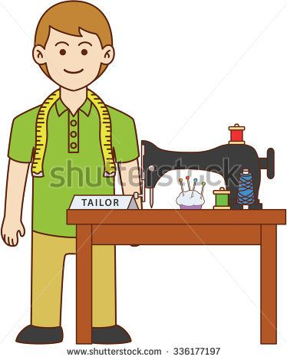
Look at the pictures
Notes:
Warm up/ verification of prior knowledge

Slide 4
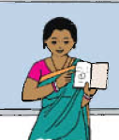
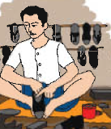
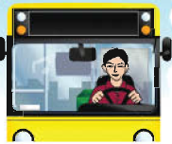
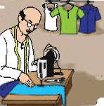
Lesson declaration
Today we will read
“Occupations”

Slide 5
Learning outcomes
By the end of the lesson Students will be able to learn:
1.1.1 Repeat words phrases and sentences after the teacher with proper sounds and stress.
6.2.1 Talk about people and object .
1.4.1 Read and match words and sentence with pictures
3.1.2 to write words, phrases and sentences using non- cursive small letters .

Slide 6
One day one word
English meaning is to expressin any subject language
Speak
কথা বলা
(Bengali meaning is)
I speak in English.
Sentence

Slide 7
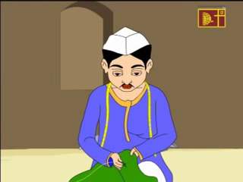
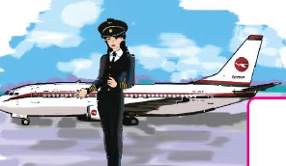
What does he do?
Tailor
Pilot
What can we see in the picture?

Slide 8
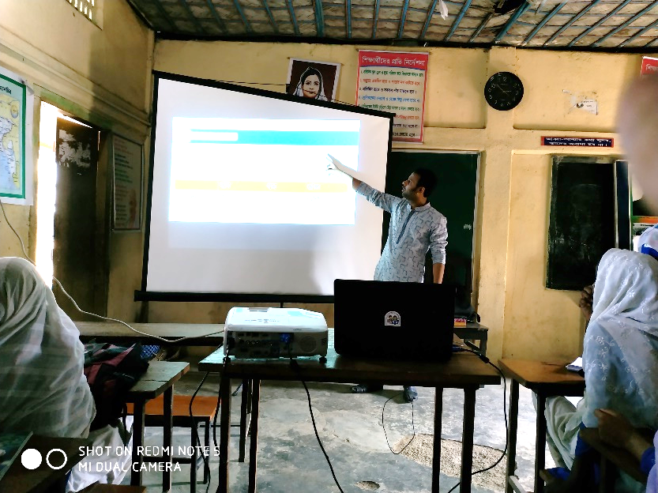
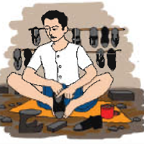
Who teaches us ?
Teacher
What does he do?
Cobbler

Slide 9
Brief description
Cobbler
A Cobbler mends shoes.
Tailor
A tailor makes clothes.
Teacher
A teacher teaches at school.
Pilot
A pilot flies a plane.

Slide 10
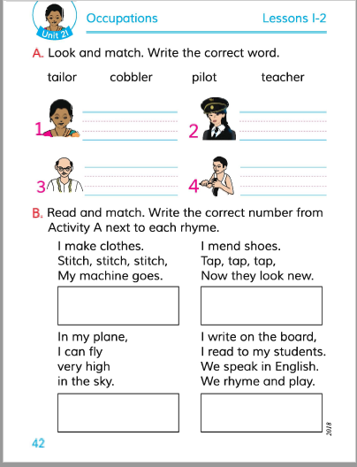
Please open your book at page- 42
Lesson-1

Slide 11
I will say the words and the students will say after with me.
I will call some students and say them to write the name of the occupation in the board one by one.

Slide 12
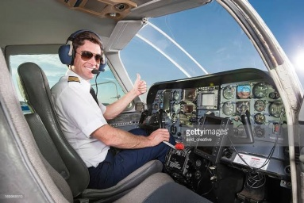
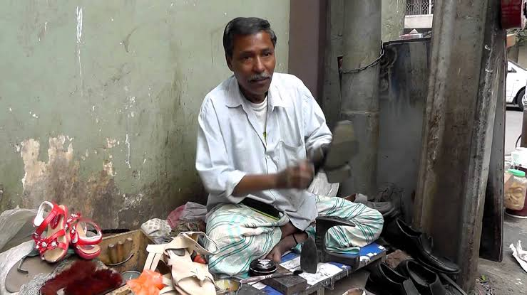
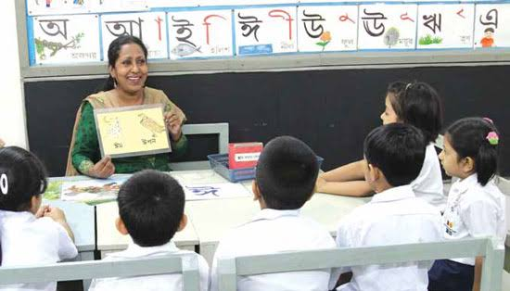
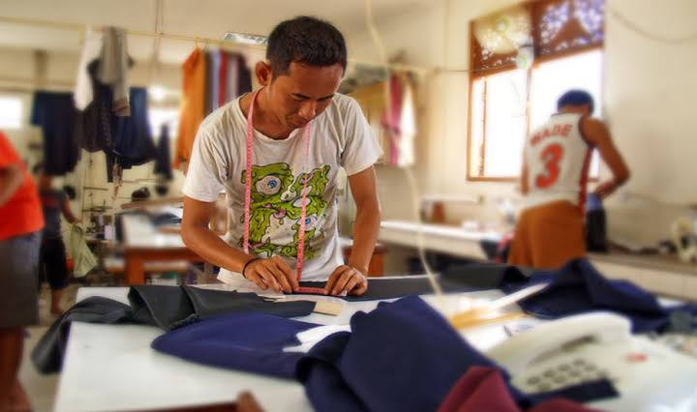
Task
Write the correct word beside the picture.
Tailor
Teacher
Cobbler
Pilot

Slide 13
Home work
Write down what your father’s and mother’s occupation is?

Slide 14
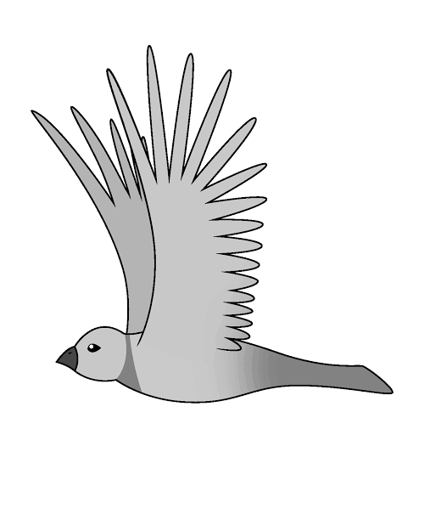
Thanks

