Slide 1
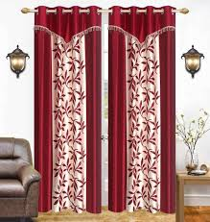

Slide 2
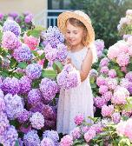
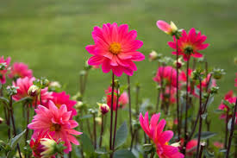
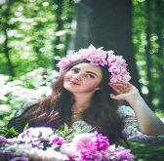
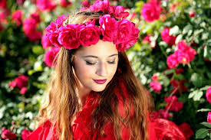
Welcome to English Class
Notes:
Welcome slide. This picture is related to the topic. So I have chosen it. Teacher may change it if he wants.

Slide 3
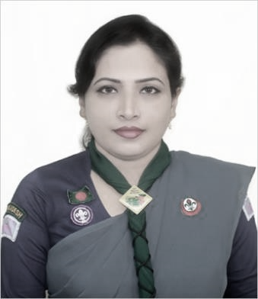
Teacher information
Sunayana Roy
Assistant teacher
Goalmath Secondary Girls School
Kachua, Bagerhat.
somabgt@gmail.com

Slide 4
Class information
Class : Ten
Subject : English 1st paper
Time: 50 min.
Date : 05/01/2020

Slide 5
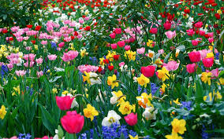
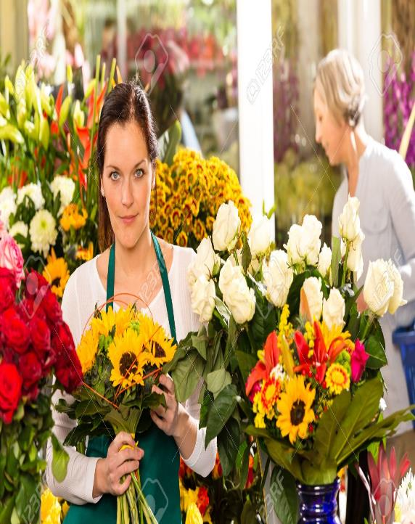
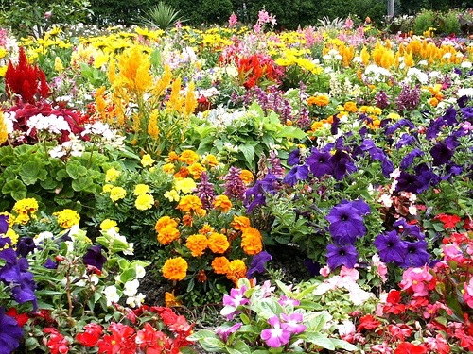

Slide 6
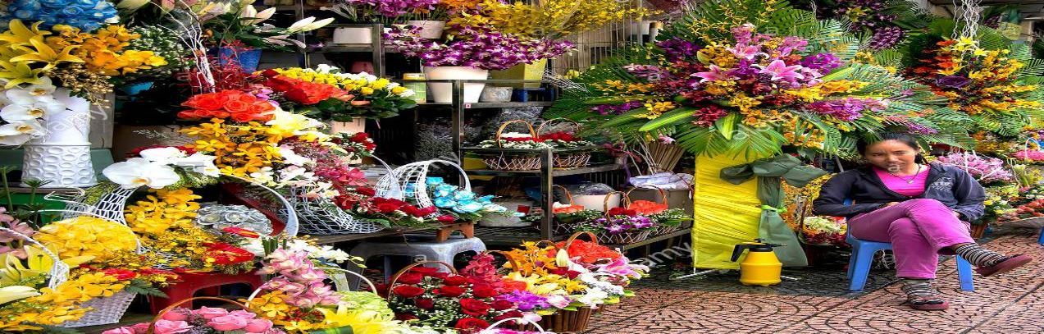
Look at the pictures and say what you see in them
Who is the person cultivating flowers commercially?
What is her profession?

Slide 7
Todays lesson is
Floral career
Unit: Nine
Lesson: Three

Slide 8
Learning outcomes
By the end of the lesson
Ss will be able to
Describe familiar objects.
Read intensively and extensively.
Write about jobs and situations.
Practise and use the words artificial, florist, unconventional, eye -catching.

Slide 9
B. Work in pairs. Choose a job from the box below but don’t tell your partner. Ask and answer the following Yes/ No questions to find out what the job is.

Slide 10
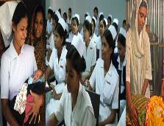
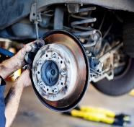
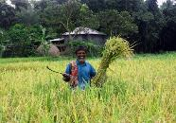
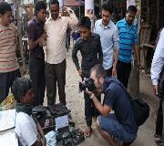
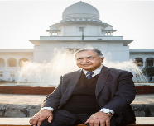
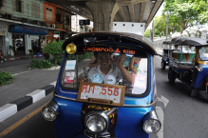
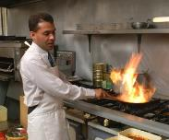
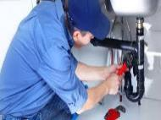
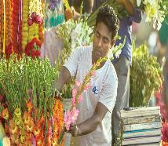
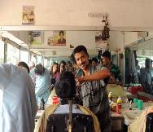
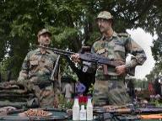
Nurse
Mechanic
Architect
Farmer
Dentist
photographer
Advocate
Taxi driver
Chef
plumber
Florist
Hairdresser
soldier

Slide 11
Use these questions to help you.
Do you -----------?
Work inside
Earn a lot
Work with people
Use a computer
Did you have to---?
Wear a uniform.
Work in shifts
Use your hands
Get up early
Speak English
Did you have to --------?
Study at college
Do a lot of training
Do internship

Slide 12
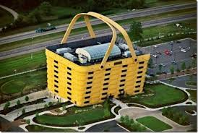
Eye catching(adj)
Attractive
The building is very eye catching.

Slide 13
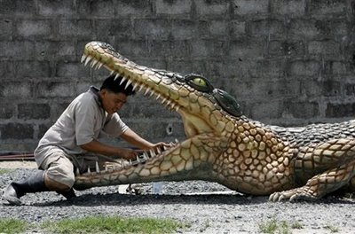
Unconventional(adj)
Not conventional
Cleaning the teeth of crocodiles is unconventional.

Slide 14
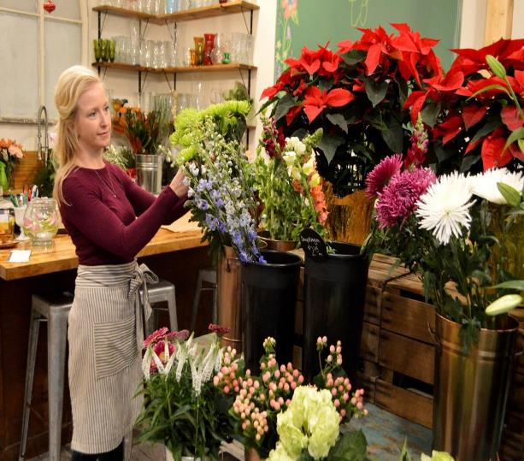
Florist(noun)
Someone who sells and arranges flowers in shop
A florist is putting flowers sticks into the basket.

Slide 15
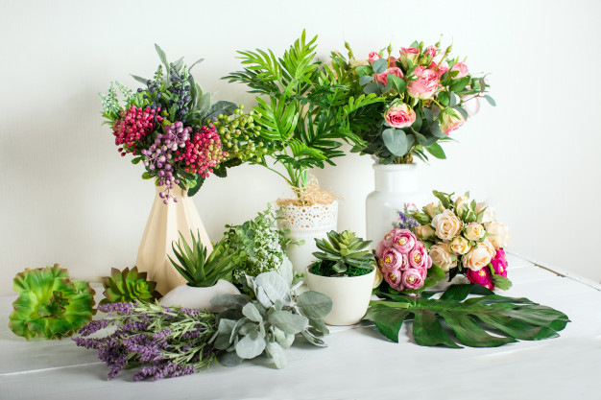
Artificial(adj)
Not natural but made by people
These flowers are artificial not natural

Slide 16
Read the text C and answer the following questions.
How is the career of a florist?
What qualities do you need to have for a florist’s job?
How does most florists learn the trade?
What is the extra advantage of a florist’s job?

Slide 17
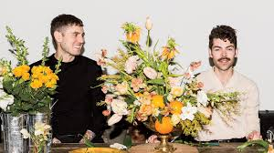
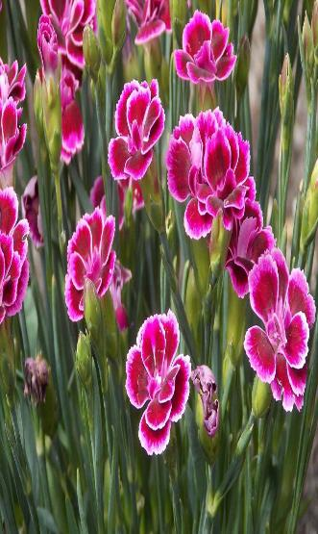
D. Suppose you have met a florist ina shop.Write an imaginary interview with him/her

Slide 18
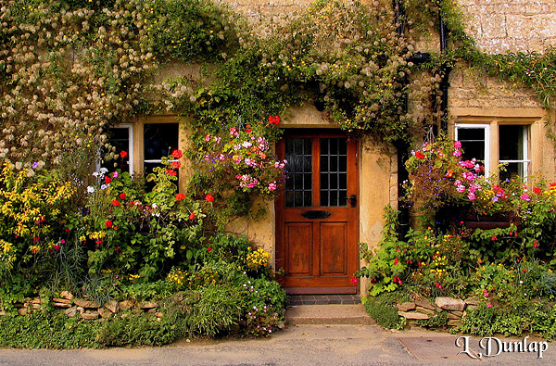
Home work
Write a short paragraph giving reasons why you like or dislike the job of florist with in 120 words.

Slide 19
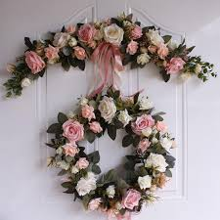
Thanks
to
all

