Slide 1
WELCOME

Slide 2
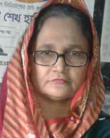
Teacher`s identity:
Rowshon Ara
Asst.teacher
PDB Secondary School
Siddhirganj
Narayanganj

Slide 3
Information of the lesson
Class-7
Subject-English 1st paper
Unit-3
Lesson-1
Tittle of the lesson-Prize –giving day at school

Slide 4
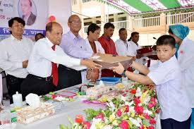
Look at the picture
Are you familiar with such picture?
In which event you can see this types of picture?
Are you familiar with this types of picture ?
In which day you can see this kinds of picture ?

Slide 5
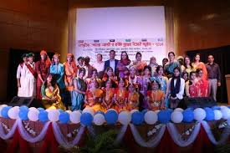
Declaration of the lesson:
So,our today`s lesson is-
Prize-giving day at school.

Slide 6
Learning Outcomes
After we have studied this unit, we will be able to
*ask & answer questions
*tatk about the familiar events
*read & understand texts
*write answers to questions
*write short compositions

Slide 7
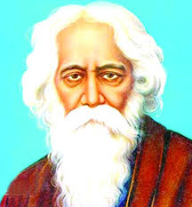
Key words presentation
Eminent (adjective) –Anybody famous in particular affair
It`s synonym-renowned,famous,celebrated
It`s antonym-unknown,obscure,uncelebrated

Slide 8
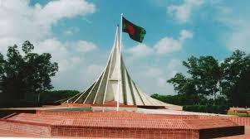
Outstanding(adjective)—exceptionaly good.
Synonym:-unique, marvellous.
Antonym:-ordinary, simple.

Slide 9
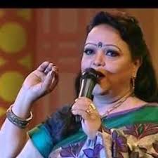
Performance(noun)—Present one`s skillfulness.
Synonym:-show,display,expose.
Antonym:-cover,hide,conceal.

Slide 10
A. Read the lesson silently.
Farabi is Flora’s best friend. They live in the same area. Also they are both in class 7. But they go to different schools.
It is a school holiday. Flora has come to visit Farabi. They are talking. Flora wants to know about the prize- giving ceremony of Farabi’s school.
“Yesterday was our school prize-giving day,” Farabi says. “On this occasion our school auditorium and its dais were brightly decorated . Prizes were also neatly displayed on a separate table on the dais. All the students were present at the function. Among eminent persons of the locality attended the function,” Farabi continues . “The principal of PN College was the chief guest.”

Slide 11
“When did the function start?” Flora asked.
“Oh, it started on time- just at 4 pm,” Farabi says. “Our Head teacher first read out the annual report. Then the Chief Guest gave a short speech. He highly praised the overall performance of the school and its excellent JSC and SSC Exam results. Then he gave away the prizes among the students for their outstanding activities.”
“Did you get any prizes, Farabi?” Flora enquires.
“Yes, I did”, Farabi replies. “I have got two prizes – one for regular attendance and the other for good result in the last year- ending exams.

Slide 12
C
words | meanings
Visit | Speak highly of something or somebody
Ceremony | Extremely good
Eminent | Go to see a person or place
Praise | Put something in a place where you can see it easily
Outstanding | People having lots of power & influence

Slide 13
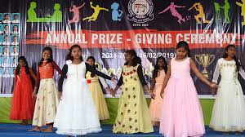
E
Complete the passage with the verbs in the box.Give their correct forms
[be sing speak stage ]
.
At the end of the prize-giving function there ----a cultural show. The students –danced and—a one act play.It was so
Good that everyone ---highly of it.

Slide 14
HOME work
Write a short paragraph about the sports day of your school.

