Slide 1
WEL COME
TO
OUR MULTIMEDIA CLASS

Slide 2
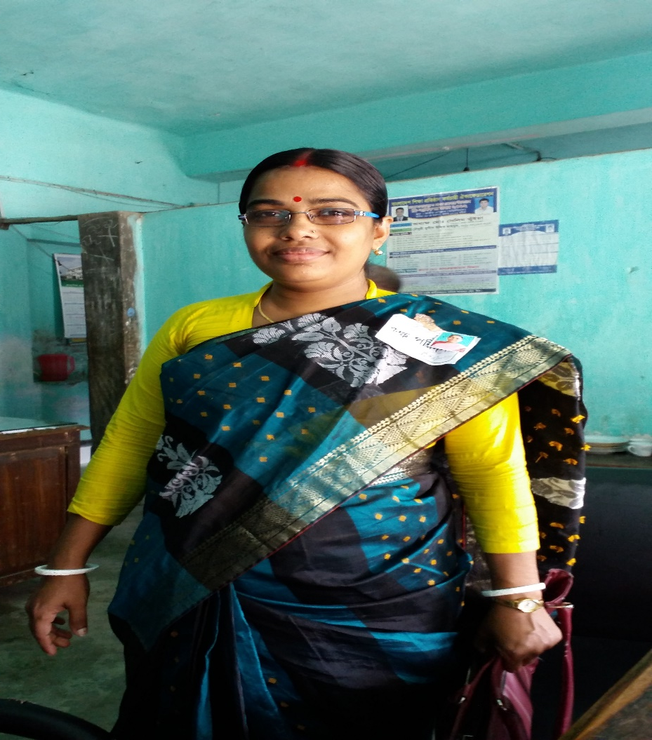
TEACHER’S IDENTITY
Tapati Rani Sarkar
Assistant Teacher
Lalmohan Secondary Girls School
Email: tapatisarkar0101@gmail.com
Class Identity
Class : Eight
Sub: English 2nd Paper
Voice (Countinuous Tense)

Slide 3
Let’s do some voices
I have a cow
He will draw a picture
They wrote a story

Slide 4
Last class we learn voice(Indefinite Tense)
Today we will learn Voice(Continuous Tense)
OUT COMES
ENDING THIS LESSON STUDENTS WILL LEARN ABOUT
The continuous Tense
Rules of voice
Change of voice

Slide 5
We discuss the continuous Tense
Continuous Tense চেনার উপায়
1. Subject এরপর Tense অনুযায়ী Auxiliary verb থাকবে
2.মুল Verb এরপর ing থাকবে।

Slide 6
Use of continuous in Voice
Object টি Subject হবে
Tense অনুযায়ী Auxiliary verb বসবে।
Being বসবে। তবে Future continuous Tense এর ক্ষেত্রে Auxiliary verb এরপর be বসবে এবং তারপর being বসবে।
মুল Verb এর ing উঠে যাবে।
মুল Verb এর Past participle form হবে।
by যোগ করতে হবে।
Subject টি Object হবে।

Slide 7
Let’s we see some example
Act: He is writing a letter
Pass: a letter is being written by him
Act: They were catching fish
Pass: Fish were being caught by them
Act: Rina will singing a song
Pass: A song will be being sung by Rina

Slide 8
Let’s see a video
https://www.youtube.com/watch?v=5RiqC0RJ-u0

Slide 9
Home work
Rules of Voice (Continuous Tense)

