Slide 1
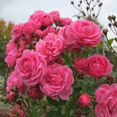
Welcome to participate the multimedia class.

Slide 2
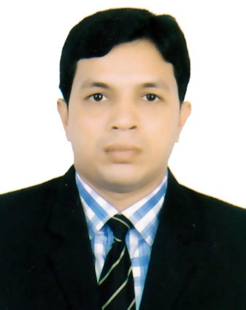
Presented by
Nishith Joardar
M.A (English) M.Ed (D.U)
M.A in ELT & Applied Linguistics (J.U)
Educator

Slide 3
Learning outcomes
SS will be able to Describe the definition of Article.
SS will be able to say the classification of article.
3. SS will be able to use the articles appropriately.

Slide 4
The Maghs build their houses on high platforms, about six to eight feet above the ground, so that their houses do not become damp. The reason to build houses on high platforms is also to protect them from the different types of insects and animals. Moreover they can use the empty space below their houses to keep things such as agricultural tools and-looms. Timber or bamboo posts support the platforms. The walls are made of bamboo, slates and the roof is thatched. These THE are one kind of article

Slide 5
Once upon a time there lived a girl named Jesmin. She had a brother named Murad. He is a student of a famous school. His school’s name is Kamolgang Primary School. His headmaster is a very active person. Eevery day he went a fishing in a pond. One day he caught a large fish with his rod. When he was going school saw a one eyed beggar with a bag in his hand. He gave a one taka note and an apple to the beggar . The beggar had a knife . Jesmin does not like begging. She wants to be an MBBS doctor.
Here All A/AN are another articles.

Slide 6
Mr. Haque is an experienced teacher. He is an efficient teacher. He is an MA. He completed an honors degree in English in 1990. He is an over-punctual person in his personal life. As we know about his boyhood he was an honest man. Everybody has an extra-confidence to him. He has an excellent quality like responsibility. This quality has given him the shape of an essential person of the society. He is now known to everyone of the society as an intellectual person.

Slide 7
Kinds of articles
There are two kinds of articles.
1. Definite article (the)
2. Indefinite articles (a, an) .
Both kinds of articles are used before nouns and adjectives.

Slide 8
The main uses of the definite article are described below:
Definite Article “THE” is used before

Slide 9
Before Three things
Part of things
1. I will eat the yellow part of the eggs.
2. I ate the small portion of the cake.
Only one thing
Bangladesh is near the Bay of Bengal. The sky is blue,
The sun rises in the east. The moon shines at night.

Slide 10
Definite thing
1.The boy is very naughty.
2. Our class teacher dislikes the naughty boy.
3. The book you wanted is out of print.

Slide 11
P
O
D
Part of things
Only one things
Definite things

Slide 12
Before Three Nouns
Before Collective noun
The class is making noise, The army is active
Before Uncountable noun
The iron, the sugar, The water of this sea is blue, The gold of this ring is pure.

Slide 13
Singular common noun
The cow lives on grass, The bird fly in the sky, The bamboo is a kind of grass. The cat loves comport, The bird can fly in the sky, The Swedish are meritorious.
C
U
S

Slide 14
Before Three “R”
Road
Race
Radio

Slide 15
This is the Arakan road
The Muslims are pious
I heard the radio news

Slide 16
Before Two “S”
Superlative
Special class
He is the best boy in the class,
The crow is the ugliest bird,
This is the most important note.
The rich are not happy, The poor are born to suffer,
The poor deserve our sympathy

Slide 17
Before Two “C”
Comparative
Cardinal number
The sooner the better, The sooner you do it the better
The 1st boy, The 2^{n d} girl, George the fifth was a ruler

Slide 18
Let’s follow up our todays lesson
P
O
D
C
U
S
R
R
R
S
S
C
C

Slide 19
Let us learn a poem on the uses of Definite Article
নদী, সাগর দ্বীপ পুঞ্জ
জাহাজ, রোড, গিরীপুঞ্জ
পার্ক, এভিনিউ পরবতপুঞ্জ
গ্রহ, নক্ষত্র, গ্রহানুপুঞ্জ
জাতি, ধর্ম , ধর্মগ্রন্থ
কোর্ট, সিনেট, সংবাদপত্র,
দিন, তারীখ, মাসের নাম
যত আছে খ্যাত ধাম
পৃথিবীতে একটি আছে যত
তৎপূবে the বসে শাস্ত্র বিধিমত

Slide 20
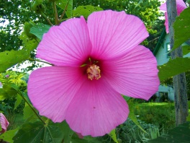
THANK YOU ALL

