Slide 1
Welcome

Slide 2
Identity of Teacher
Rowshon Ara
Asst.teacher
PDB Secondary School
Siddhirganj
Narayanganj

Slide 3
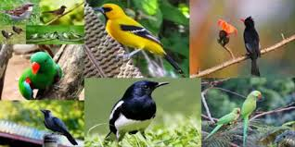
Look at the picture below
1)Are you familiar with these birds ?
2)Do you think these birds are native or local in our country ?

Slide 4
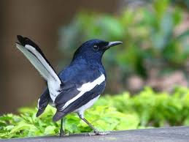
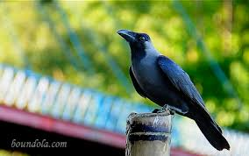
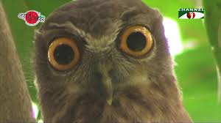
Lesson declaration:
Our Today`s Lesson :
Lesson-12
Topic : Birds of Bangladesh

Slide 6
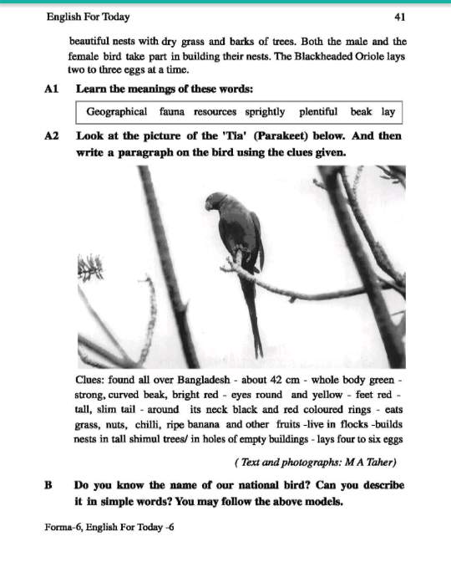

Slide 7
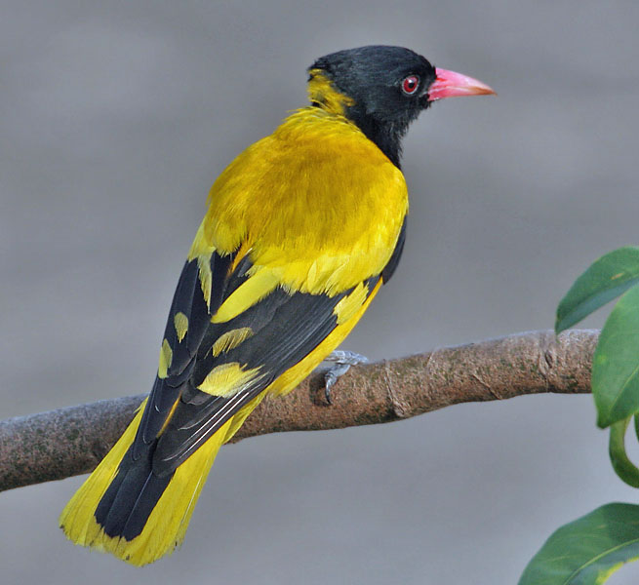
What is the colour of its beak?
What is the colour of its body?
Yellow
Red
Can you guess what is the length of this bird?
What is the colour of its throat, tail and some parts of its wings?
25cm
Black

Slide 8
Learn the meaning of the following words:
Geograpfical—relating to geography
Fauna—the animals of a particular region
Resources –capital, funds
Sprightly—lively,sportive
Plentyful—abundant, a lot of
Beak—bill,nib,neb

Slide 9
Individual work
True or False?
1. The Blackheaded Oriole is found in the hilly regions of Bangladesh.
2. The Blackheaded Oriole does not build nests.
3. It can sing sweetly and pleasantly.
1.False
2. False
3. True

Slide 10
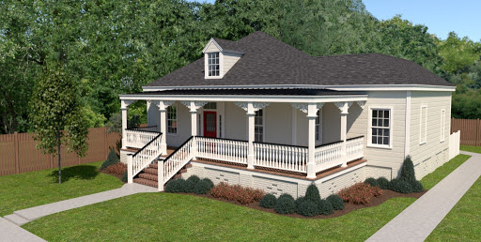
Home work
Do you know the name of our national bird? Write a paragraph on it.

Slide 11
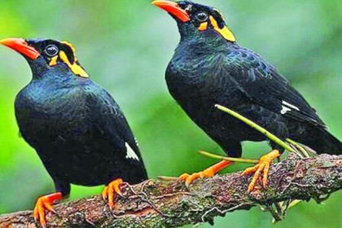
Thank You Very Much

