Slide 1
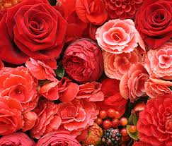
Welcome

Slide 2
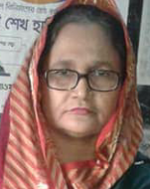
Teacher’s introduction:
Rowshon Ara
Assistant teacher
PDB Secondary School,
Siddhirganj, Narayanganj.

Slide 3
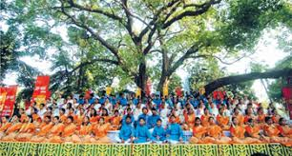
Look at the picture . Then ask & answer the following questions:
1)What`s the picture about ?
2) Where do you think it is ?
3) What are the people doing ?

Slide 4
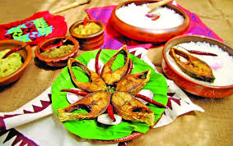
Are you familiar with this type of dish?
When do you especially take such dish ?

Slide 5
Our Today`s Lesson
Unit # 3, Lesson # 06
Topic: Pahela Boishakh

Slide 6
Learning outcomes:
After completing this lesson the Ss will be able to:--
Ask & answer questions
Write answer to some qestions
Complete a passage with suitable words

Slide 7
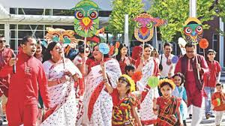
When do women & girls wear white Sharees with red borders?

Slide 8
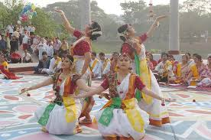
What kind of culture do you think in the above picture?

Slide 9
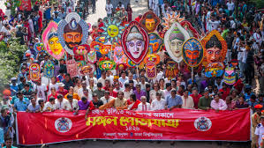
When do you can see such kind of picture?

Slide 10
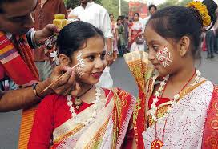
Do you ever take such kinds of make up ? In which occasion you do it ?

Slide 11
Section:C
Write the answer of the following questions:
Do you go out in the morning of Pahela Boishakh? If you do, where do you go? If not, what do you do?
What kind of food do you eat in the morning of Pahela Boishakh?
Do you wear any special clothes on this occasion?

Slide 12
Section:d group work
Complete the passage with suitable words
Let’s check the answers.
1. First,
6. in
2. only
7. also
8.procession
3.also
4. Celebrated/ observed
9.biggest
5. celebration
10. outside

Slide 13
Homework
Describe your own cultural or religious festival that you celebrate. You can use the following words. You can also use other words relevant to the festival.
Colourful, special, traditional, religious, dance, cultural, flower, food, songs, festive

