Slide 1
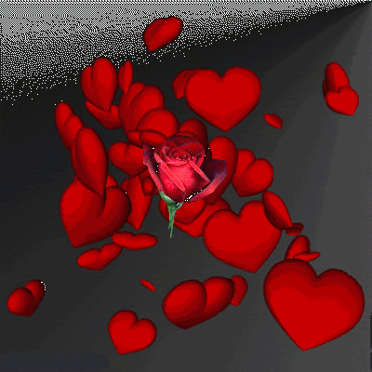
WELCOME TO ALL

Slide 2
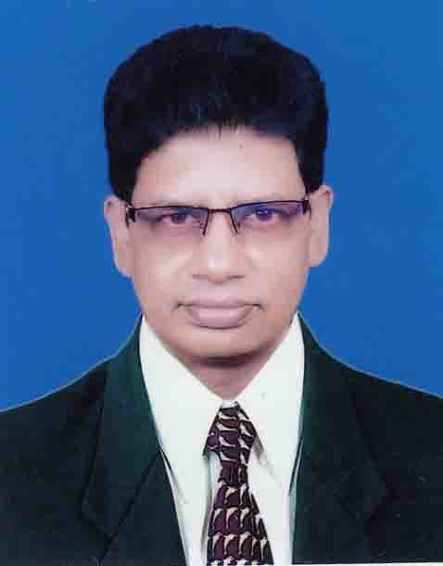
BORUN CHANDRA SARKER
JAJIRA MOHAR ALI MODEL HIGH SCHOOL
JAJIRA,SHARIATPUR.

Slide 3

Class :Eight
Sub :English 1st paper
Unit :One
Lesson : two
Time :40 minutes
Date :25/7/2020

Slide 4
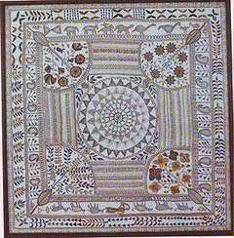
Look at the picture and talk about it

Slide 5
Let us enjoy the video.

Slide 6
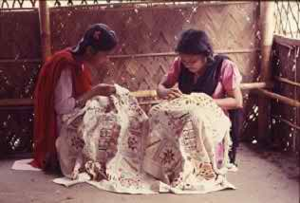
What are they doing?

Slide 7
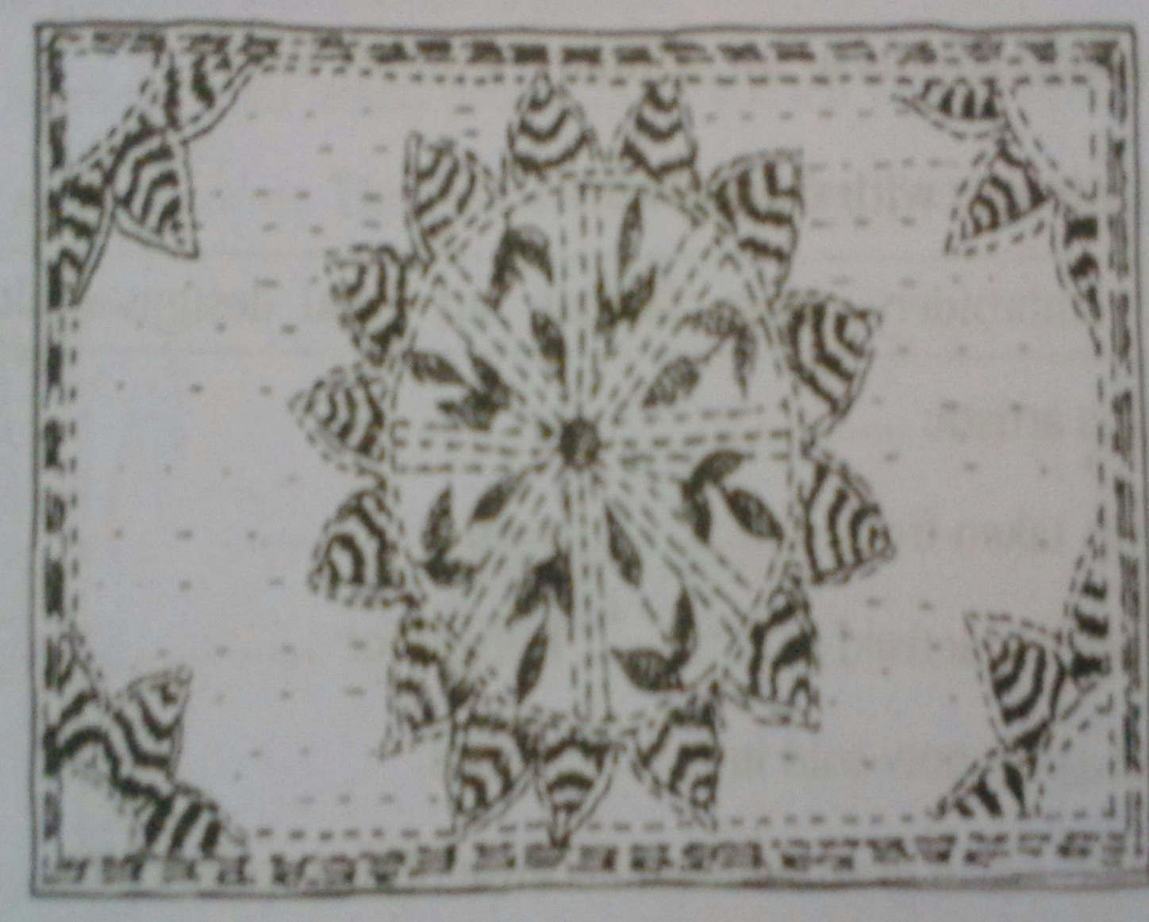
Today’s lesson is
NAKSHI KANTHA

Slide 8
Learning Outcomes
By the end of the lesson ,the students will be able to—
*read and understand texts through silent reading.
*ask answer questions.
*write answer to question.
*write short composition.

Slide 9

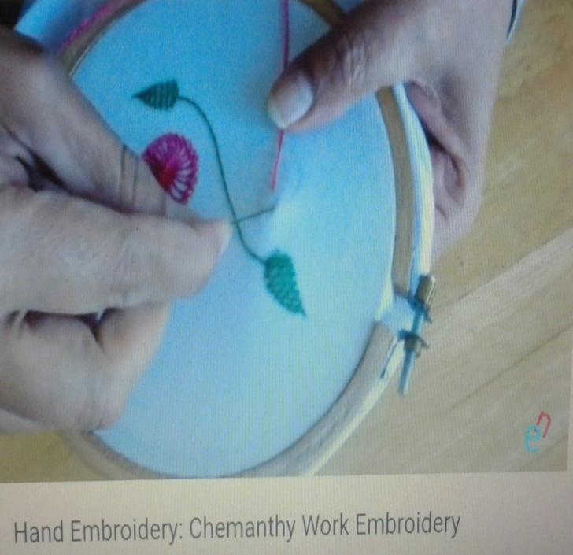
Key Words:
Quilt-
Splotch
Embroidered-
Designed

Slide 10
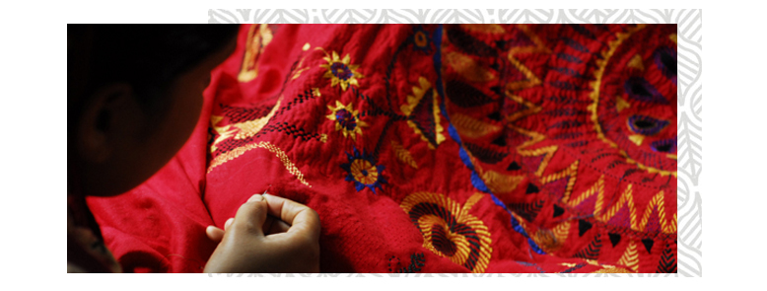
Artistic-
Imaginative

Slide 11
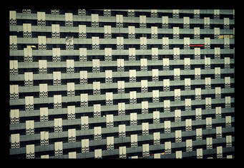
pattern
Prototype

Slide 12
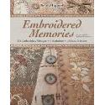
Nakshi Kantha is a kind of embroidered quilt. The name was taken from the Bengali word naksha which means artistic pattern.

Slide 13
The art has been practised in rural Bengla for centuries.

Slide 14
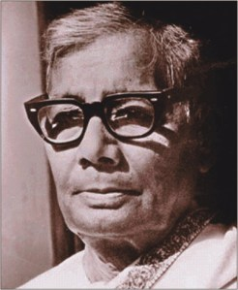
The name ‘Nakshi Kantha’ become popular after the poet Jasimuddin’s ‘Nakshi Kanthar Math’ was published in 1929.

Slide 15
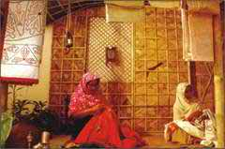
Traditional Kanthas are made for family use.

Slide 16
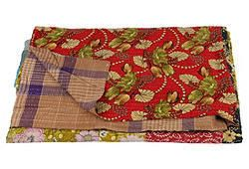
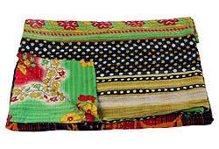
Old or new cloth and thread are used to make these quilts.

Slide 17
Read the passage carefully and answer the questions following it
Nakshi Kantha is a kind of embroidered quilt. The name was taken from the Bengali word ‘Naksha’ which means artistic pattern. It is a kind of traditional craft and is said to be indigenous to Bangladesh and west Bengal in India. The art has been practiced in rural Bengal for centuries. The name ‘Nakshi Kantha’ became popular after the poet Jasimuddin’s poem ‘Nakshi Kanthas Math’ Published in 1929.Traditional Kanthas are made for family use. Old or new cloth and thread are used to make take quilts. Mymensingh, Jamalpur, Rajshahi, Faridpur, Bogra and Jessore are most famous for this craft. Now it is produced commercially. You can find them in many expensive handicraft shops in cities. The quilts are now in great demand became of the colorful patterns and designs embroidered on them.
.

Slide 18
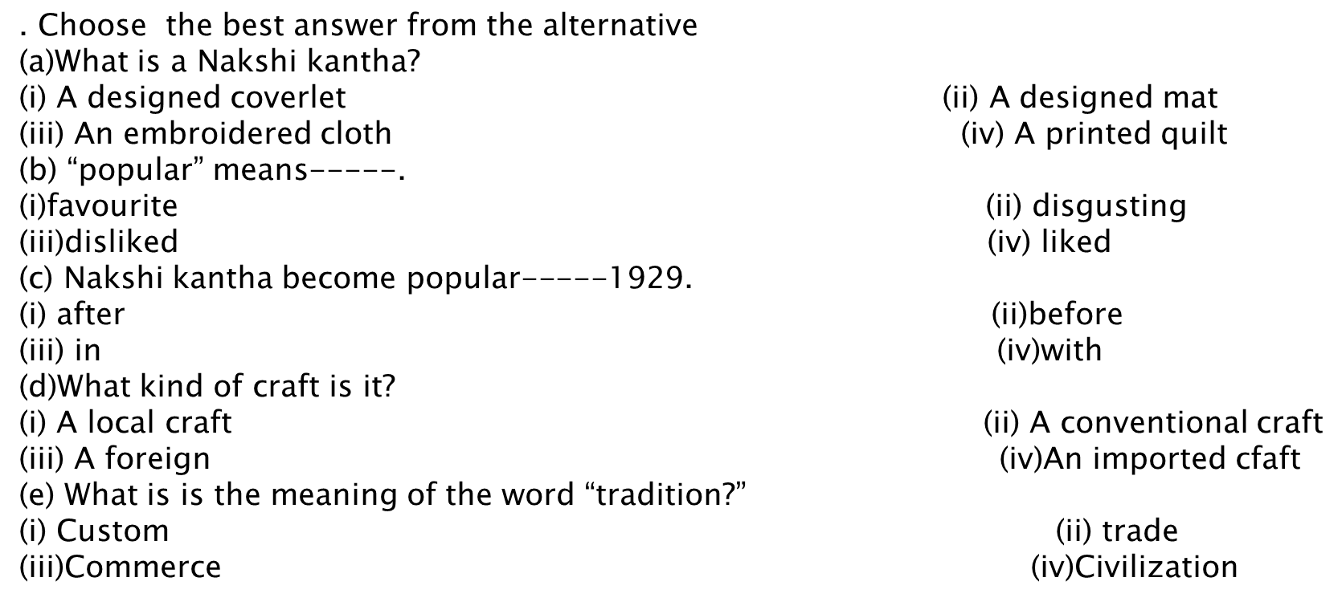

Slide 19
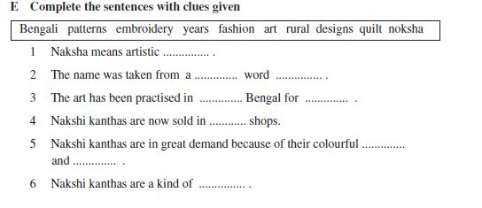

Slide 20
Evaluation
a. What is Nakshi Kantha?
b. Where was the name taken from?
c. Why are the traditional kanthas made?
d. How long has the art been practiced?
(e)What was the name of popular?

Slide 21

HOME WORK
#Write a paragraph about “Nakshi Kantha’

Slide 22
