Slide 1
Good Morning Students

Slide 2
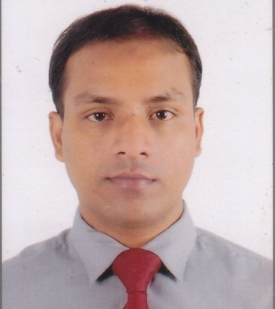
Identify:
Md. Ahsan Habib
Assistant Teacher(English)
SPPM High School, Chhatak, Sunamgonj.
Class:-Nine
Subject:-English
Unit:-6
Lesson:-6

Slide 3
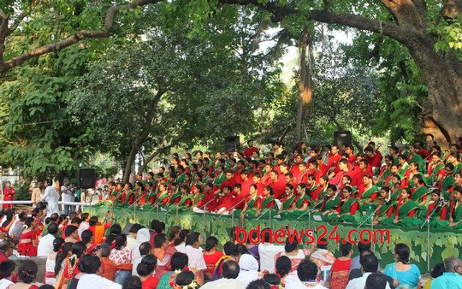
Look at the pictures
Ramna Botomul

Slide 4
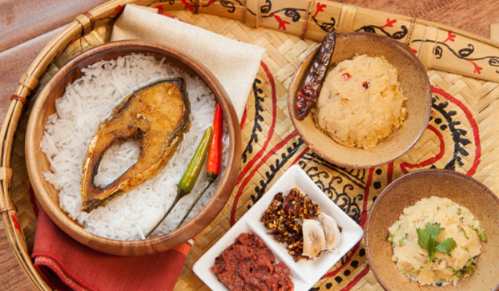
Panta Bhat with Hilsa Fish

Slide 5
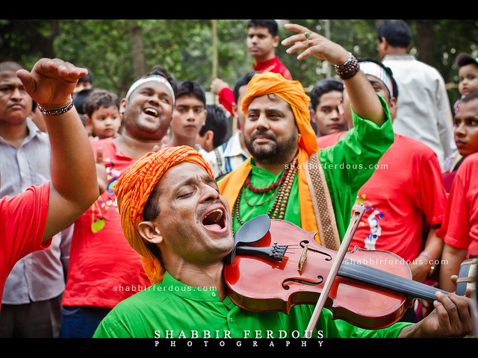
Bhoul Song

Slide 6
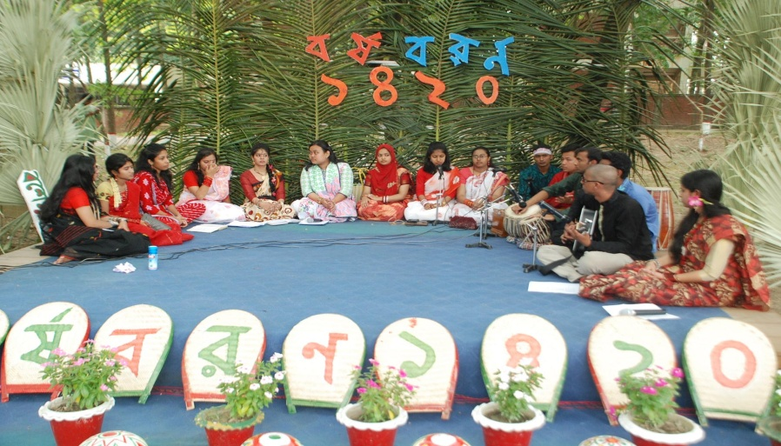
Cultural And Traditional Songs

Slide 7
Today’s lesson:
PAHELA BOISHAK

Slide 8
Learning Outcome:
After studied this lesson, students will be able to-------
Talk about events and festivals
Ask and answer questions and give opinions in a logical sequence
Understand the meaning from the text

Slide 9
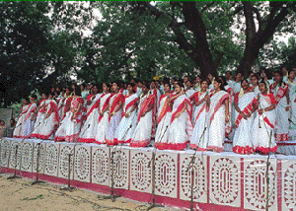
Look at the picture.
Now answer the questions about it.
1.What is the picture about?
2. Where do you think it is?
3.What are the people doing there?

Slide 10
Read the text .
Page at 78
Now answer the questions in pair
1.Do you go out in the morning?
2.What kind of food do you eat in the morning of Pahela Boishakh ?
3.Do you wear any special clothes on this occasion?

Slide 11
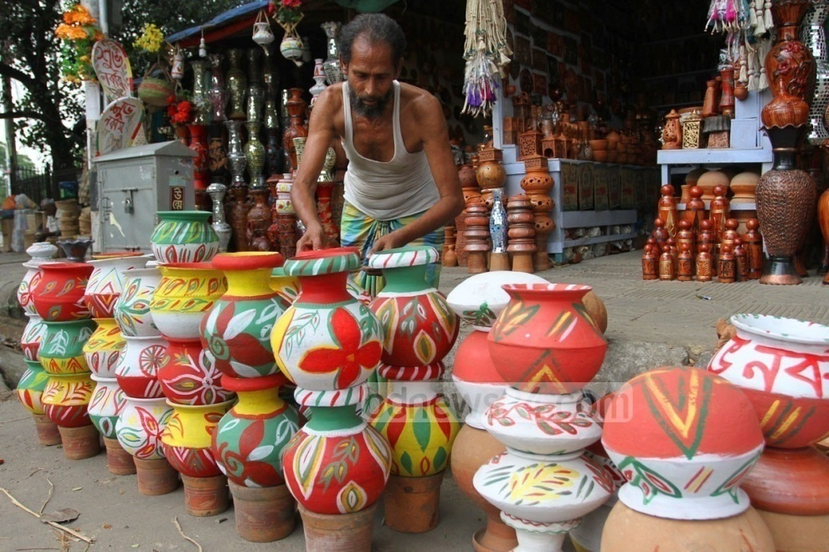
Crafts on different pots and utencels

Slide 12
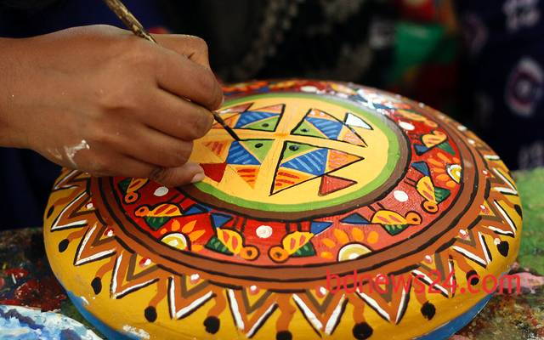
Crafts on different utencels

Slide 13
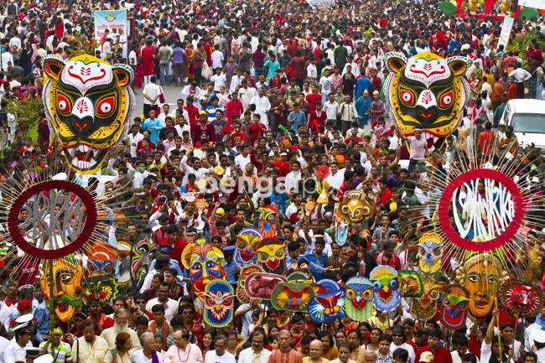
Traditional really on this occation

Slide 14
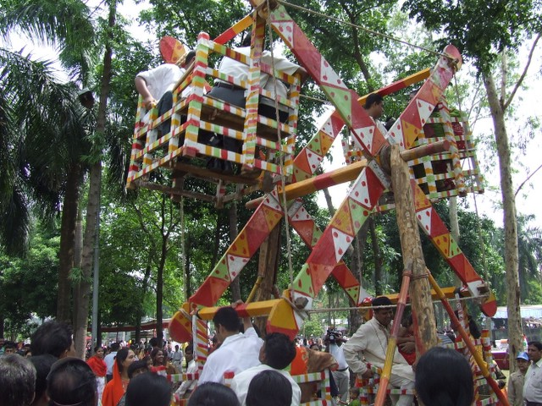
Gathering of the people on the occasion

Slide 15
# Describe your own cultural or religious festival
that you celebrate this year.
Home Work

Slide 16
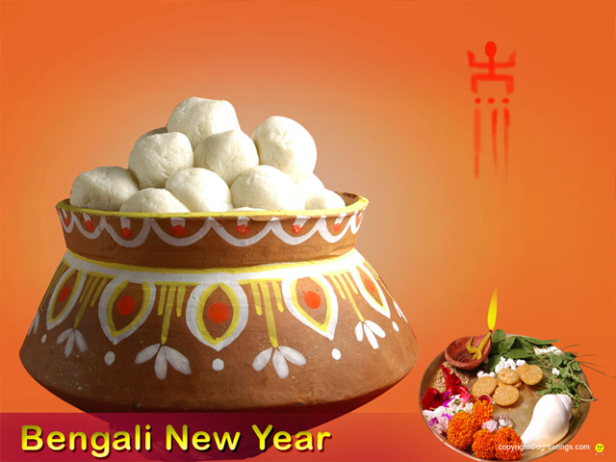
Good luck

