Slide 1
Good Morning

Slide 2
Welcome to Malijhikanda High School

Slide 3
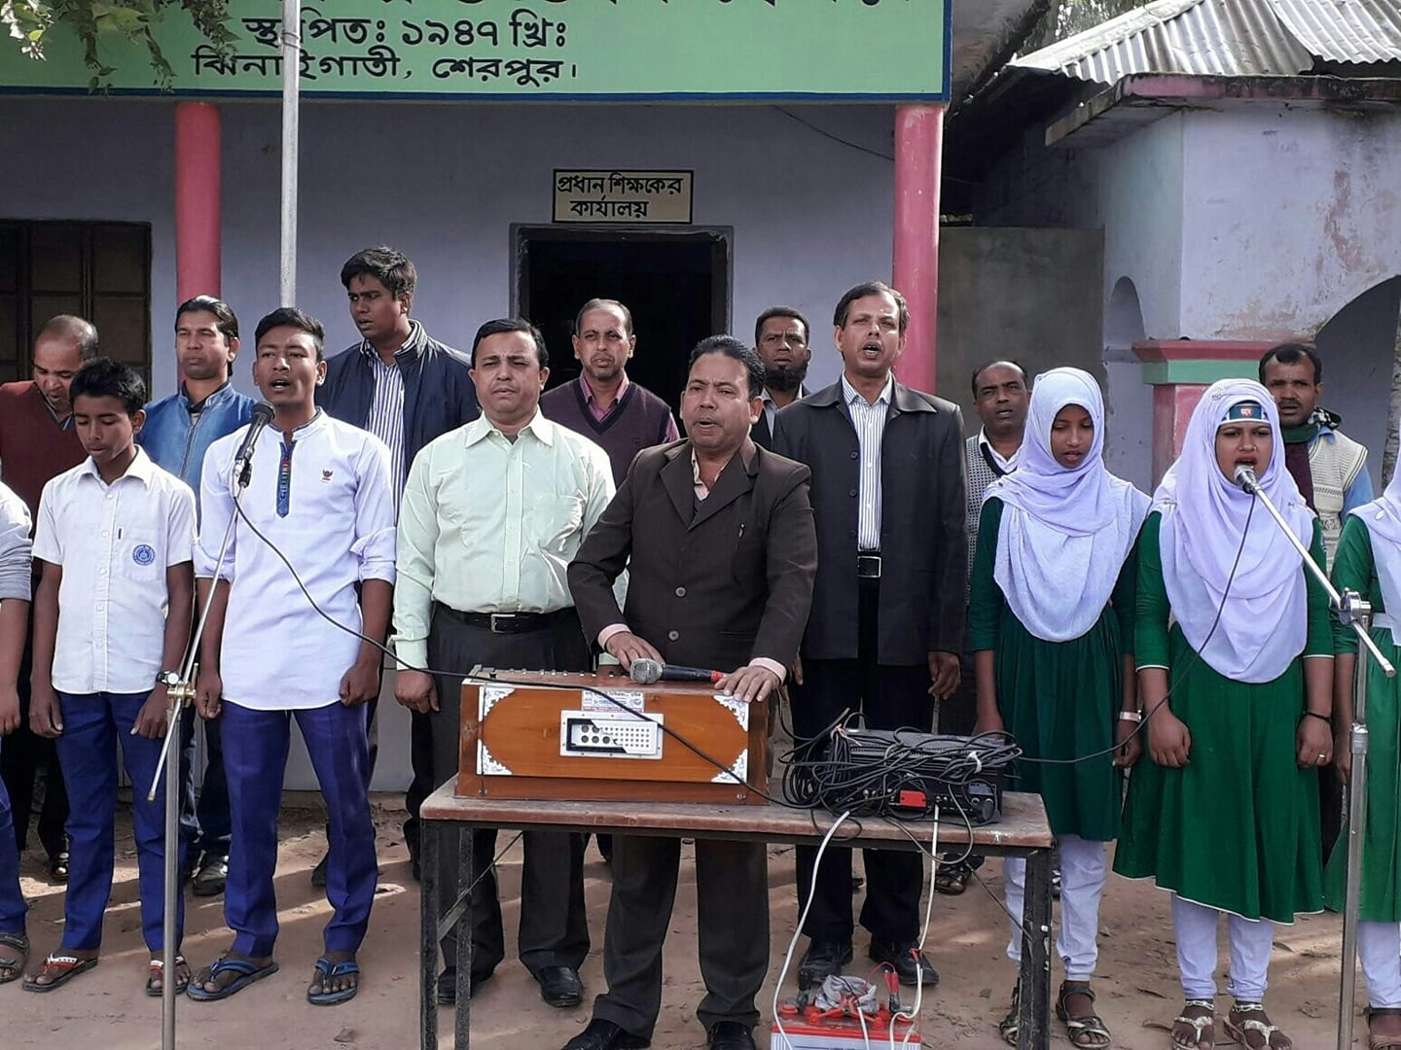

Slide 4
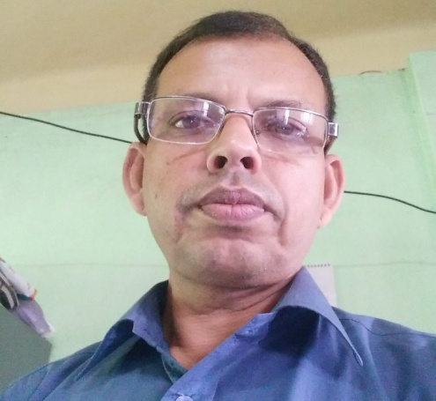
Teacher’s information
Class Information
Class- ix,x, xii
English 2nd paper
Changing sentence
( simple, compound & complex
Md. Hafiz Uddin Dulal
Assistant Headmaster
Malijhikanda High School
Jhinaigati, Sherpur
Mobile : 01712306321

Slide 5
Aims
Students will be able to – a. change the sentences from simple to compound & complex

Slide 6
Complex
5. If + subject (you)+ verb + ext, subject ( you)+ verb + ext,
If you read attentively, you will pass in the exam.
If you learn English, you can speak well.
Compound
5.Verb + ext + and +subject ( you)+ verb + ext +and +( you will be deleted )
a. Read attentively and you will pass in the exam.
B . Learn English and you can speak well.
Simple
5 . By + (verb + ing)+ ext, subject ( you)+verb + ext,
a.By reading attentively, you will pass in the exam.
By learning English, you can speak well.

Slide 7
Complex
6. If + subject ( I/he/she/they)+ verb + ext, subject ( you)+ verb + ext,
If she takes tea, she will feel freshness.
b. If I finish my
homework early, I can go to my bed.
Compound
6. Subject ( I/he/she/they)+ should/like to/+ verb + ext,
+ verb + ext,
a. She likes to take tea and she will feel freshness.
b. I should finish my homework early and I can go to my bed.
Simple
6. By + (verb + ing)+ ext, subject + verb + ext,
A . By taking tea, she will feel freshness.
B . By finishing my homework early I can go to my bed.

Slide 8
Complex
7. If + subject ( you) + do not + present form of verb + ext, + sub + shall / will + can + not + verb + ext.
Or, Unless + subject ( you) + present form of verb + ext, + sub + shall / will /can + not + verb +. you do not answer all the questions, you will not cut ext.
If a good figure in the exam.
Unless you take medicine , you will not come round soon
Compound
7. Principal verb + ext + or + sub + shall / will / can + not + verb + ext.
Answer all the questions or you will not cut a good figure in the exam.
Take medicine or you will not come round soon
Simple
7.Without + (verb + ing) + ext, + sub + shall / will /can + not + verb + ext
Without answering all the questions, you will not cut a good figure in the exam.
Without taking medicine , you will not come round soon

Slide 9
Complex
8. If + subject ( I /we/he/she/they) + do not /does not + present form of verb + ext, + sub + shall / will / can + not + verb + ext.
Or, Unless + subject (he/she/they/I) + present form of verb + ext, + sub + shall / will + can + not + verb + ext.
a.If he does not be punctual , he will not be able to do his work properly.
b. Unless she gets up early, she can not go to school timely
Compound
8. Subject + should + principal verb + ext + or + sub + shall / will / can + not + verb + ext.
a. He should be punctual or he will not be able to do his work properly.
b. She should get up early or she can not go to school timely
Simple
8. Without + (verb + ing ) + ext, + sub + shall / will /can+ verb + ext.
A .Without being punctual , he will not be able to do his work properly.
b. Without getting up early, she can not go to school timely

Slide 10
Change the sentences
A. Without speaking the truth you will not be rewarded.( complex & compound)
B. If the man walks fast, he will get the train.( simple & compound)
C. Move or you will die. ( simple & complex)
D. By planting more trees one can be benefitted. .( complex & compound)
E. He should take exercise regularly and he can be healthy. ( simple & complex)
F. Unless they sow good seeds, they will not get good crops. .( simple & compound)
G. Have a cup of tea and you will remove your fotigue. ( simple & complex)
H. If you do not follow the roles of health, you will be unhealthy. .( simple & compound)

Slide 11
Good bye

