Slide 1
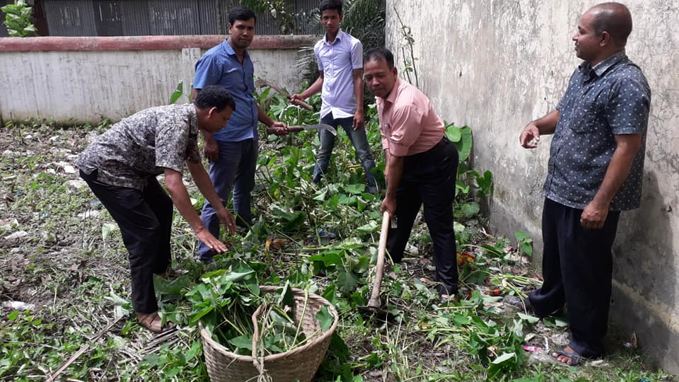
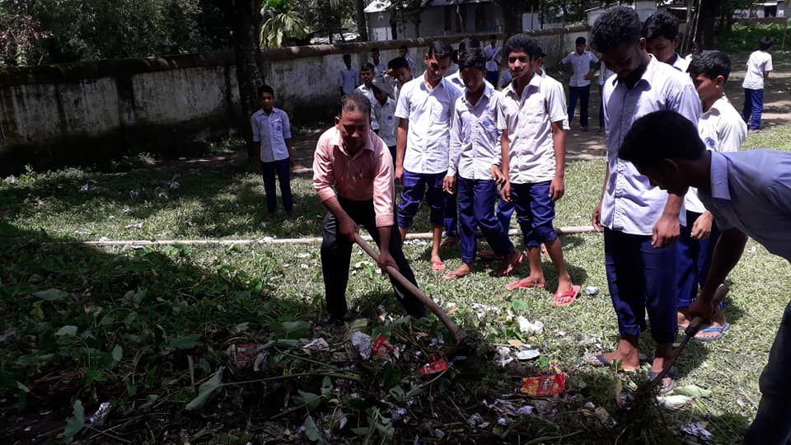
Welcome to Malijhikanda High School

Slide 2
Good Morning

Slide 3
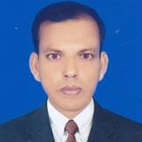
Teacher’s Information
Md. Hafiz Uddin Dulal
Assistant Headmaster
Malijhikanda High School
Jhinaigati, Sherpur
01712306321

Slide 4
Complex
9. As /since/when + subject + verb + ext, + same subject + verb + ext.
a. When the man completed the course, he could apply for the post.
b. Since she returned home , she met me.
Compound
9. Subject + verb + ext, + and + (same subject) + verb + ext.
a.The man completed the course and could apply for the post.
b. She returned home and met me.
Simple
9. ( Verb + ing)+ ext, + same subject + verb + ext.
NB. As/since/when/ and will be deducted.
a. Completing the course, he could apply for the post.
b. Returning home she met me.

Slide 5
Complex
10. As /since/when + subject + verb + ext, + different subject+ verb + ext.
When the marriage ceremony was over, the guest went to the feast.
Compound
10. Subject + verb + ext, + and + subject + verb + ext.
a. The marriage ceremony was over and the guest went to the feast.
Simple
10. Subject + being/ having ( Verb + ing)+ ext, + same subject + verb + ext.
NB. 1. As/since/when/ and will be deducted.
NB.Am/is/are/was/were = being.
Have/has/had= having/(verb +ing)
The marriage ceremony being over, the guest went to the feast.

Slide 6
Complex
11. As /since + subject +verb + ext, + subject + verb + ext.
Since I was ill, I could not go to school.
As the lady had much property, she helped the poor.
Compound
11.Subject + verb + ext.+ and + subject +verb + ext.
I was ill and I could not go to school.
The lady had much property and she helped the poor.
Simple
11. Because of + possessive of Subject + being/ having ( Verb + ing)+ ext, + same subject + verb + ext.
NB. 1. As/since/ and will be deducted.
Because of my being ill I could not go to school.
B.Because of her having much property,the lady helped the poor.

Slide 7
Complex
12. When + subject + verb( time of the working) + ext, + different subject + verb + ext.
When they arrived the station, the train left.
When the man was saying his prayer, the thief entered into the room.
Compound
12.Subject + verb + ext+ and + subject + verb + ext.
They arrived the station and the train left.
b. The man was saying his prayer and the thief entered into the room.
Simple
12. At the time of + possessive of subject + noun of the verb + ext. + principal clause.
Or, At the time of + possessive of subject + (verb+ing) + ext. + principal clause.
At the time of their arrival the station, the train left.
At the time of saying his prayer, the thief entered into the room.

Slide 8
Complex
13. When + subject + verb + age + ext, + subject + verb + ext.
When she was thirty years old, she went to Dhaka.
When I was ten years old , I completed my primary school.
Compound
13. Subject + verb + age + ext + and + subject + verb + ext.
a. She was thirty years old and she went to Dhaka.
b. I was ten years old and I completed my primary school.
Simple
13. At the age of + possessive of subject + age + subject + verb + ext.
At the age of her thirty she went to Dhaka.
At the age of my ten I completed my primary school.

Slide 9
Evaluation a. At age of his fifty he came to my house.( complex & compound) b . When the Headmaster came to school, he entered into the office. ( simple & compound ) c. the sea water was salty and the sailors could not drink it. ( simple & complex) d. The sun having set we returned home. .( complex & compound E. Since the boy had no parents, he was taken care of by the orphanage. ( simple & compound )

Slide 10
Good Bye

