Slide 1
WELCOME

Slide 2
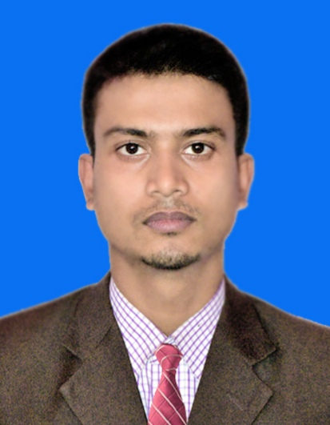
Sabuj Kumar Das
Assistant Teacher, English
Attaka K. Ali Pilot High School
Fakirhat, Bagerhat

Slide 3
Lesson Identity
Class: Six
Sub: English 2nd Paper
Unit: Five
Lesson: Five
Topic: Articles
Time: 50 minutes

Slide 4
Learning Outcomes
Learners will be able to learn Articles.
They will be able to use articles.
They will be able to identify vowel & consonant.

Slide 5
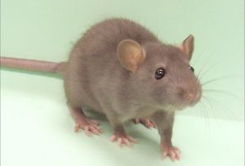
A rat

Slide 6
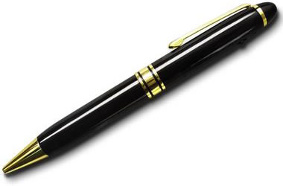
A pen

Slide 7
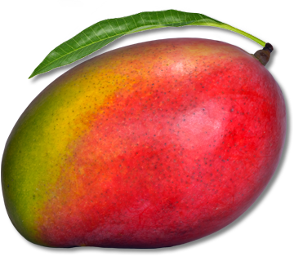
A mango

Slide 8
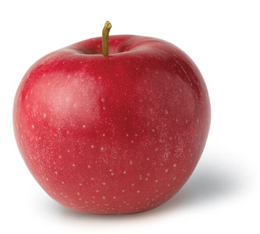
An apple

Slide 9
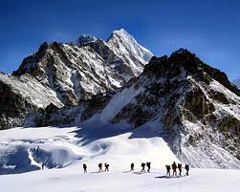
The Himalayans

Slide 10
The earth moves round the sun.
Earth
Sun

Slide 11
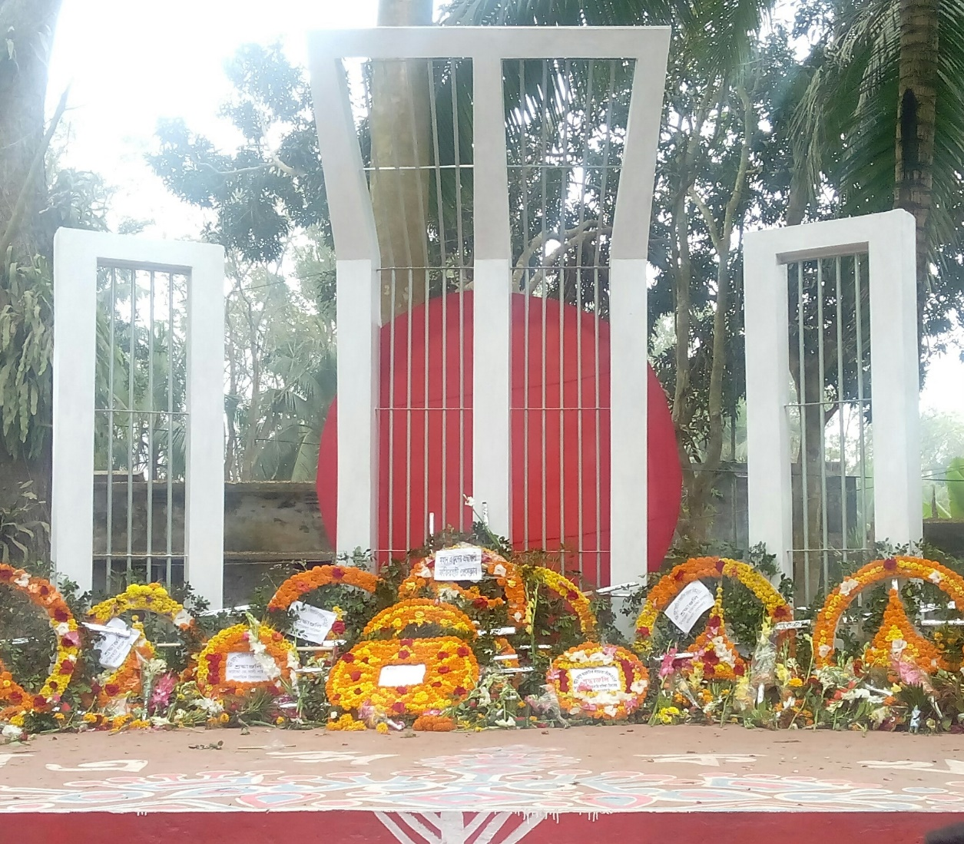
The Shaheed Minar

Slide 12
A, An, The
What are those called?

Slide 13
ARTICLE

Slide 14
So, what is article?

Slide 15
The word that always goes with a noun to point out it particularly or indefinitely is called Article.

Slide 16
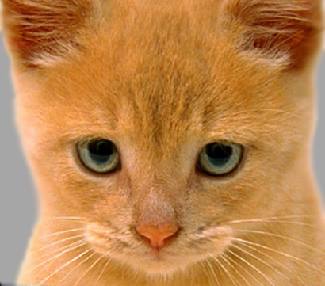
A cat

Slide 17
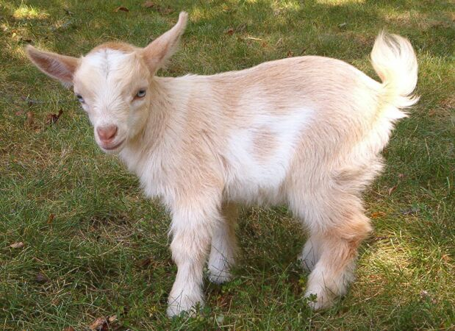
A goat

Slide 18
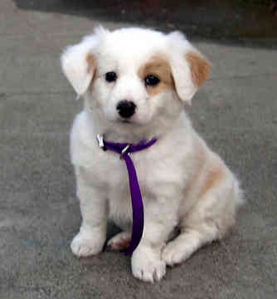
A dog

Slide 19
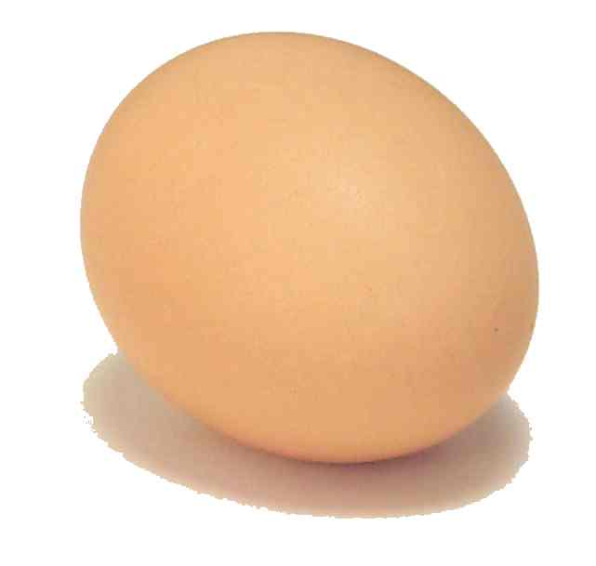
An egg

Slide 20
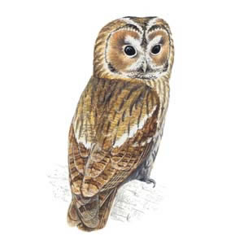
An owl

Slide 21
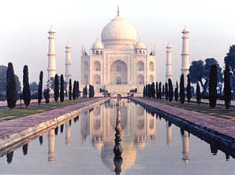
The Tajmahal

Slide 22
The king

Slide 23
Individual work
This is ___ umbrella.
I have ____ cow.
Dhaka is ___ capital of Bangladesh.
Karim is ___ doctor.
This is ___ interesting book..

Slide 24
Pair work
___ sun rises ___ the east.
She is ___ untidy girl.
He has ___ football.

Slide 25
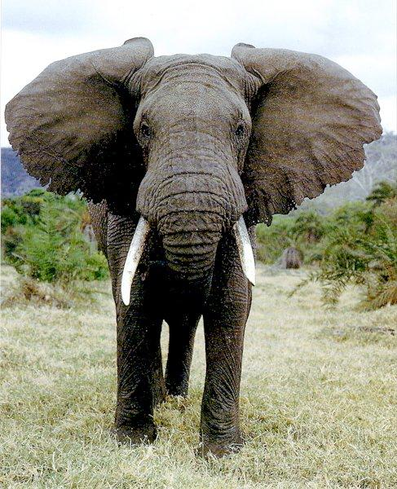
Evaluation
------- Elephant.

Slide 26
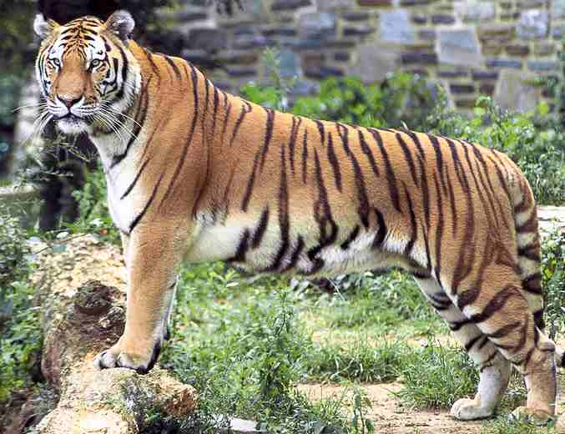
--------- Royal Bengal Tiger.

Slide 27
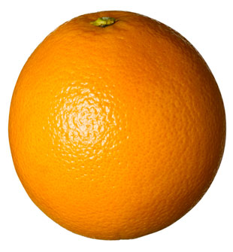
--------Orange.

Slide 28
Homework
He saw ___ boat on ___ river.
English is ___ international language.
___ earth moves round ___ sun.

Slide 29
Thanks

