Slide 1
Welcome To My Class
Stay Home
Save Yourselves

Slide 2
Teacher’s Identity
Ranjan Kumar Roy
Lecturer in English
Kaharole Govt.College
Phone:01723993090
Study can make you perfect.

Slide 3
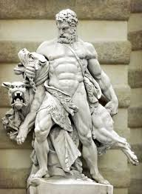
Today’s Lesson?
Hercules
Unit: 14
Lesson: Four

Slide 4
Learning outcome
Student will able to learn about Myth.
Able to learn about Hercules
Able to learn about some unknown words .
Able to write summary.

Slide 5
What is myth ?
Myth is a folklore genre consisting of narratives or stories that play a fundamental role in a society. The main characters in myths are usually gods demigods and supernatural humans

Slide 6
Text: Hercules was the son of Jupiter and Alcmena. Eurystheus, the King of Mycenae and his cousin, made him undergo some difficult tasks, which are known in Greek myths as the twelve labours of Hercules’. The first involved a fight with a lion. The valley of Nemea was being disturbed by a terrible lion and so Eurystheus ordered Hercules to slay the beast and bring him his skin. At first, Hercules tried to fight the lion with his clubs and arrows but this took him nowhere.

Slide 7
Then Hercules attempted a different tactic: he decided he would use his hands .He thus managed to slay the animal on his own, relying entirely on his immense strength. Victorious, he returned to Mycenae carrying the dead lion on his shoulders a sight that terrified the King.

Slide 8
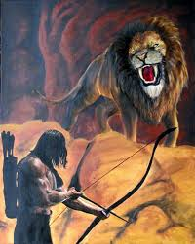
Fight with arrows

Slide 9
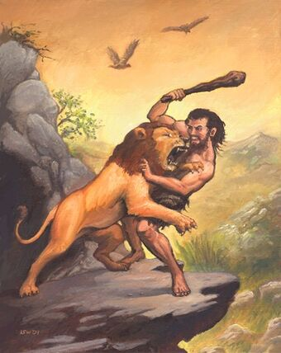
Fight with Club

Slide 10
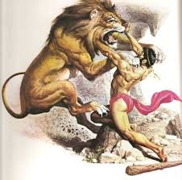
Fight with bare hands

Slide 11
Let us enjoy a video

Slide 12
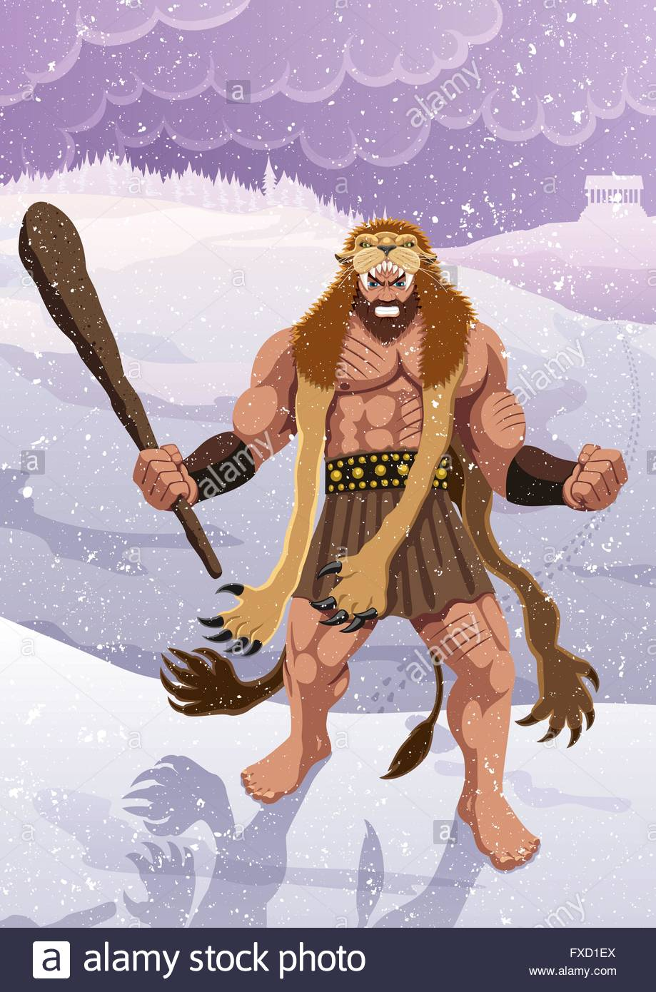
Lion skin on his shoulders

Slide 13
His next task was to slay a monster called Hydra that was ravaging the country of Argos. The hydra had nine heads, of which the middle one was said to be immortal. Our hero struck off its heads with his club but whenever he knocked off a head , two new ones erupted in its place. Eventually with the help of his devoted servant Iolaus, Hercules succeeded in burning all the heads of Hydra except the ninth or immortal one, which he decided to burry under a huge rock.

Slide 14
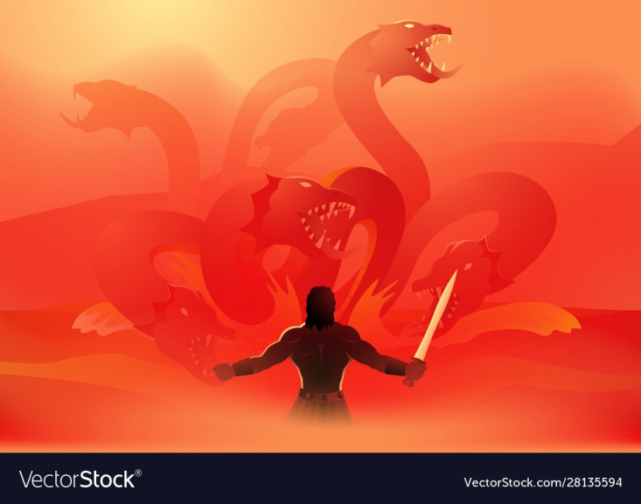
Fight with Hydra

Slide 15
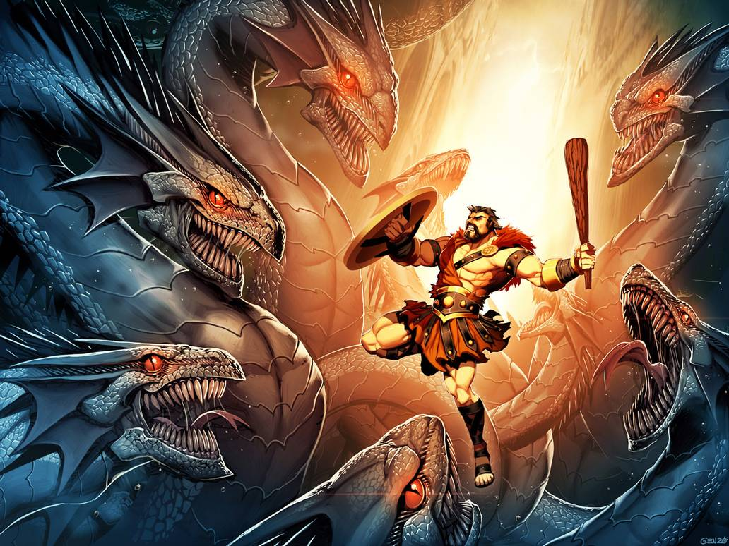
Burnt the Hydra’s heads

Slide 16
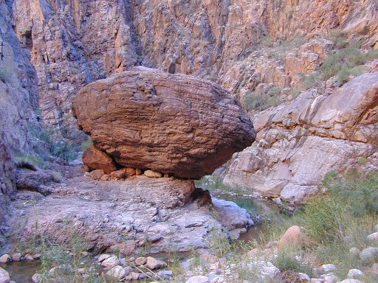
Buried the Hydra’s immortal head Under a huge rock.

Slide 17
In other words , Hercules triumphed again ,as he would every time he was given an impossible task by Eutystheus ! And this is how he began to acquire the reputation of a hero possessing immense strength throughout the world.

Slide 18
Word Meaning
Attempt | Endeavour ( প্রচেষ্টা )
Arrow | Cursor ,dart ( তীর )
Devoted | Loyal ( অনুগত )
Erupt | Blast ( বিস্ফোরিত হওয়া )
Immense | Huge ( প্রকান্ড )
Impressed | Touch ( মনোঃপুত )
Monster | Giant ( দানব )
Ravaging | Destroy ( ধ্বংস করা )
Slay | Kill ( হত্যা করা )
Struck | Beaten ( তাড়িত করা )
Tactic | Strategy ( কৌশল )
Club | Baton ( গদা )
Undergo | Suffer ( ভোগ করা )
Burry | Entomb ( কবর দেওয়া )

Slide 19
Summary: Hercules was Greek mythical hero . He was the son of Jupiter and Alcmena. He had immense strength. He was compelled to do some difficult tasks by Eurystheus ,his cousin and the King of Mycenae which are known as ‘ twelve labours of Hercules. His first labour was to kill a lion which was terrorizing the people in the valley of Nemea. The second labour was to slay a hydra which was creating a ravang the country of Argos . He became success to accomplish his tasks. Thus possessing immense strength and a desire to help the people , he became famous all over the world.
Write a Summary from the text above.

Slide 20
Home work
Make a flow chart showing the activities of Hercules . One is given for you.
1. Started fighting with a terrible lion

Slide 21
Thank you to all

