Slide 1
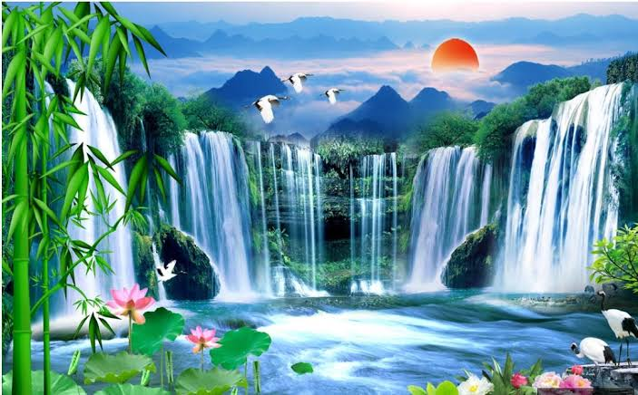

Slide 2
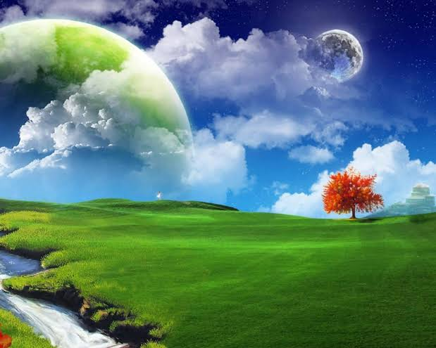
Welcome

Slide 3
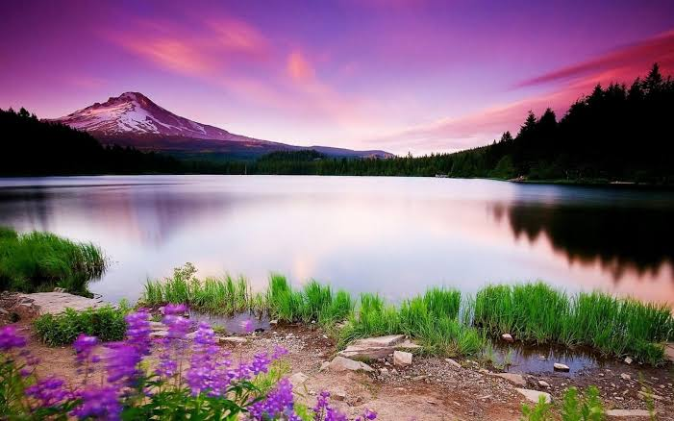
Teacher's Identity
Md.Abdur Razzak
Assistant Teacher(English)
Satgram Akota High School
Baniachang,Hobiganj

Slide 4
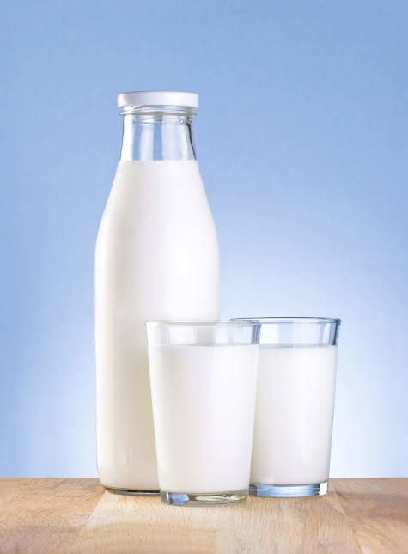
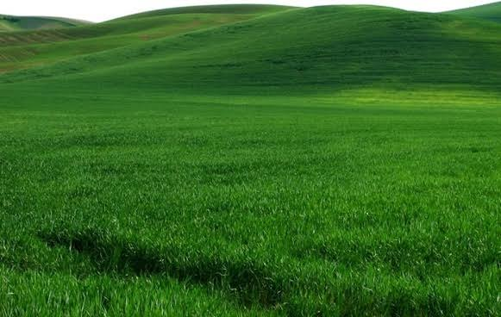
Look at the the following sentences.
How white milk is!
Milk is very white.
How green the field is!
The field is very green.

Slide 5
What kind of change do you notice in the above sentences?
Exclamatory to Assertive

Slide 6
So today our lesson is on-
Exclamatory to Exclamatory

Slide 7
Class Introduction
Class: Ten
Subject: English grammar & Composition
Unit:Nine
Topic: Exclamatory to Assertive
Time:45 minutes

Slide 8
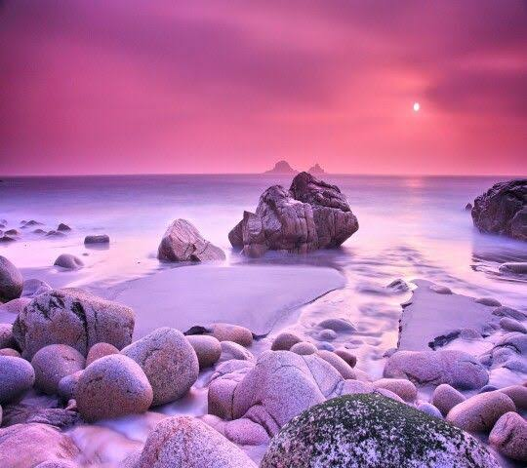
Learning Outcome
By the end of the lesson, the learners will be able to transform exclamatory sentences with-
"how" into assertive sentences.
"what a" into assertive sentences.
" if/would that" into assertive sentences.
"hurrah!" into assertive sentences.
"alas!" into assertive sentences.
"fie" into assertive sentences.

Slide 9
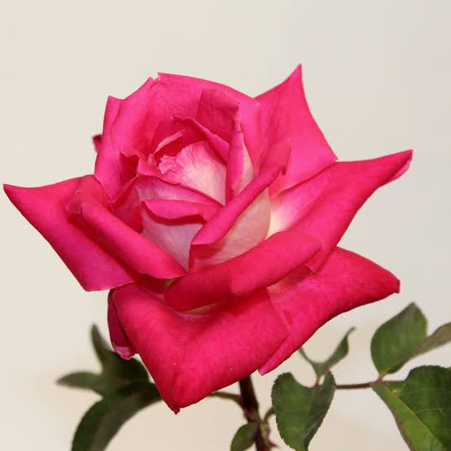
Notice the following sentences
How
beautiful the flower is!
The flower is
very
beautiful
If we get
How
in an exclamatory sentence,
we should write
Subject+ verb+ very+ adjective.

Slide 10
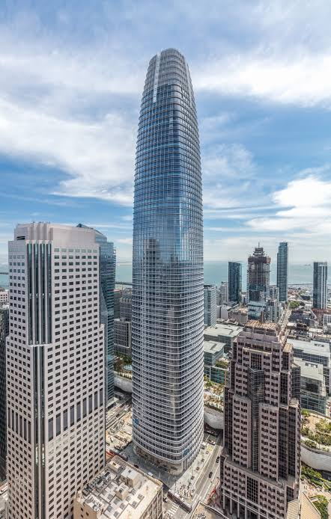
Let's practise
How beautiful Rakhi is!(assertive)
Rakhi is very beautiful.
How big the building is!(assertive)
The building is very big.

Slide 11
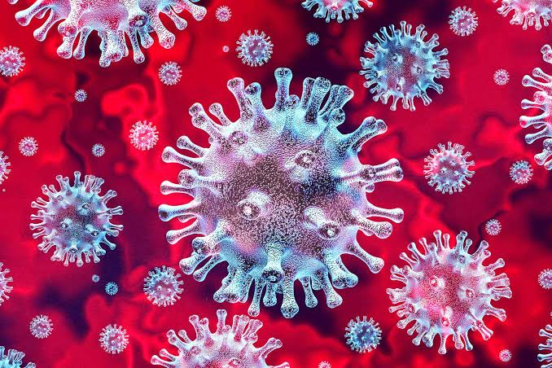
How contagious COVID 19 is!(Assertive)
COVID 19 is very contagious.
How fat the man is!(Assertive)
The man is very fat.

Slide 12
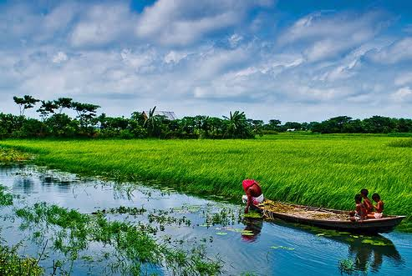
Notice the following sentence.
What a
beautiful country Bangladesh is!
a very
beautiful country.
Bangladesh is
If we get
in an exclamatory sentence,
What a
we should write
Subject+ verb +a very+ adjective+ noun.

Slide 13
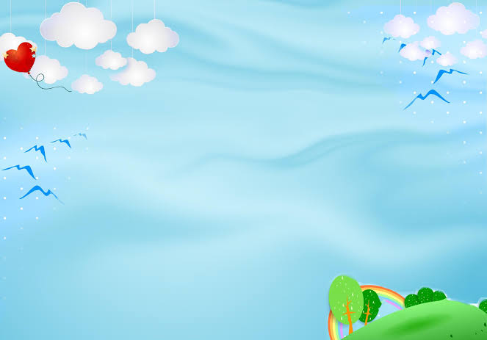
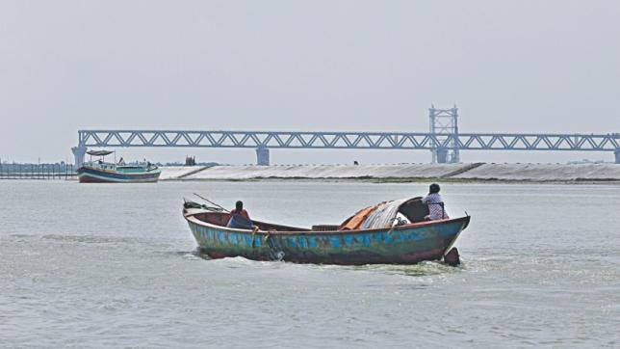
Let's practise
What a big river the Padma is!(Assertive)
The Padma is a very big river.
What a beautiful flower the rose is!(Exclamatory)
The rose is a very beautiful flower.

Slide 14
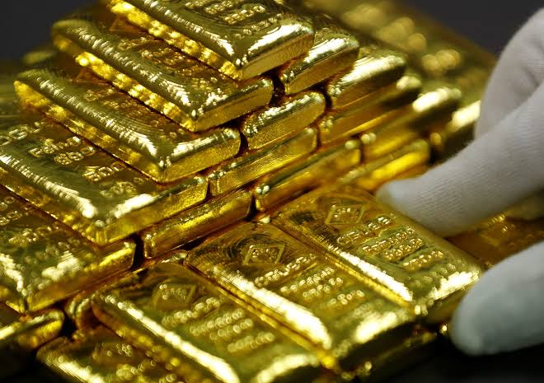
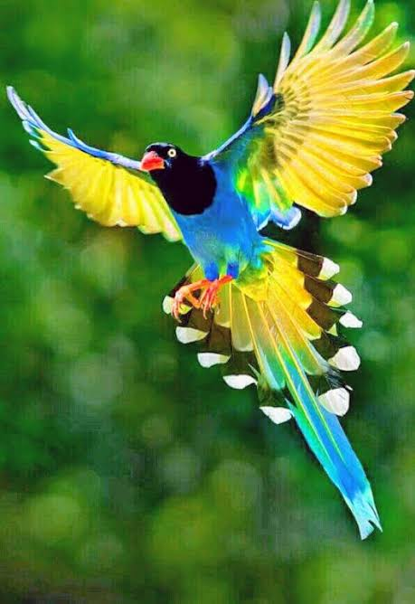
What a precious metal gold is!(Assertive)
Gold is a very precious metal.
What a beautiful bird it is!(Assertive)
It is a very beautiful bird.

Slide 15
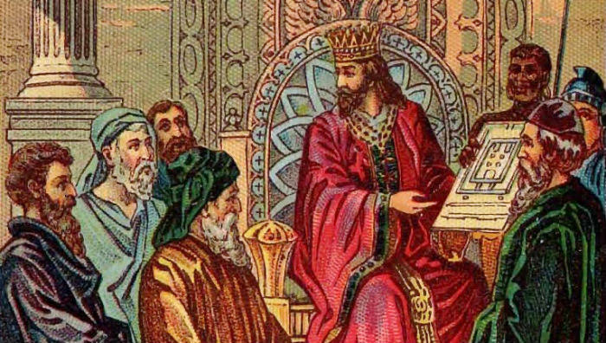
Notice the following sentence
If
I were a king!(Assertive)
I wish
I were a king.
If we get
If/Would that/O that
in an Exclamatory sentence
We should write
I wish+Subject+could/were
for making an Assertive sentence

Slide 16
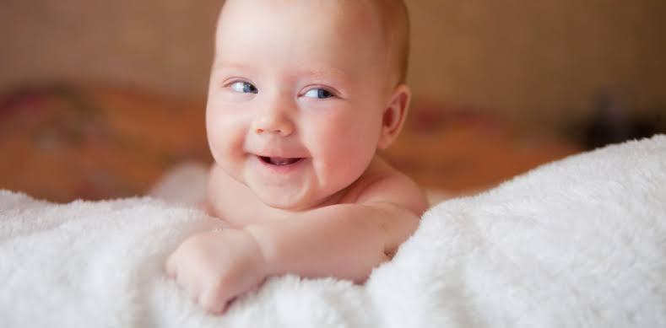
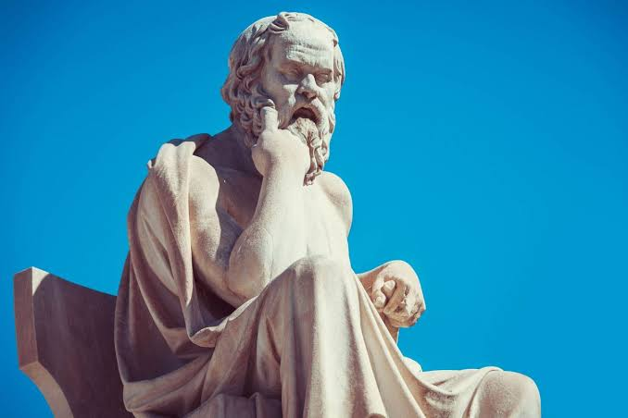
Let's practise
If I could be a child again!(Assertive)
I wish I could be a child again.
If I could be a philosopher like Socrates!(Assertive)
I wish I could be a philosopher like Socrates.(Exclamatory)

Slide 17
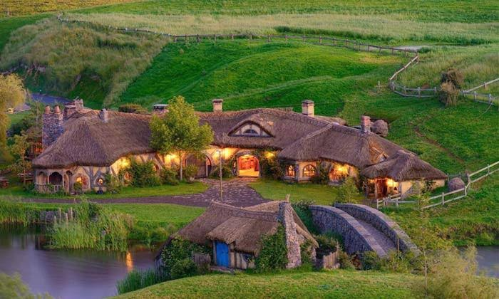
If/Would that I could go to my village!(Assertive)
I wish I could go to my village.
If /Would that I could enter the house!(Assertive)
I wish I could enter the house.

Slide 18
Notice the following sentence
Hurrah!
Bangladesh has won the cup.(Assertive)
It is a matter of joy that
Bangladesh has won the cup.
Hurrah!+Extension.
If we get
in Exclamatory sentence
We should write,
It is a matter of joy that+Subject+verb+Extension.

Slide 19
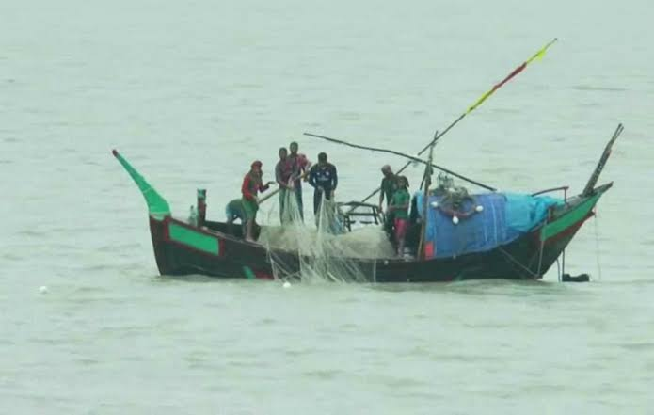
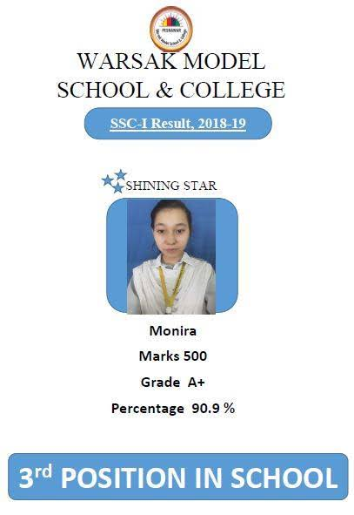
Let's practise
Hurrah! Bangladesh has got many resources.
1.It is a matter of joy that Bangladesh has got many resources.
Hurrah! Monira has got A+.
2.It is a matter of joy that Monira has got A+.

Slide 20
Notice the following sentence
Alas!
Contagious diseases are increasing
It is a matter of sorrow that
contagious diseases are increasing.
If we get,
in exclamatory sentence
Alas!
We should write
It is a matter of sorrow that
for making assertive sentences.

Slide 21
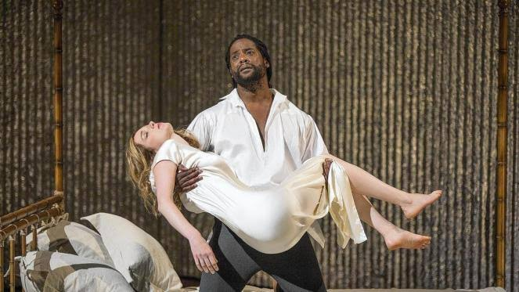
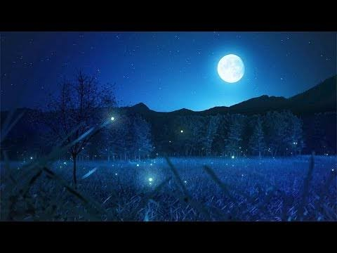
Let's practise
Alas! I am undone.
It is a matter of sorrow that I am undone.
Alas!It is deep night.
It is a matter of sorrow that it is deep night.

Slide 22
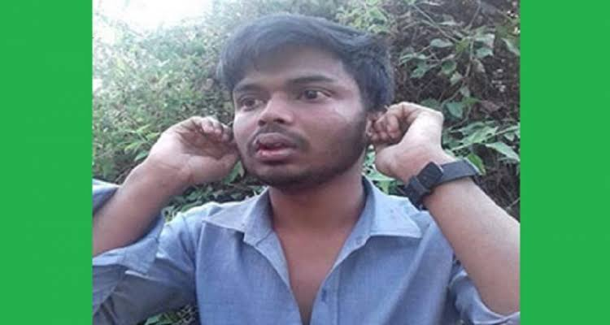
Notice the following sentence.
Fie!
He is a lier.
It is a matter of shame that
he is a lier.
If we get
Fie+!
in an Exclamatory sentence
We should write
It is a matter of shame that+subject+verb+extension.

Slide 23
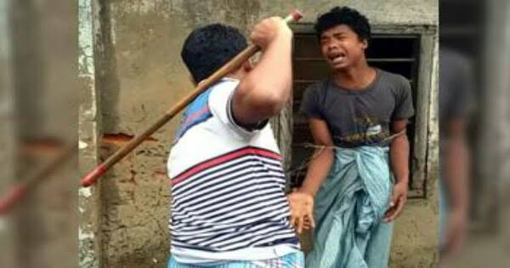
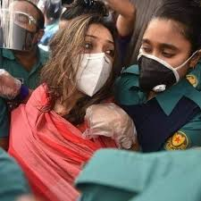
Let's practise
Fie! He is a theif.
It is a matter of shame that he is a theif.
Fie ! She is a corrupter.
It is a matter of shame that she is a corrupter.

Slide 24
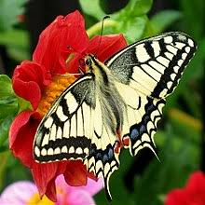
Evaluation
1.If I were a millionaire!(Assertive)
I wish I were a millionaire.
2.How beautiful the butterfly is!
The butterfly is very beautiful.

Slide 25
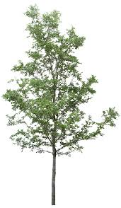
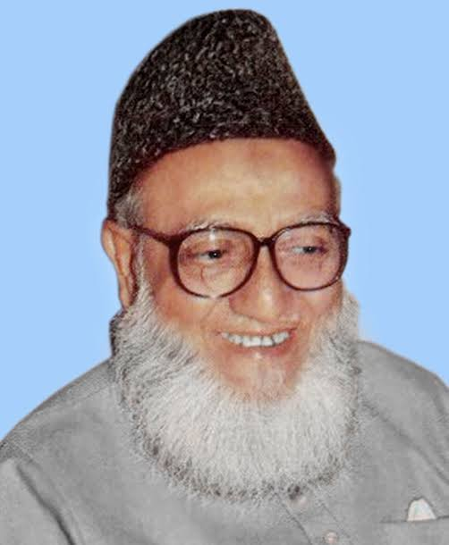
3.What a tall tree it is!(Assertive)
It is a very tall tree.
4.Fie ! He is a criminal.(Assertive)
It is a matter of sorrow that he is a lier.

Slide 26
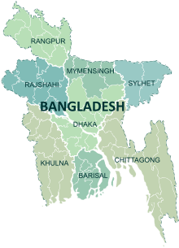
5.Would that I could be a child again!(Assertive)
I wish I could be a child again.
6.Hurrah! Bangladesh is developing day by day.(Assertive)
It is matter of joy that Bangladesh is developing day by day.

Slide 27
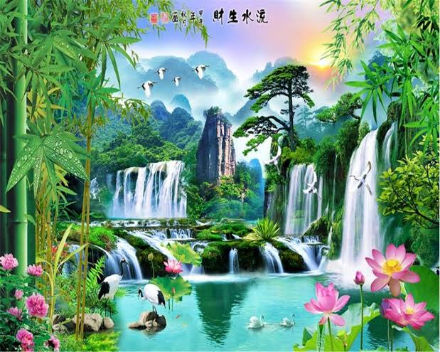
Homework
Write 5 Exclamatory sentences about yourself by using "how", "What a","if/would that","Alas","Hurrah","Fie" and transfer them into assertive sentences.

Slide 29
Acknowledgement
We would like to express our cordial gratitude to the Ministry of Education, Directorate of Secondary & Higher Education, NCTB, A2i and the panel of honorable editors ( Md. Jahangir Hasan, Assistant Professor (English) TTC, Rangpur, Ranjit Poddar, Associate Professor (English) TTC, Dhaka, and Urmila Khaled, Assistant Professor (English) TTC, Dhaka, to enrich the contents.

