Slide 1
Good Afternoon

Slide 2
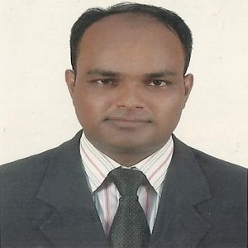
Teacher’s Identity
MD. ABDUL KADER
Assistant Teacher
Borni Govt. Primary School,
Companigonj, Sylhet.

Slide 3
GREETINGS
Teacher
Good morning, students
Good morning, teacher
Student’s
How are you today ?
Teacher
Fine
Student’s

Slide 4
Lesson’s identity
Class: Four
Subject : English
Unit : 3 Family
Lesson 1-2 (A)

Slide 5
Learning Outcomes
Listening :
1.1.1 recognize sound differences in context of words.
3.1.1 Understand questions ask by the teacher about the student.
3.2.1 3.1.1 Understand questions about family and friends.
Speaking
6.2.1 Talk about people , object events etc.
Reading
1.4.1 Read words, phrases and sentences in the text.

Slide 6
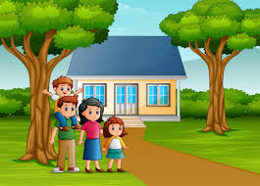
Students look at this picture.
What do you seeing in this picture ?
How many people are here ?
What is their relationship?

Slide 7
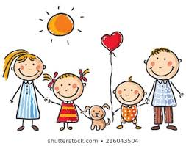
Today we are going to start a new lesson.
The name of the new lesson is-
Family.

Slide 8
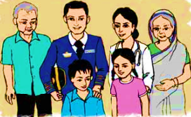
What is this picture ?
A family

Slide 9
Whom do you live with ?
What do you mean by a family?

Slide 10
Family
Mother
Daughter
Son
Father
But sometimes other close relatives like the grandfather and grandmother can live with us. They are also a part of the family.

Slide 11
Family
Mother
Daughter
Son
Father
Grandfather
Grandmother
But sometimes other close relatives like the grandfather and grandmother can live with us. They are also a part of the family.

Slide 12
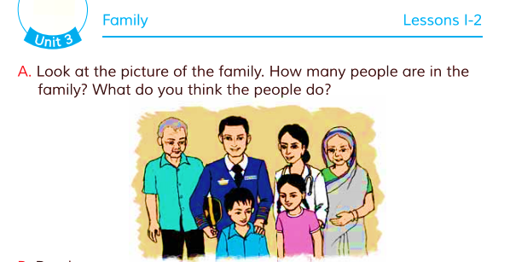
Now open your English book at page no 6 and think about the picture.
How many people are their in the family ?
What is their relationship ?

Slide 13
It is a picture of a joint family.
They are 6 members in the family and they are father, mother, children, grandfather and grandmother.

Slide 14
Pair work
How many people are their in the family ?
What is their relationship ?

Slide 15
Assessment
1.What do you mean by a family ?
2.What do you mean by a joint family ?

Slide 16
Home work
1.How many people in your family ?
2.What does your father and mother do ?

