Slide 1
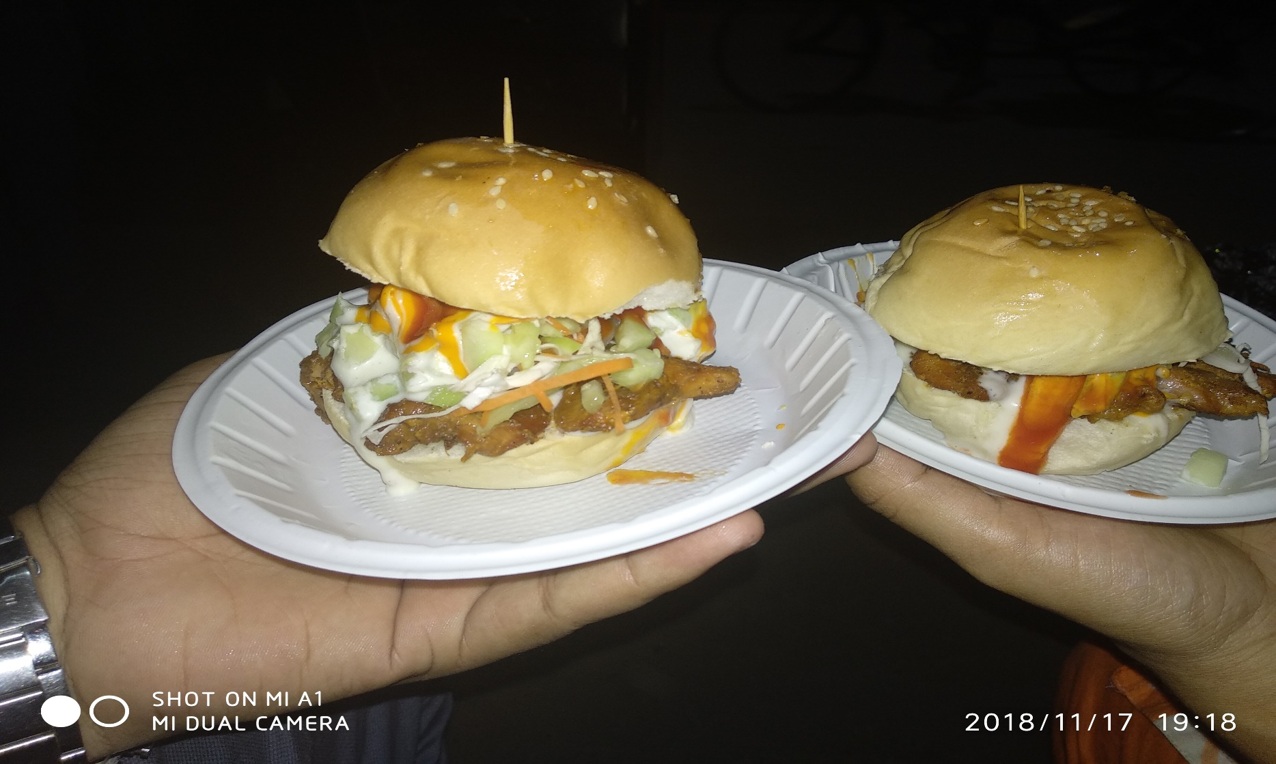
Welcome

Slide 2
Fazana Akter
Asst.Teacher
Shiber Bazar Govt Primary School.

Slide 3
Class- Five
Sub- English
Chapter- 7
Time- 35 min

Slide 4
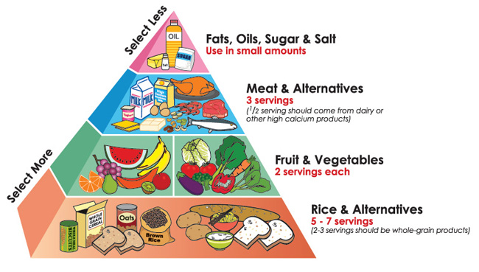
Food Pyramid
There is a ----------------------------little of these foods.

Slide 5
Learning outcomes :
1.5.1 :Read word phrases and sentences in the text proper pronunciation,stress and intonation.
3.1.1 :Ask and answer wh questions .
5.1.1 :Read word phrases and sentences in the text proper pronunciation ,stress and intonation .
8.1.1 :Make sentences using words and phrases given in the textbook .

Slide 6
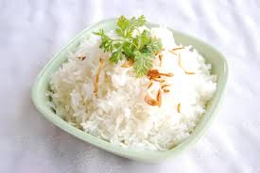
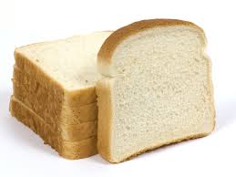
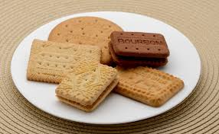
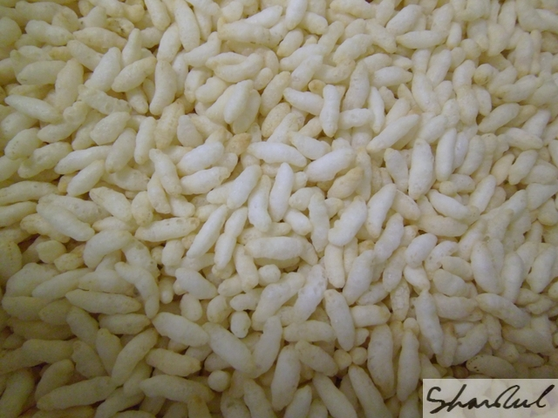
Rice
Bread
Biscuit
Muri
These foods are plenty foods .
The bottom layer of pyramid.

Slide 7
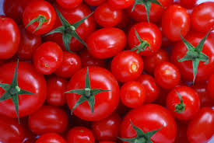
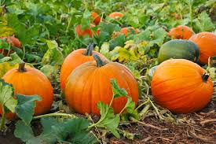
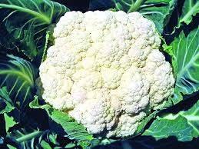
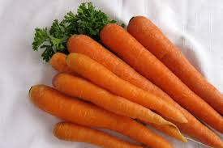
Tomato
Pumpkin
Carrot
Fulkopy
These foods are some fresh vegetables.
Second layer of food pyramid.

Slide 8
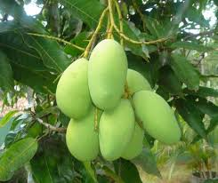
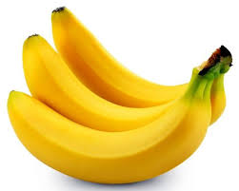
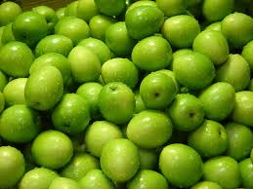
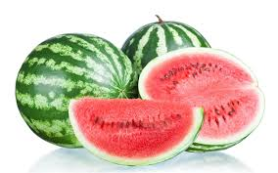
Mango
Banana
Boroi
Water melon
These foods are some fresh fruits.
Second layer of food pyramid .

Slide 9
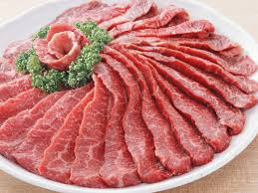
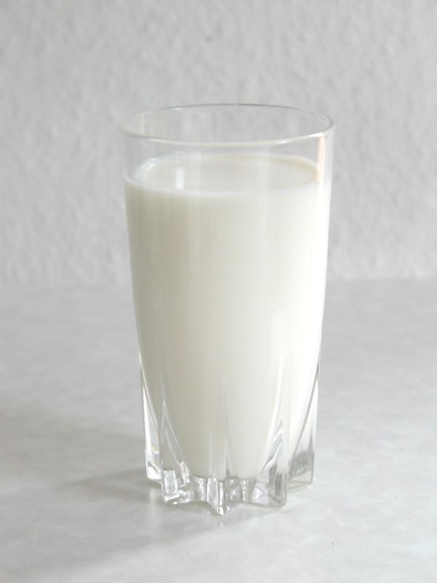
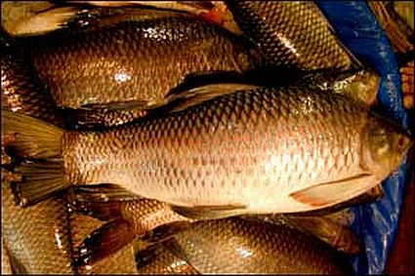
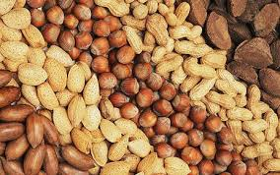
Meat
Milk
Nut
Fish
We should eat these food moderately.
Third layer of food pyramid .

Slide 10
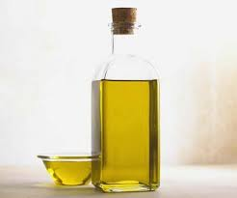
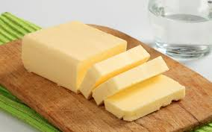
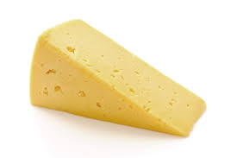
Oil
Butter
Chese
Nut
These foods are fat food.
Top layer of food pyramid.

Slide 11
Food Pyramid

Slide 12
New Words
Pyramid –
Cereals –
Plenty –
Moderately -

Slide 13
We must eat these food item regulerly-
Some fresh fruits and vegetables .

Slide 14
We should eat these food items moderately
Milk , cheese, yoghurt, meat,nuts, beans and eggs.

Slide 15
Teachers activities.
Students activities.

Slide 16
Group Work
Fruit
Vegetable
Which of these foods you should eat most of the time?
What foods at the top of the pyramid?
Some fresh fruits and vegetables.
Fats ,oils ,sweets,etc .

Slide 17
Make words groups .Put each of the following food items in a basket with the suitable heading.
Tomato ,lichi ,pumpkins ,singara ,banana, pudding ,noddles, guava, sandwich , pineapple ,biscuits ,orange, cake ,carrots .
vegetables
fruits
Dairy
snacks

Slide 18
Home work
Write a paragraph about food pyramid .

Slide 19
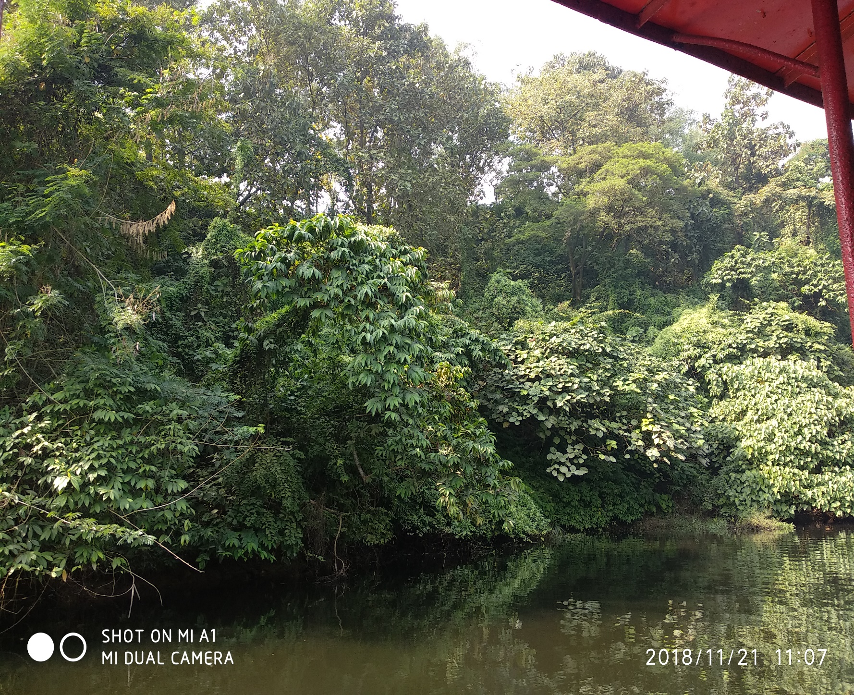
Thank you

