Slide 1
Welcome

Slide 2
Teacher’s Information
Md. Samim Reza
BA(Hons.)MA in English.
Assistant Teacher( English)
Teghoria SESDP Model High School
Lakhai,Habiganj
Phone : 01717170255
Email : rezasamim4@gmail.com
Lesson’s Introduction
Class : NINE-TEN
Subject : ENGLISH 1ST PAPER
Time : 45 minutes
Date : 01-12-2020

Slide 3
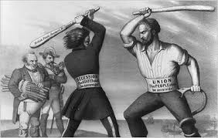
Look at the picture below and say what they represent
They are fighting for something valuable
A war is going on

Slide 4
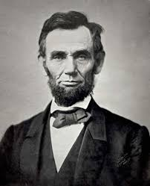
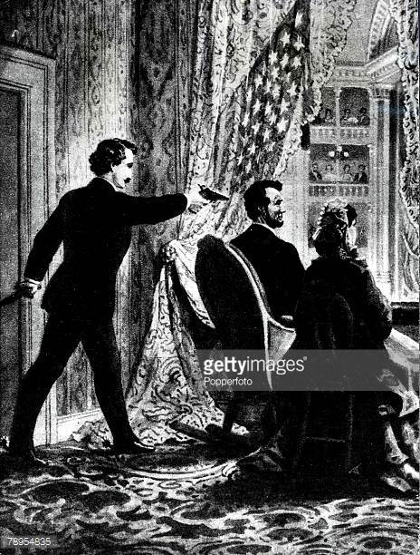
Look at the pictures below and say what they represent
This is Abraham Lincoln
Someone is trying to shoot Abraham Lincoln

Slide 5
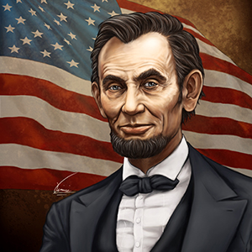
Today’s Topic is
Abraham Lincoln
(Unseen passage)

Slide 6
Learning outcomes :
By the end of the lesson, students will be able to …
do the information transfer
write a summary of an unseen passage

Slide 7
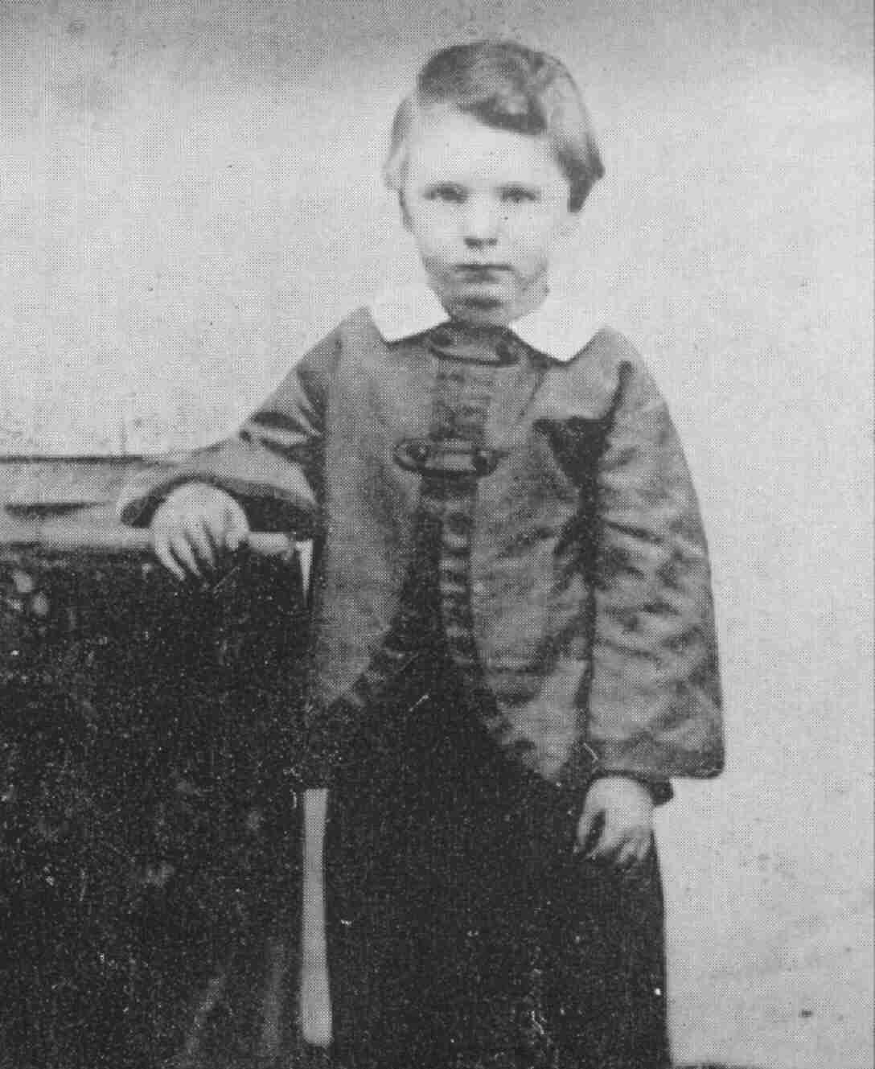
Look at the pictures below and say what they represent
Abraham Lincoln, born in 1809

Slide 8
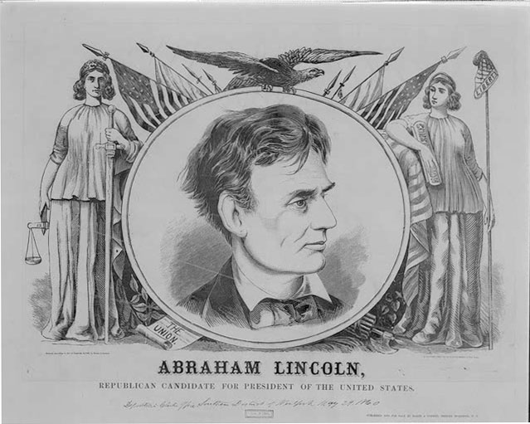
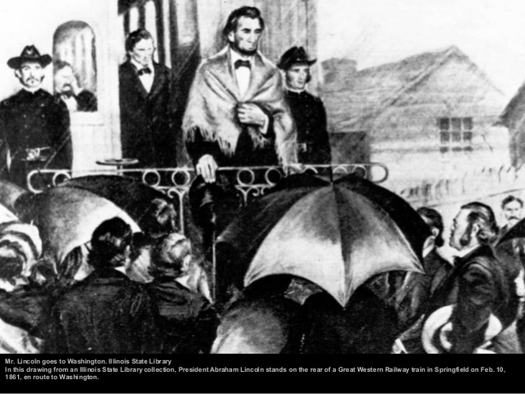
Look at the pictures below and say what they represent
Abraham got the nomination for the president in 1850
Became the 16th president of America

Slide 9
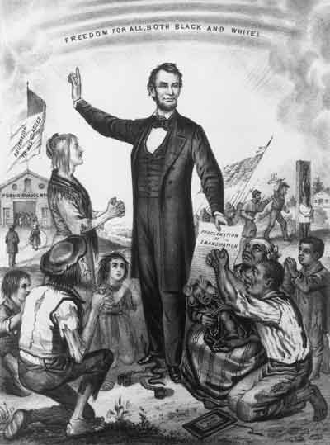
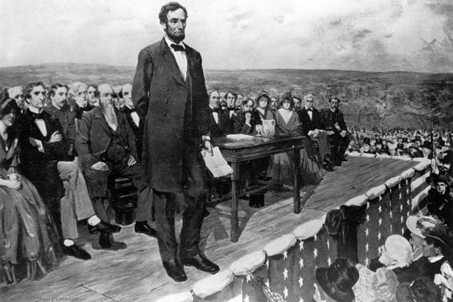
Look at the pictures below and say what they represent
Declaring the ban of slavery
Delivering Gettysburg Address

Slide 10
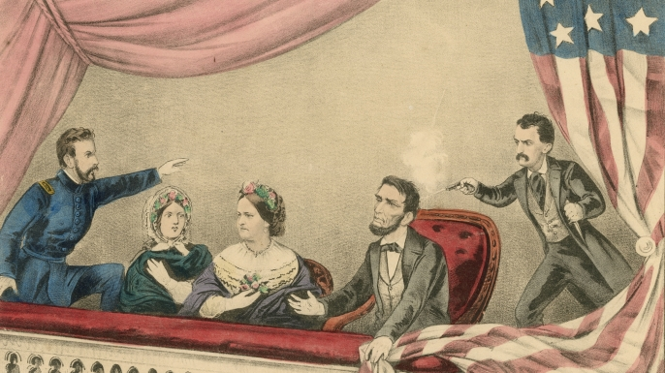
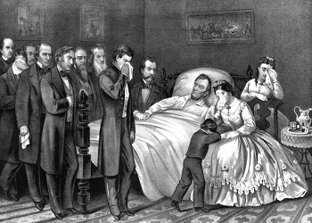
Look at the pictures below and say what they represent
Abraham Lincoln being assassinated at Ford’s theatre
Abraham Lincoln is dead

Slide 11
Look at the circle carefully
Abraham Lincoln
Birth February12,1809 in Kentucky , The USA
His mother died in 1819
Got the nomination for president in 1850
Was reelected president in 1864
Became the president in 1861
Declaration of ban on slavery in 1863
Was assassinated at Ford’s theatre in Washington

Slide 12
Work : 01
Time : 7 min.
Pair work
Go through the script and complete the following table
Name of the Events | Place | Year/Time
Born | Kentucky | i) ------------------
ii)------------------------- |  | November19,1863
Became the president |  | iii) ----------------
Banned slavery in America |  | iv) -------------
Died | v) ----------------
February12,1809
Delivered Gettysburg Address
1861
January 1,1863
in Washington

Slide 13
Work : 02
Time : 10 min.
Group work
Read the script again and write a summary of the passage .
Abraham Lincoln , the 16th President of the USA , was elected president twice. He was famous for his speech that was delivered on November 19,1863. This great man banned slavery in America. That time America was very chaotic. So , he tried to establish peace in the country. Besides, he strengthened the federal government and modernized the economy. But this great leader was assassinated on April 14, 1865.

Slide 14
Evaluation
Abraham was born in -------------------------
i) 1961 ii) 1816 iii)1861 iv) 1809
2. He banned ----------------------- in America .
i) abortion ii) child marriage iii) slavery iv) divorce
3. Abraham became the ------------------- president of America.
i) second ii) sixteenth iii) third iv) tenth

Slide 15
Homework
Write a letter to your friend about Abraham Lincoln

Slide 16
Thanks a Lot.

