Slide 1
Welcome

Slide 2
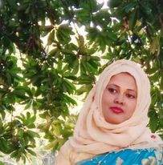
Teacher’s Introduction
Mst.Sharmin Akter
Assistant teacher
Matoin Govt. Primary School
Hajigonj, Chandpur
E-mail:
mstsharminakter1985@gmail.com

Slide 3
Lesson Identity
Class :Four
Subject : English
Lesson : 1-2(A)
Unit:16
Time : 40 min

Slide 4
Learning Outcomes
Student’s will be able to-
Listening:1.1.1-become familiar with English sounds by listening to common English word.
Speaking:1.1.2-say simple words and phrases with proper sounds and stress.
Reading:1.4.1-read words and phrases with the help of visual clause (about 30 new words) and simple sentences.

Slide 5
What can you see in the picture ?
What will be our todays topic ?

Slide 6
Todays lesson topic
Sagar’s week

Slide 7
Input

Slide 8
prayer
study
spend
grandparents
leave
cousin
N
E
W
W
O
R
D
S

Slide 9
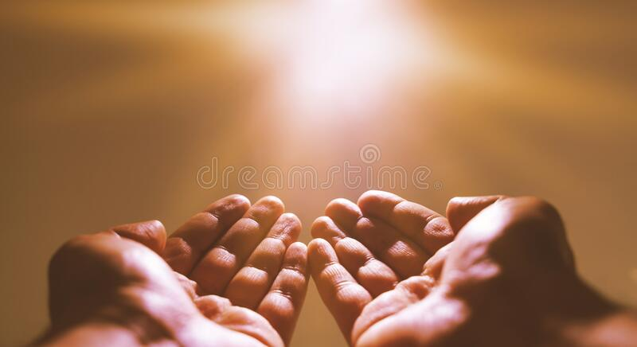
prayer
adoration

Slide 10
study
reading

Slide 11
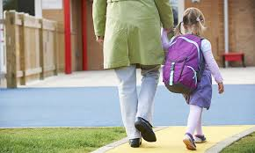
leave
Go away from

Slide 12
grandparents
Parents of one’s father or mother.

Slide 13
spend
pass

Slide 14
cousin
A child of one’s uncle or aunt.

Slide 15
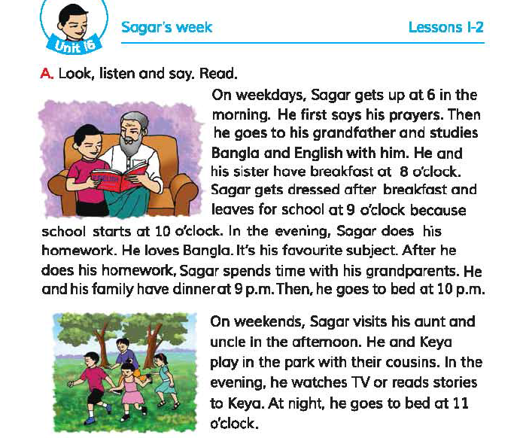
Open at page 32.

Slide 16
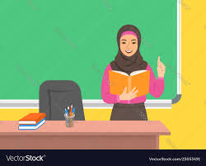
Teacher’s reading

Slide 17
Practice

Slide 18
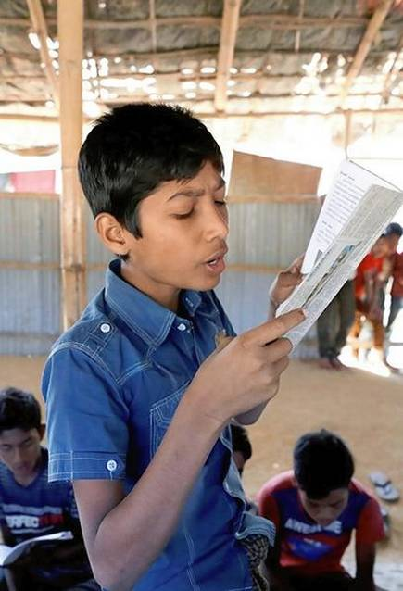
Student`s reading

Slide 19
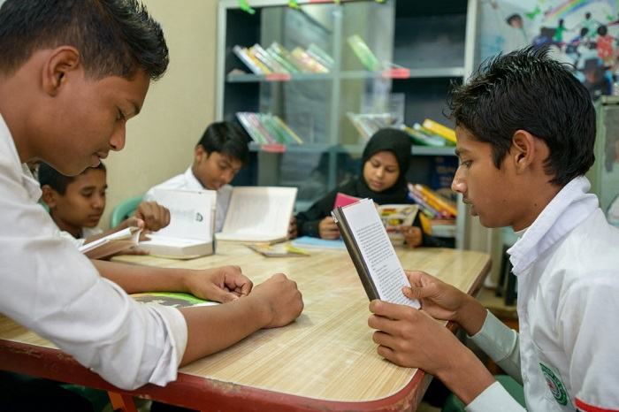
Group reading

Slide 20
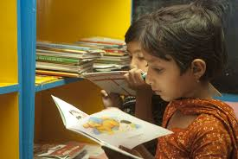
Silent Reading
5 minutes

Slide 21
Questions
1.What time Sagar gets up on weekdays ?
2.What is Sagar’s favourite subject ?
3.What does he do in the evening ?

Slide 22
Answer’s
1.Sagar gets up at 6 on weekdays.
2.Sagar’s favourite subject is Bangla.
3.He watches tv and reads stories in the evening.

Slide 23
Now we will play “BINGO” game
prayer
dinner
night
spend
studies
cousin
evening
story

Slide 24
task
Write five sentences about your family.

Slide 25
Thanks

