Slide 1
Welcome

Slide 2
Presented By
BIBI FATEMA
Assistant Teacher
Noapara High School,
Raozan, Chattogram.

Slide 3
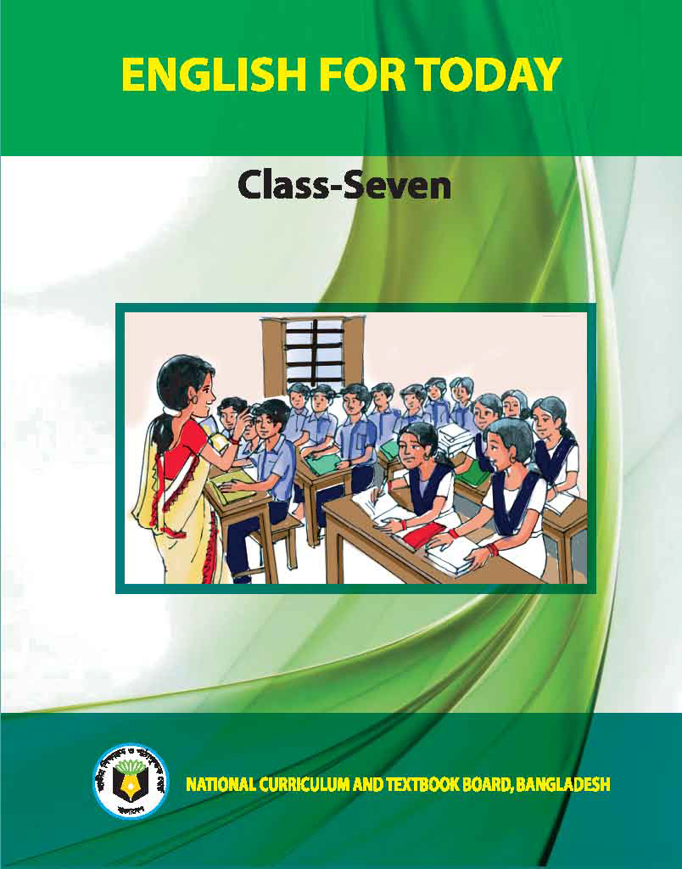
Class Seven
English For Today
Unit – 9
Lesson – 4

Slide 4
Lesson – 4
Unit – 9
What happens next?

Slide 5
Learning outcomes
After completing the lesson students will be able to -
ask and answer questions
talk about climate and environment
write answers to questions

Slide 6
What happens next?
Word
Meaning
Synonym/Meaning
Melt – গলে যাওয়া dissolve
Overflow – প্লাবিত করা flood
Huge – অনেক vast
Happen – ঘটা occur
Extreme – তীব্র severe
Hungry – ক্ষুধার্ত starving
Violent – বৈরী aggressive
Storm – ঝড় tempest
Desert – মরুভূমি sandy region
Erosion – ভাঙ্গন landslides
Territory – এলাকা/ভূখন্ড land area

Slide 7
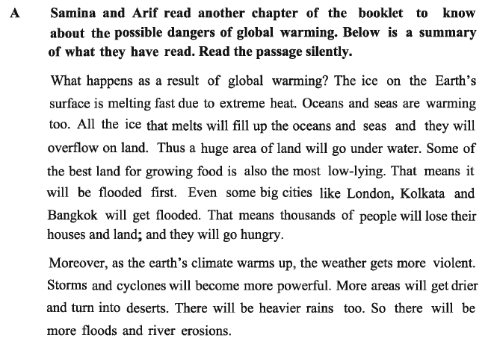
What happens next?

Slide 8
What happens next?

Slide 9
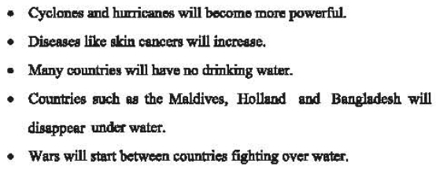
What happens next?

Slide 10
What happens next?
Evaluation
1. What will happen as a result of global warming?
2. Which land will be flooded first?
3. Why does the weather get more violent?
4. Why is the ice on the Earth’s surface melting first?

Slide 11
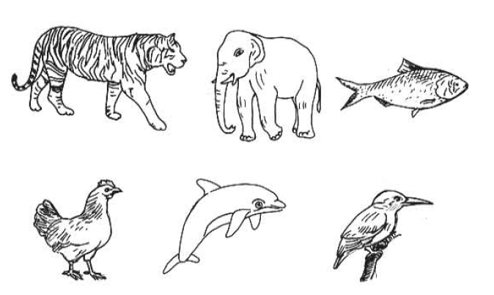
What happens next?

Slide 12
What happens next?
Home work

Slide 13
Thank you

