Slide 2
Presented By
BIBI FATEMA
Assistant Teacher
Noapara High School,
Raozan, Chattogram.

Slide 3
Class Seven
English For Today
Unit – 9
Lesson – 3

Slide 4
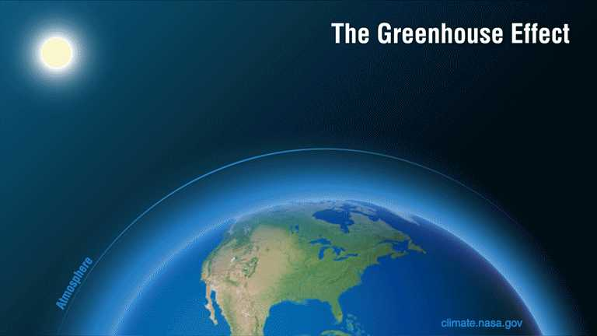
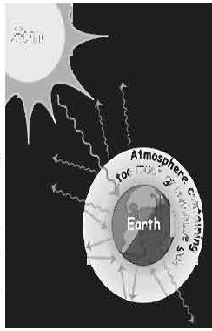

Slide 5
Lesson – 3
Unit – 9
The greenhouse effect

Slide 6
Learning outcomes
After completing the lesson students will be able to -
ask and answer questions
talk about climate and environment
write answers to questions

Slide 7
The greenhouse effect
Word
Meaning
Synonym/Meaning
Greenhouse – সবুজ ঘর/কাঁচের ঘর glass house
Warm – উষ্ণ, হালকা গরম hot
Pretty – বেশ quite
Trap – আটকা পড়া block
Surface – পৃষ্ঠদেশ outside
Release – মুক্ত করা discharge
Atmosphere – বায়ুমন্ডল the mass of air surrounding the Earth
Stay – থাকা exist
Unfortunately – দুর্ভাগ্যবশত unluckily

Slide 8
The greenhouse effect

Slide 9
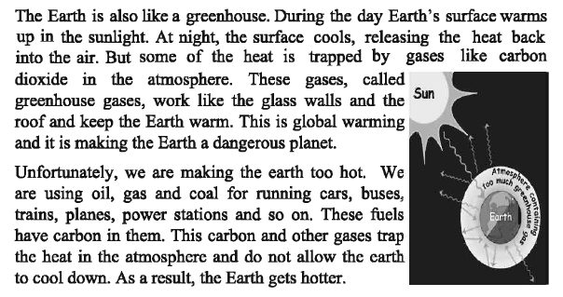
The greenhouse effect

Slide 10
The greenhouse effect
Evaluation
But some of the heat is trapped by gases like carbon dioxide in the atmosphere. Here ‘trapped’ means
a) collapse b) stop c) blocked d) clear
A greenhouse becomes warmer and warmer
a) to receive heat from the sun at daytime b) to receive warmth at night
c) owing to temperature-rise in the world d) owing to making fire in it
The word ‘dangerous’ means
a) afraid b) unsafe c) problem d) disorder
4. The word ‘stay’ means
a) keep b) live c) inside d) exist
What is called greenhouse gas?
a) Carbon dioxide b) Oxygen c) Sulphur dioxide d) Air

Slide 11
The greenhouse effect
Home work
What is a greenhouse?
Why does the earth turn into a dangerous planet?
When does the surface become cool?
What can people do in a greenhouse?
How are we making the earth hot?

