Slide 1
Welcome

Slide 2
Presented By
Bibi Fatema
Assistant Teacher
Noapara High School
Raozan, Chattogram

Slide 3
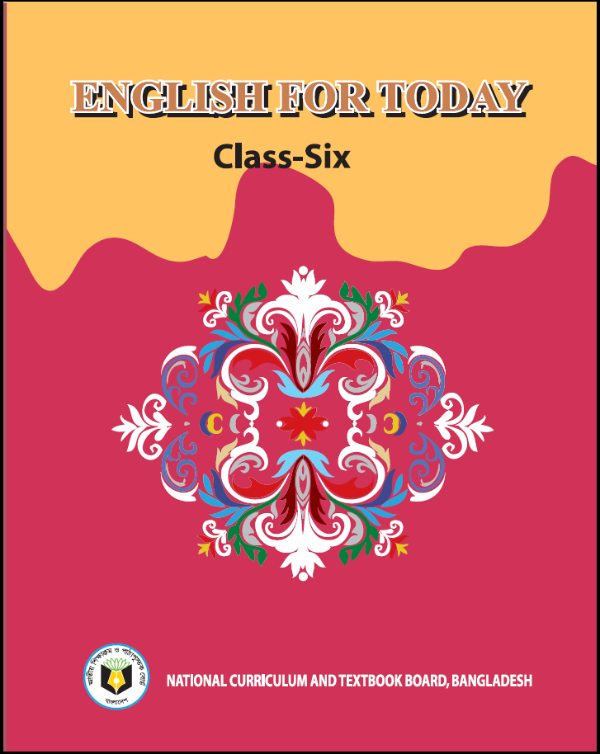
Class Six
English For Today
Lesson – 10

Slide 4
Remedies: modern and traditional

Slide 5
Learning Outcomes
After completing the lesson students will be able to –
read and understand written instructions
ask and answer questions
participate in dialogues and conversations on familiar
topics
read and understand texts

Slide 6
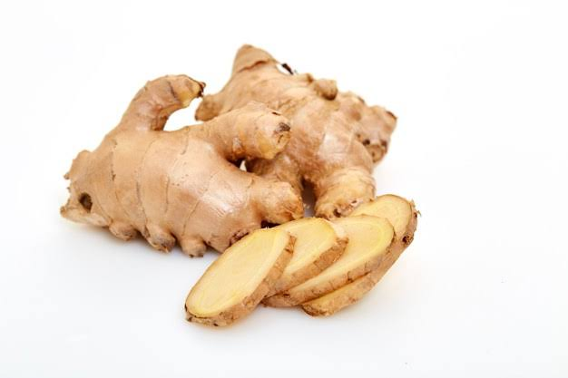
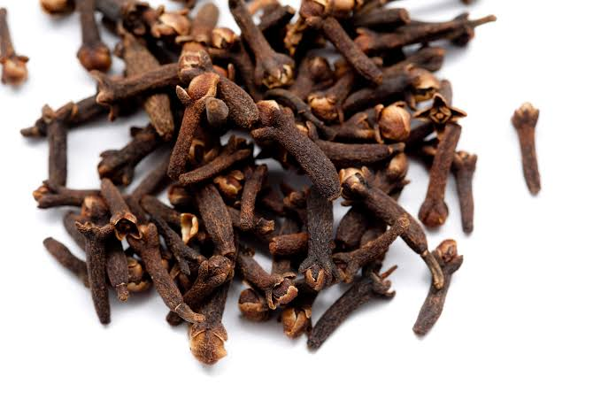
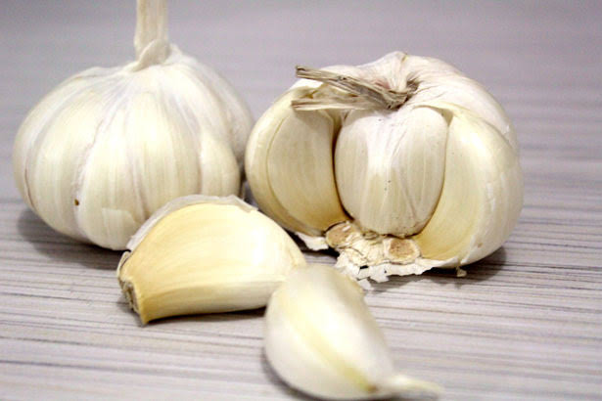
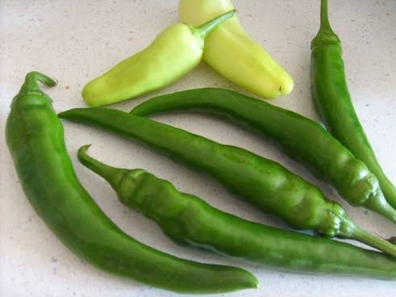
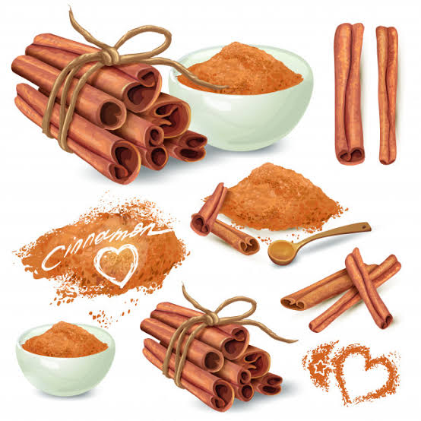

Slide 7
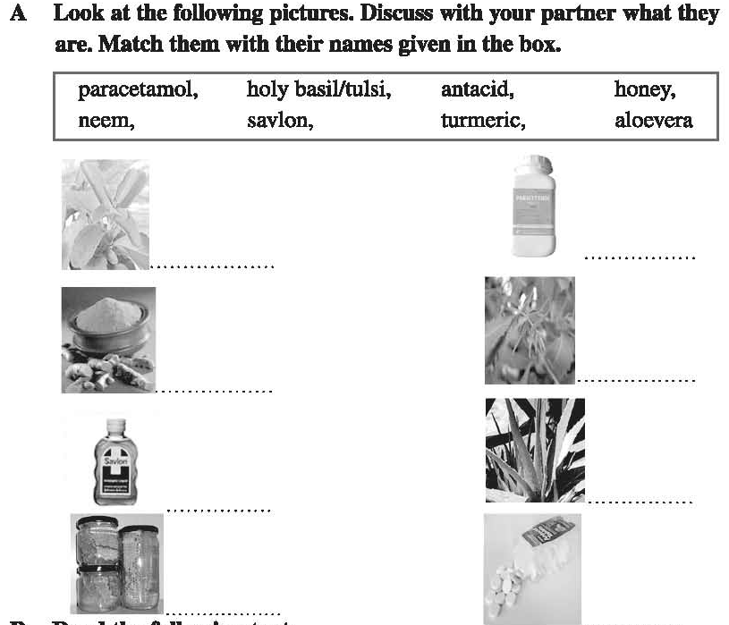
Remedies: modern and traditional
Neem
Paracetamol
Turmeric
Tulsi
Savlon
Aloevera
Honey
Antacid

Slide 9
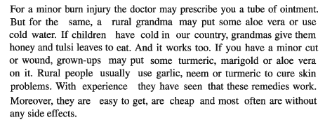

Slide 10
1. Ans: Natural cures are made of natural things, most often herbs and plants.
2. Ans: Herbal cures are not modern inventions. They are ancient. Some of the treatment systems are still in practice today. Since then we know them.
3. Ans: Some ancient civilizations like India, China, Greece, Egypt and Rome are known for herbal treatments.
4. Ans: The natural remedies used for cold is eating tulsi leaves with honey. Yes I’m familiar with another natural remedy used for cold and it is – taking lemon juice and honey mixed in lukewarm water.
5. Ans: For skin problems, garlic, neem or turmeric are used.

Slide 11
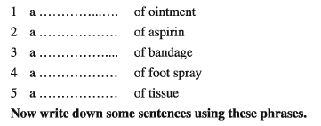
tube
box
package
can/bottle
package

Slide 14
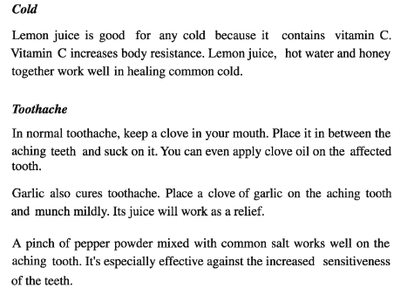

Slide 17
Thank You

