Slide 1
INDEX
Thank you
SLIDE 2WELCOME
SLIDE 12 : PAIR WORK
SLIDE 3 : IDENTIY
SLIDE 13 : GROUP WORK
SLIDE 4-8 : MENTAL PREPARATION
SLIDE 14 : Evaluation
SLIDE 10 : LESSON DECLARATION
SLIDE 15 : THANKS
SLIDE 11 : LEARNING OUTCOME

Slide 2
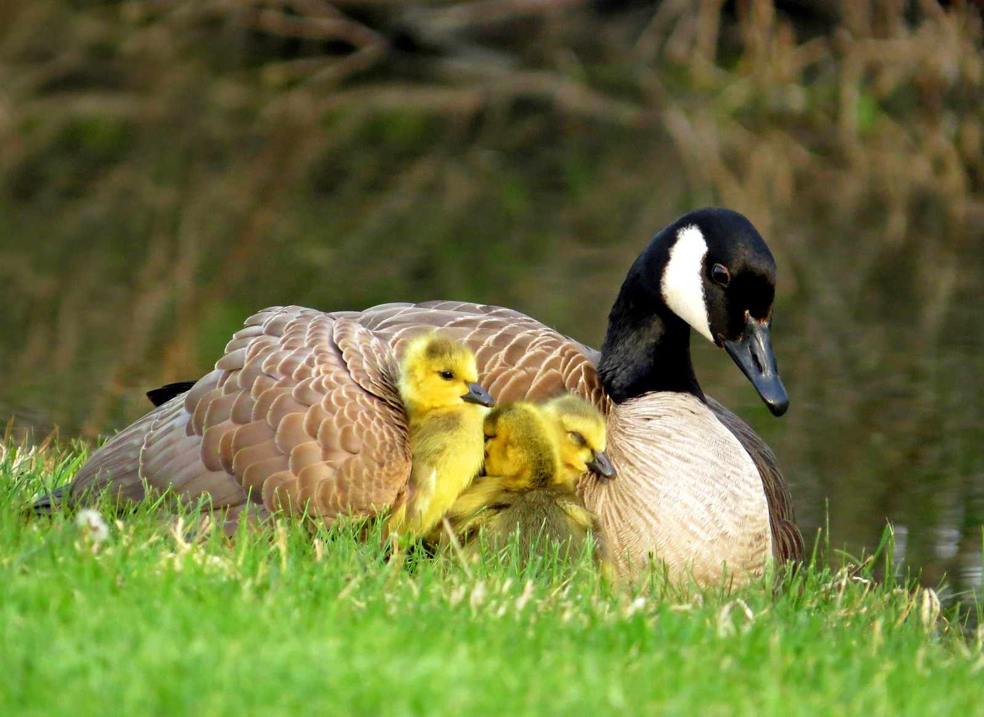
Welcome
Thank you

Slide 3
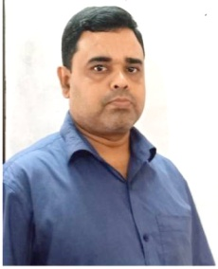
IDENTITY
ABDUL AZIZ
B.A(Hon’s) M.A (English)
Asssistant Teacher (English)
Madhaia Bazar Sadim High School
Master Trainer, UITRCE, Banbies, Chandina,Cumilla
ICT4E District Ambassador, Chandina, Cumilla
E-mail: azizabidpur@gmail.com
Unit : 03, Lesson : 01
Mobile : 01921767310, 01741627571

Slide 4
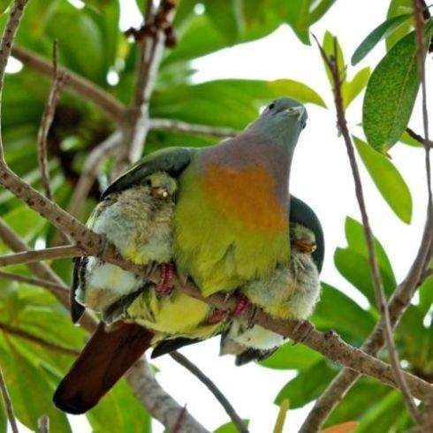
Look at the picture
What can you see in the pictures?
Mother bird protects her babies
Mother bird shelter her babies

Slide 5
Thank you
Mother hen protects her babies from rain

Slide 6
Mother bird is feeding her baby
Thank you

Slide 7
Mother is in smiling face holding her baby
Thank you

Slide 8
Mother
Thank you

Slide 9
Our Today’s Topic
Thank you
Mother’s Day

Slide 10
Learning Outcome
Thank you
01
Talk about events
02
ask and answer questions
03
Describe image

Slide 11
Write a paragraph by answering each of the following questions
Thank you
Individual Work
1. Do you help your mother with her household? How?
2. Do you celebrate Mother’s Day? If yes, when and how?
3. Do you celebrate Mother’s Day? If yes, when and how?

Slide 12
Discuss the questions
Thank you
Pair Work
What do you think the woman is to the child
I think the child is her offspring. She loves her baby very much
Why is she holding the child on her frank?
I think the child is her offspring. She is holding her child on frank
to pose for a photograph
Can a mother be compared to anybody?
No, mother can never be compared to anybody in the world.

Slide 13
Answer the following questions
Thank you
Group Work
What country first observed Mother’s Day as a national holiday?
America first observed Mother’s Day as national holiday.
When is Mother’s Day now celebrated by most of the countries in the world?
When is Mother’s Day now celebrated on the second Sunday of May
by most of the countries in the world.
How is Mother’s Day usually observed?
Mother’s Day is usually observed by honouring mothers with different gifts
such as flowers, cards, candy etc. and also by dining out
Why should we observe Mother’s Day?
We should observe Mother’s Day to express our respect and great love for our
dear mothers

Slide 14
My Mother
Thank you
EVALUATION
I love my mother more than anybody in the world. Her smile is the most beautiful thing to me in my life. My mother also loves me very much. She always takes care of me. She cooks food for me, teaches me and does so many things for me. I love to keep close contact with my mother. Sometimes, whenever I am at home, I help my mother with her household works. Every year celebrate ‘Mother’s Day ‘ on 2nd Sunday of May. To celebrate the day I collect flowers from my garden and make a bouquet and offer it to her as a gift.

Slide 15
_{Thank You}
Thank you

