Slide 2
Introduction
Shekhar kumar Biswas
Assistant teacher
Pakhimara Govt. Primary School Kalia , Narail .
English For Today
Class:One
Lesson:4-6
Unit:5
Topic:Alphabet(D,d)

Slide 3
Learning outcomes
Students will be able to...
Listening
become familiar with English sounds by listening to common English words.
Speaking
repeat after the teacher simple words and phrases.
Reading
recognize and read the alphabet both small and capital (non-cursive).
Writing
practise letter shapes of D and d.

Slide 4
Our Today’s lesson is-
Alphabet
Unit-5, Lesson-(4-6)

Slide 5
Listen the audio
See the picture

Slide 6
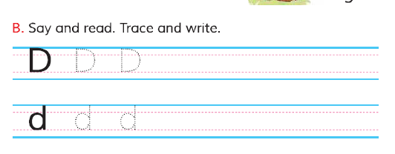
Open your book at page no.11 and read loudly with me.

Slide 7
Follow my writing….

Slide 8
Follow my writing….

Slide 9
Say the letters with your group.
Small group work

Slide 10
Read the letter
p.w

Slide 11
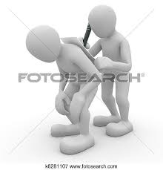
Trace the letter D and d to your partners back.
p.w

Slide 12
Write the letter
w.c.w
Write letters like these.

Slide 13
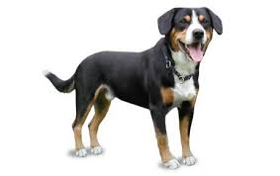
Write the missing letter
w.c.w
D
og

Slide 14
w.c.w
Write the missing letter
D
oll

Slide 15
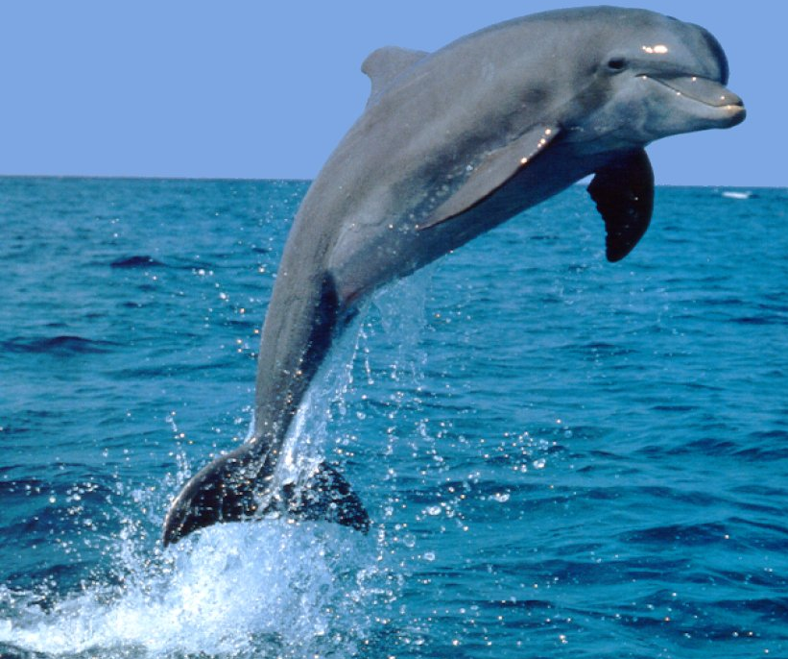
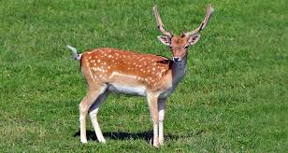
Evaluation
Write and say the first letter of the words
D
olphin
d
eer

Slide 16
Home Work
Write the letter D and d, then colour them.

Slide 17
Bye Bye.

