Slide 1
Good Morning

Slide 2
GREETINGS
Good morning, students
Teacher
Good morning, teacher
Student’s
Teacher
How are you today ?
Fine
Student’s

Slide 3
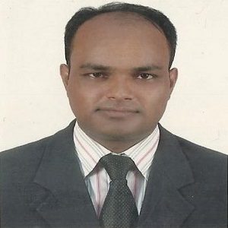
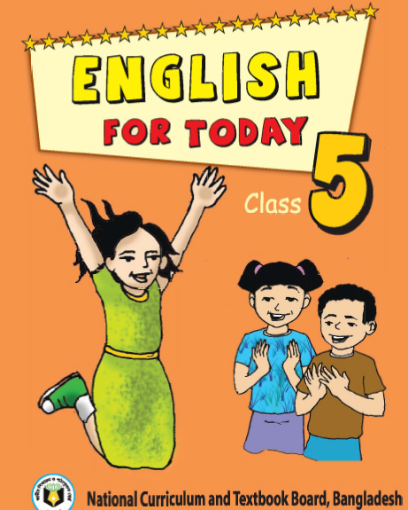
Teacher’s Identity
Lesson Identity
Subject: English. Class: Five. Unit:21, Lessons: 1-2
(It was a great day)
Topic: There was-our tents.
MD. ABDUL KADER
Assistant Teacher
Borni Govt. Primary School,
Companigonj, Sylhet.

Slide 4
Let’s enjoy a video

Slide 5
Can you guess what is our today’s lesson?
Today we will read…
It was a great day

Slide 6
Learning Outcomes

Slide 7
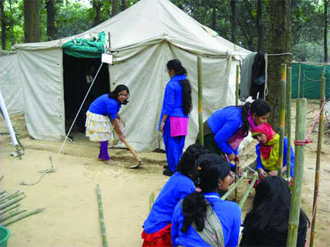
The cub scouts are making their tent. Here To make something is called…………..
Set up

Slide 8
Key words Meaning
Key Words | English Meaning | Bangla Meaning
Leader | Who lead a group or class | দলনেতা
Tent | A small type of house which is made of cloth | তাবু
Prepared | Ready to use | তৈরি বা প্রস্তুত করা
Set up | To build or make something | প্রতিষ্ঠা করা
Recited | To read aloud from memory | কবিতা আবৃতি করা

Slide 9
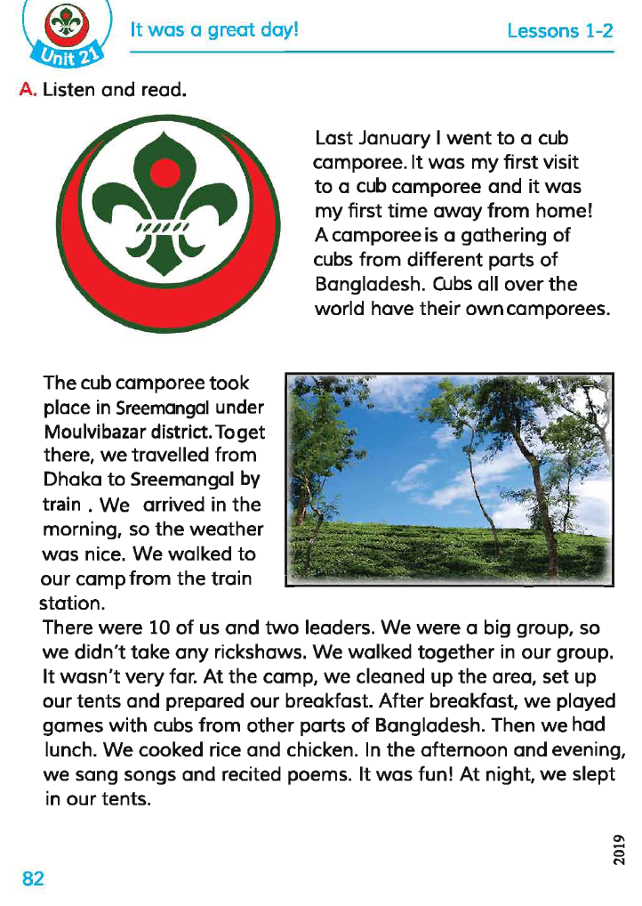
Teacher’s Reading
Dear students,
open your book at page 82. Say after me.

Slide 10
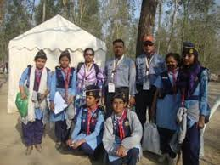
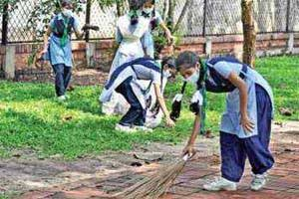
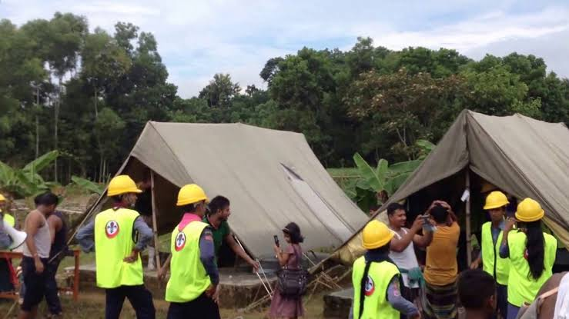
Look at the picture and read the text
There were 10 of us and two leaders. We were a big group, so, we didn`t take any rickshaws.
We walked together in our group. It wasn`t very far. At the camp, we cleaned up the area, set up our tents and prepared our breakfast.

Slide 11
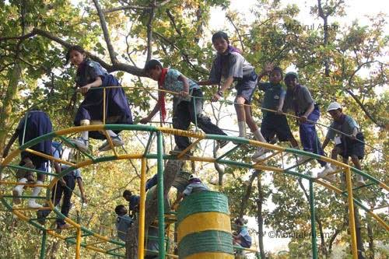
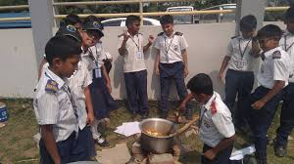
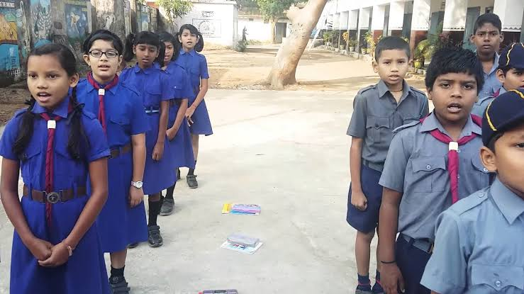
After breakfast, we played games with cubs from other parts of Bangladesh. Then we had launch. We cooked rice and chicken. In the afternoon and evening, we sang song and recited poems. It was fun. At night, we slept in our tents.

Slide 12
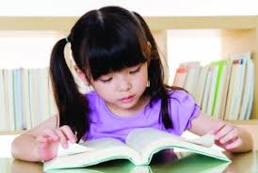
Individual Work
Dear students, open your book at page 82 and read the text loudly.

Slide 13
Pair Work
Say ‘True’ for correct statement or ‘False’ for incorrect statement.
Statements | True/False
a) At noon, we slept in our tent.
b) We cooked rice and egg.
c) At the camp, we cleaned up area.
d) We walked alone in our group.
e) There were 10 of us and two leaders.
False
False
True
False
True

Slide 14
Group Work
Answer the following questions
Questions | Answers
a) When did they sleep in their tents?
b)What did they do in the afternoon and evening?
c) What did they do after breakfast?
d) What did they do at their camp?
e) How many leaders are their in the group?
Ans: At night.
Ans: They sang songs and recited poems.
Ans:They played games with cubs from other parts of Bangladesh
Ans:They cleaned up their camp, set up tents and prepared their breakfast
Ans: There are two leaders in the group

Slide 15
Student’s Silent Reading
Dear students, read the text silently.

Slide 16
Evaluation
Write the answer of the following questions
a) Why didn`t they take any rickshaws?
b) How did they go to their camp?
c) Write three activities that they did in the afternoon and evening?

Slide 17
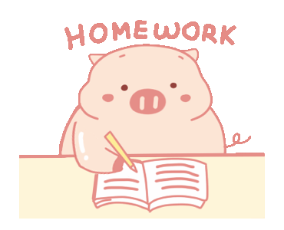
Answer the following questions.
a) How were the group?
b) What did they cook?

