Slide 1
Welcome
to
MR multimedia class presentation

Slide 2
Teacher’s identity
Md. Mashiur Rahman
Lecturer in English
Kalni Islamia Fazil Madrasah
Kalni, Gazipur Sadar, Gazipur
Cell phone: 01917962219
E-mail: mashiurminu1983@gmail.com

Slide 3
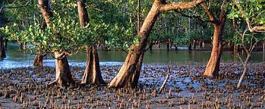
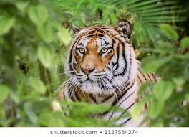
Try to guess what the title of today’s lesson may be.
Picture-1
Picture-2
What do you see in picture -1 and where is it situated?
What is The picture-2 about and Where is it found?

Slide 4
Unit-08: Environment and Nature Lesson-04 : Threats to tigers of Mangrove Forest
Our Today’s lesson

Slide 5
Learning outcome
At end of the lesson the stundents will be able to:
ask and answer questions
understand the text
say the features of mangrove forest
infer new vocabulary

Slide 6
Individual Work: Silent Reading
Read the passage silently and underline the new words.

Slide 7
Word meaning
No | Words | Parts of speech | Meaning
1. | vast | adjective | unusually great in size, large
2. | erosion | noun | consumption, destruction, corrosion
3. | coastline | noun | the outline or contour of a coast
4. | retreat | noun | withdrawal, moving back
5. | evident | adjective | clear, obvious, plan
6. | extend | verb | stretch, expand, spread
7. | recede | verb | go or move away ;retreat

Slide 8
8. | anthropogenic | adjective | relating to the study of the origins and development of human beings
9. | salinity | noun | the state of being saline
10. | shield | noun | a board piece of armor guard
11. | degrade | verb | degenerate; get worse
12. | inevitably | adverb | necessarily; surely ; inescapably
13. | biodiverse | adjective | of the variety of plant and animal life in a particular habitat
14. | extinction | noun | annihilation; destruction, abolition
15 | habitat | noun | the natural environment in which a species or group of species lives

Slide 9
1. What are the reasons behind the destruction of the Sundarbans? 2. ” Coastline retreat is evident everywhere” . Do you agree or disagree with this statement? Give reasons in your favour. 3. What was the prediction of the scientists about the treatment of the Sundarbans? 4. What do the results of the scientific study indicate? 5. What is biodiversity? 6. Which factors will lead to species loss in the Sundarbans? 7. Why does the dwelling place of Royal Bengal Tiger under threat? 8. What makes the Sundarbans a ‘critical’ tiger habitat? 9. What are the causes of rising sea level? 10. How does a mangrove forest differ from a normal forest?
Group Work

Slide 10
EVALUATION
Read the text and make a flow chart showing the causes of the destruction of the Sundarbans and its effects. (one is done for you)
1.Increased frequency of storm surges
2
3
4
5
6

