Slide 1
welcome

Slide 2
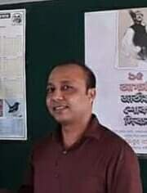
Introducing
Class : Three
Subject: English
Lesson: 1 - 2
Lesson Unit: 19
Satyajit goswami
Head Teacher
Betory GPS
Sadar,Moulvibazar

Slide 3
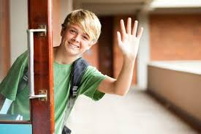
Let`s enjoy a song

Slide 4
Today's lesson
Occupations

Slide 5
Learning outcomes
Students will be able to
1.1.3 repeat words, phrases and sentences after the teacher with proper sounds and stress
1.1.4 say words, phrases and sentences with proper sounds and stress.
1.3.1 recognize which words in a sentence are stressed.

Slide 6
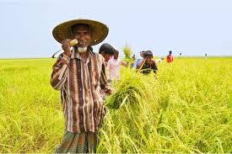
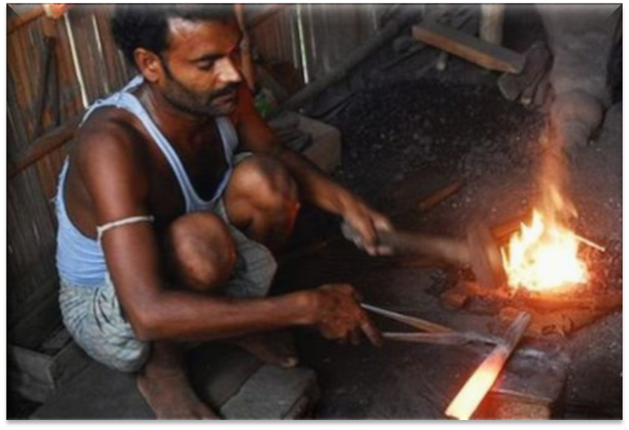
What do you see in the pictures?
Farmer
Blacksmith

Slide 7
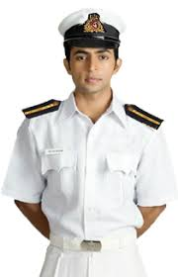
What do you see in the pictures?
Doctor
Pilot

Slide 8
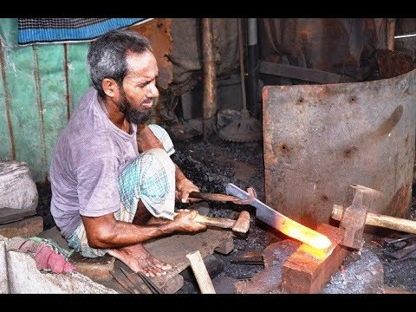
Everybody look, listen and say after me.
A doctor helps people.
A blacksmith makes metal things.

Slide 9
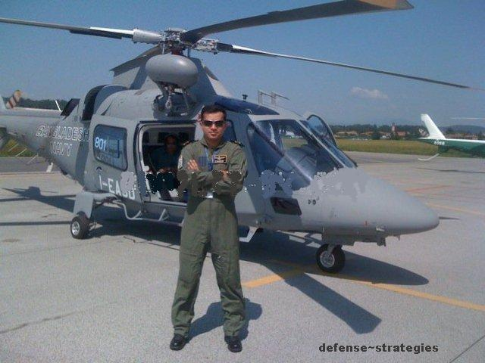
Everybody look, listen and say after me.
A farmer grows food.
A pilot flies a plane.

Slide 10
Open your book
at page 38

Slide 11
Student’s reading silently
farmer
A farmer grows food.
doctor
A doctor helps people.
pilot
A pilot flies plane.
blacksmith
A blacksm ithmakes metal things.

Slide 12
Let’s play a Kim’s game.
farmer
Occupation
blacksmith
doctor
pilot

Slide 13
Group work
Group A
Who teaches students?
Group B
Who grows foods and crops?
Group C
Who drives a bus?
Group D
Who helps people?
Group E
Who makes metal things?

Slide 14
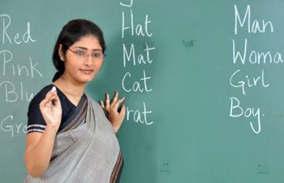
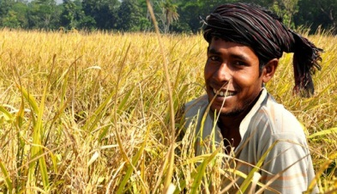
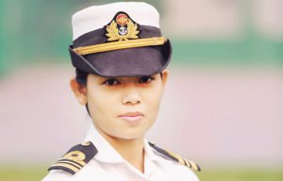
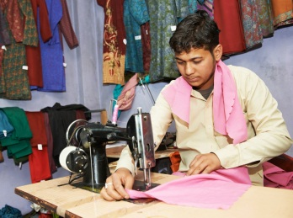
Individual
work
See the pictures and say about these
Teacher
Farmer
Doctor
Blacksmith
Pilot
Tailor

Slide 15
Elvauation
1. Who Teaches at school?
2. Who makes clothes?
3. Who helps people?
4. Who flies a plane?
5. Who grows food?

Slide 16
Home work
Make a list of different occupation people who live in your area.

Slide 17
b
e
G
o
y
o
d

