Slide 2
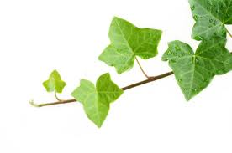
Teacher I.D.
s Shipra Rani Dey .
Asst. Teacher
Jafar nagar A.C. high School
Sitakunda, Ctg.

Slide 3
Class:Ten Sub:English 1st Paper

Slide 4
Aims and objectives: By the end of the lesson students will able to
* look at a picture and ask and answer questions.
* complete a conversation.
* answer questions.

Slide 5
National Memorial

Slide 6
PRESENTATION
Look at the picture of the monument and ask the qusetions about it.
1.What can you see the picture ?
2.Where is it ?
3.Why was it built ?

Slide 7
TOPIC
Independence day

Slide 8
Vocabulary
Now write the meaning of the following words:
Fervour – a strong feeling of excitement .
Martyrs-someone killed because of political or religion beliefs.
Displays- acts of performing skill.
Liberation-freedom.
Valiant-brave.
Alike-in a similar way.

Slide 9
READ THE TEXT
Open at page No. 36 of your text book and read the text on Independence Day .

Slide 10
Evaluation
Students, write answers of the following questions:
1.Where is the National Mausoleum located ?
2.What is the biggest state festival in our country ?
3. How does the day begin?

Slide 11
Home Task:
Write a paragraph on the National Memorial 0f your won words [within 75 words]

Slide 12
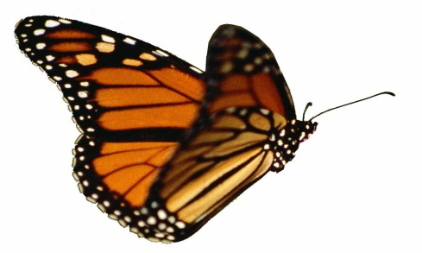
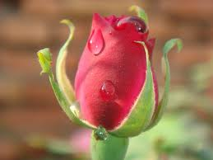
Our time is over.So,no more today.

