Slide 1
Welcome
TO
Everybody

Slide 2
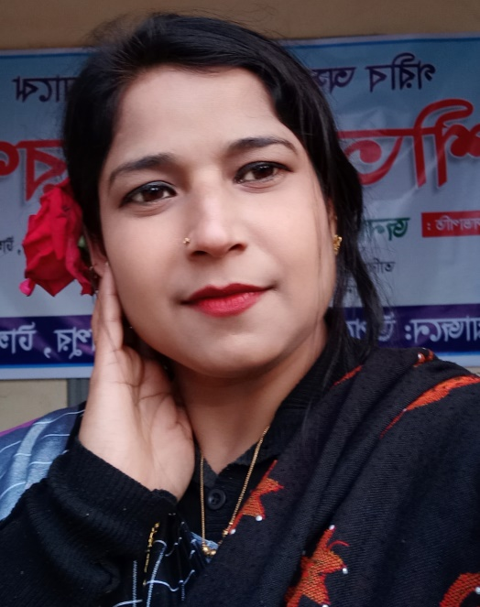
Class:v
Subject:English
Lesson:SM Sultan
Unit:34 (SM Sultan is-----of Bangladesh)
Time:45 minutes
Nasima Akter
Assistant Teacher
Chatiachala.Government Primary School
Sakhipur,Tangail,

Slide 3
Let’s see the video
Who is speaking in the video?
What do you think today’s lesson might be?

Slide 4
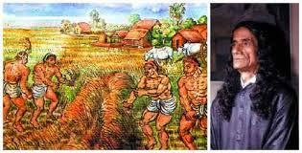
Our todays lesson is--------
SM Sultan

Slide 5
Learning outcomes-------
Students will be able to-----
read the texts with proper pronunciation, stress and intonation.
spelling three words and use in sentences.
write about people, objects, events etc.

Slide 6
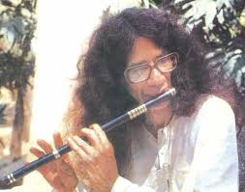
SM Sultan is a famous painter of our country.He was born in Narail in 1923.

Slide 7
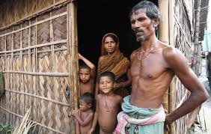
His family didn’t have a lot of money.

Slide 8
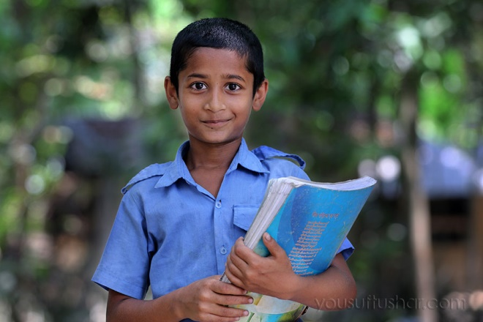
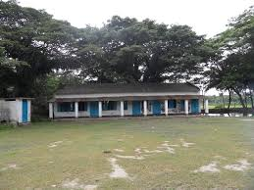
Sultan went to school for five years.

Slide 9
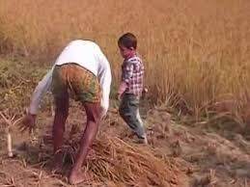
But then he went to work with his father.

Slide 10
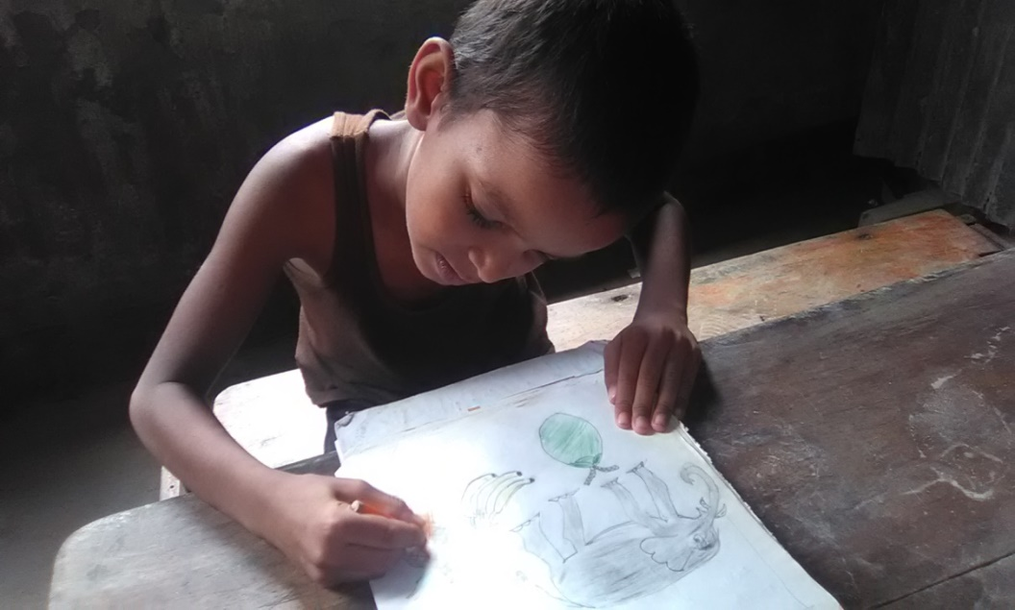
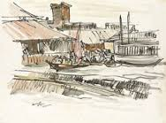
As a child Sultan loved to draw.He drew picture of buildings and other things.

Slide 11
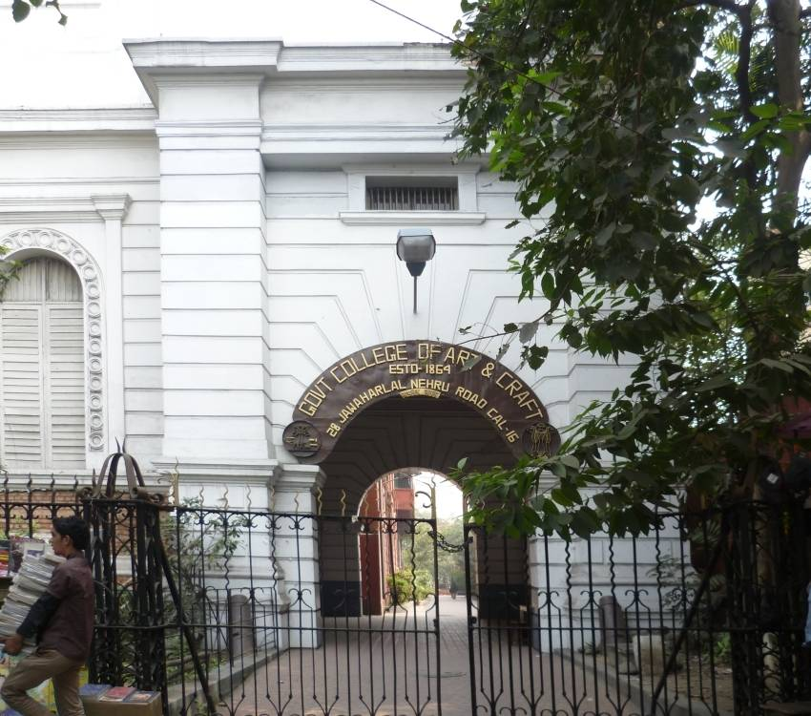
He wanted to study at Calcutta Art College,but his family didn’t have the money.In 1938,he got the money and he went to the Calcutta Art College.He stayed there for three years and then he left.

Slide 12
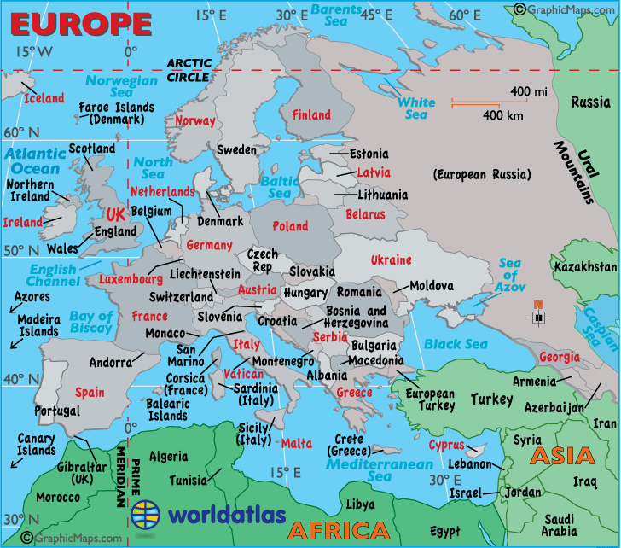
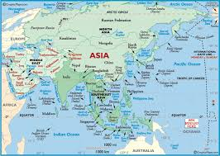
He travelled around Asia and Europe and painted rivers trees and villages and its people.

Slide 13
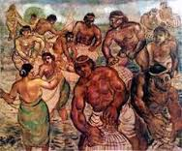
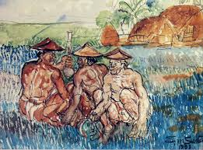
Then he came back to Bangladesh.He painted pictures of the farmers and fisherman of Bangladesh.

Slide 14
Let’s listen my audio

Slide 15
Read the text then write the paragraph
Zainul was eager to study in Calcutta Art Collage. But his father didn’t have that ability. To fulfill his dream his mother sold her gold necklace .With that money , Zainul got admitted in Calcutta Art Collage. He made brilliant result in all the exams.
Write five sentences about a great painter of Bangladesh.

Slide 16
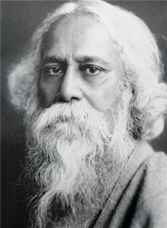
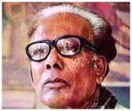
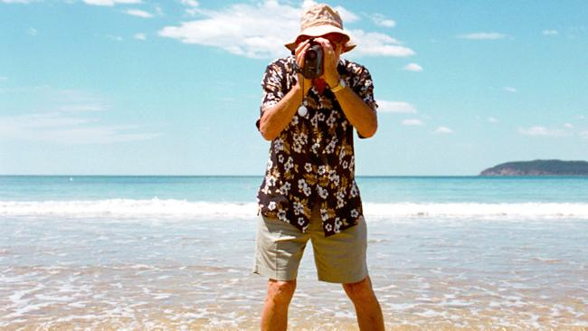
New words with sentences(by using pictures)
Famous
Painter
Travel
Word
Word meaning
Known about by many people
He is a famous poet.
An artist who paints pictures
Zainul is a great painter.
The action of travelling
They travel around Africa.

Slide 17
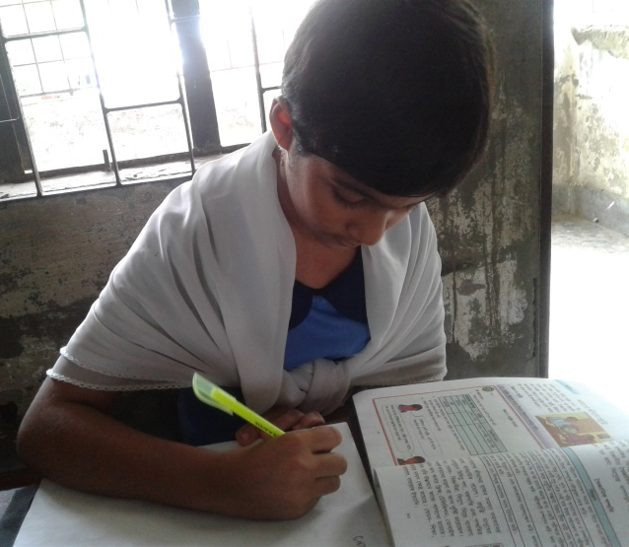
Let’s play a game(iw)
Time: 5 minutes
Bingo Game

Slide 18
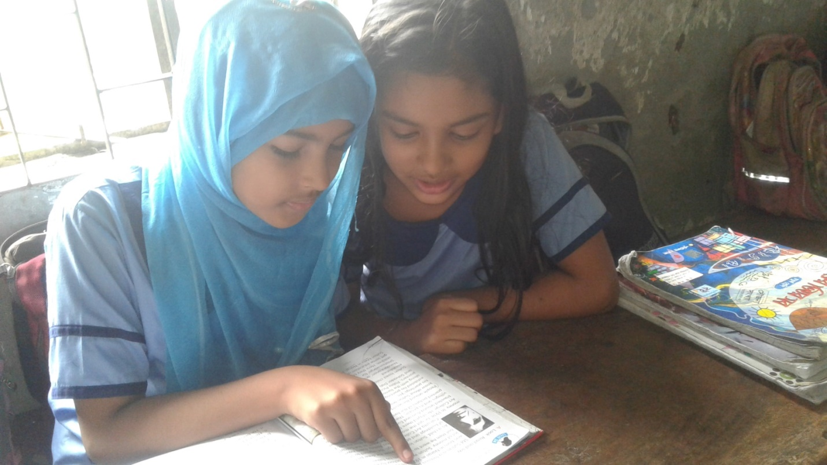
One read and other listen (pw)
Time: 5 minutes

Slide 19
Match the words with their similar meaning
Time:5 minutes
Painter known about by many people
Travel an artist who paint pictures
Famous a man who catch fish
Fisherman existing as a result of birth
Born the action of travelling

Slide 20
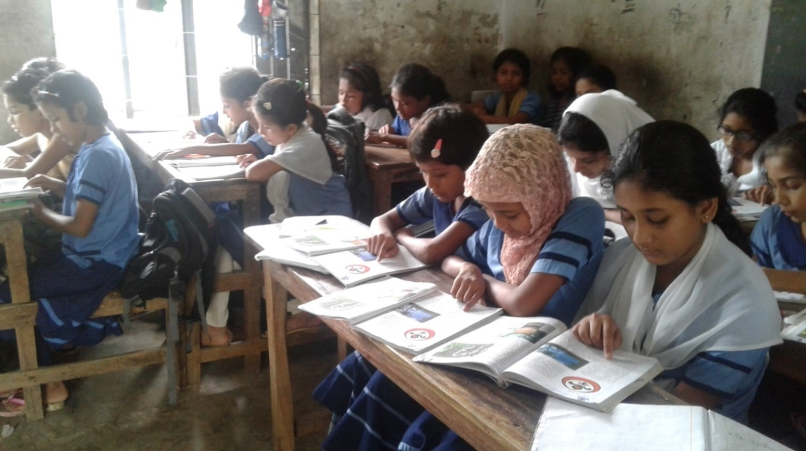
Silent Reading

Slide 21
Evaluation
Mark the right answer on the blackboard.
Sultan was from-------
a. Jessore b. Rajshahi
c. Narail d. Noakhali
2.He came from a ------family.
a. rich b. solvent
c. well-to-do d. poor
3.How long did Sultan stay at school?
a. three years b. five years
c. four years d. six years

Slide 22
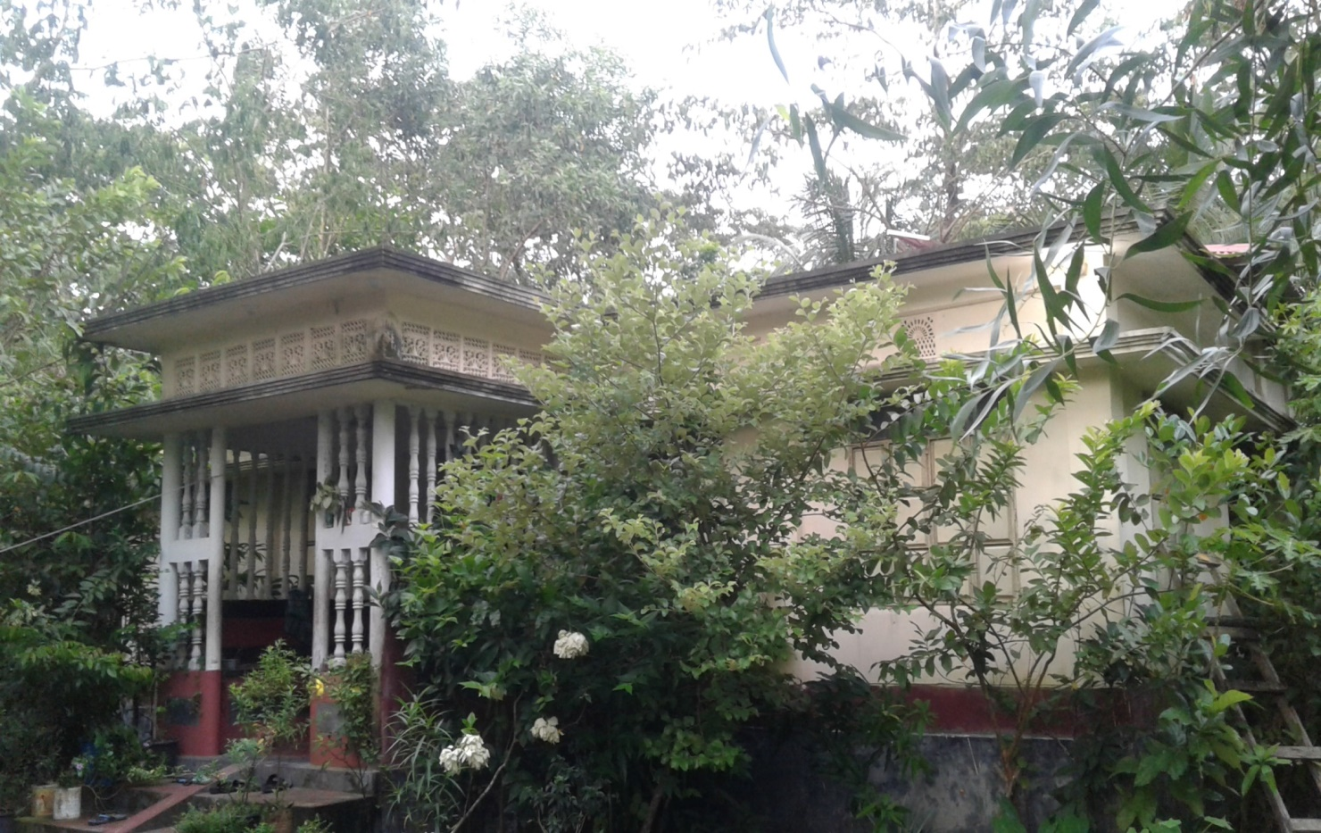
Homework
Write five sentences about a person you like most.

Slide 23
Good bye

