Slide 1
WELCOME

Slide 2
Madhab Roy Chowdhury
Assistant Head Teacher
Raozan Aryamaitreya Institution, Raozan;ctg.
01716298429
Class :-IX
Subject: Eng-1st paper
Duration :- 45
Students:- 60
Present :-55

Slide 3
2.propeller
1.Solar system
3.Windmill
Sources of energy
6.Flow of water
4.biomass
5.Burning of coal

Slide 4
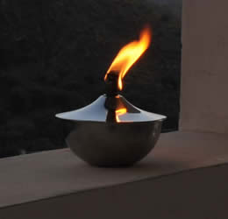
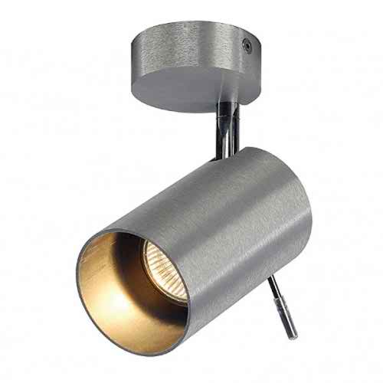
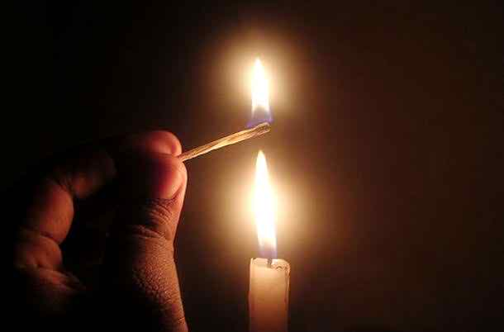
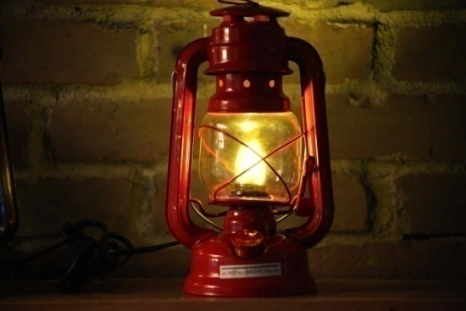
Charge light
Oil lamp
Table light
Stage light
Tube light
dim light
Candle light
Hurricane lamp

Slide 5
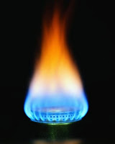
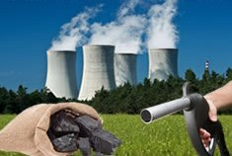
SOLAR ENERGY
WID MILL
Nuclear and coal
Gas

Slide 7
UNIT -11 ; LESSON-03
Renewable energy sources(3)

Slide 8
Learning outcomes
By the end of this lesson, the students will be able to….
make sentences with the following words-----
Conestantly,Replenish,Evaporate,Molten,biomass,Tremendous,abundant
read and answer the questions.
listen and answer questions from a dialogue.
read the dialogue and act it out.
write a dialogue.

Slide 9
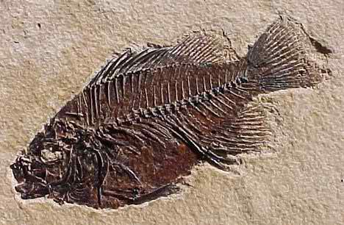
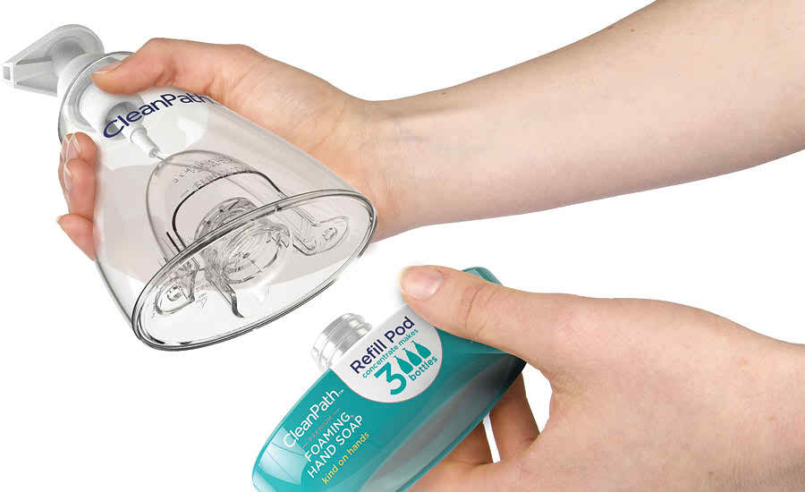
NEW WORDS
Preserved remains of animal or plant
Fossil
Replenish
Replace used items, or refill.

Slide 10
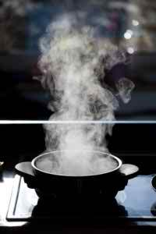
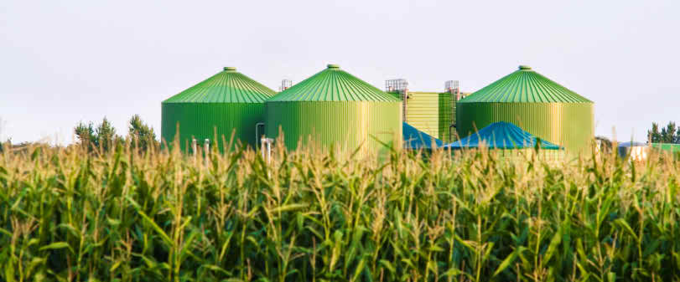
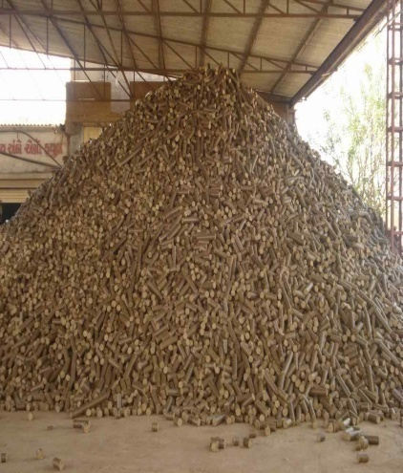
More new words
Evaporate
Change liquid to vapour.
Biomass
biogas

Slide 11
Pair Work: The person next to you is your partner.
Q1:What do you see in the pictures?
Q2:How are they related to each other?
Time:5minutes

Slide 12
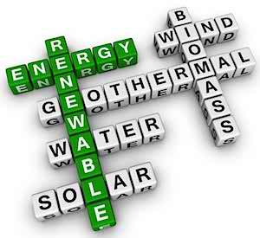
Write some meaningful wards from the puzzle.

Slide 13
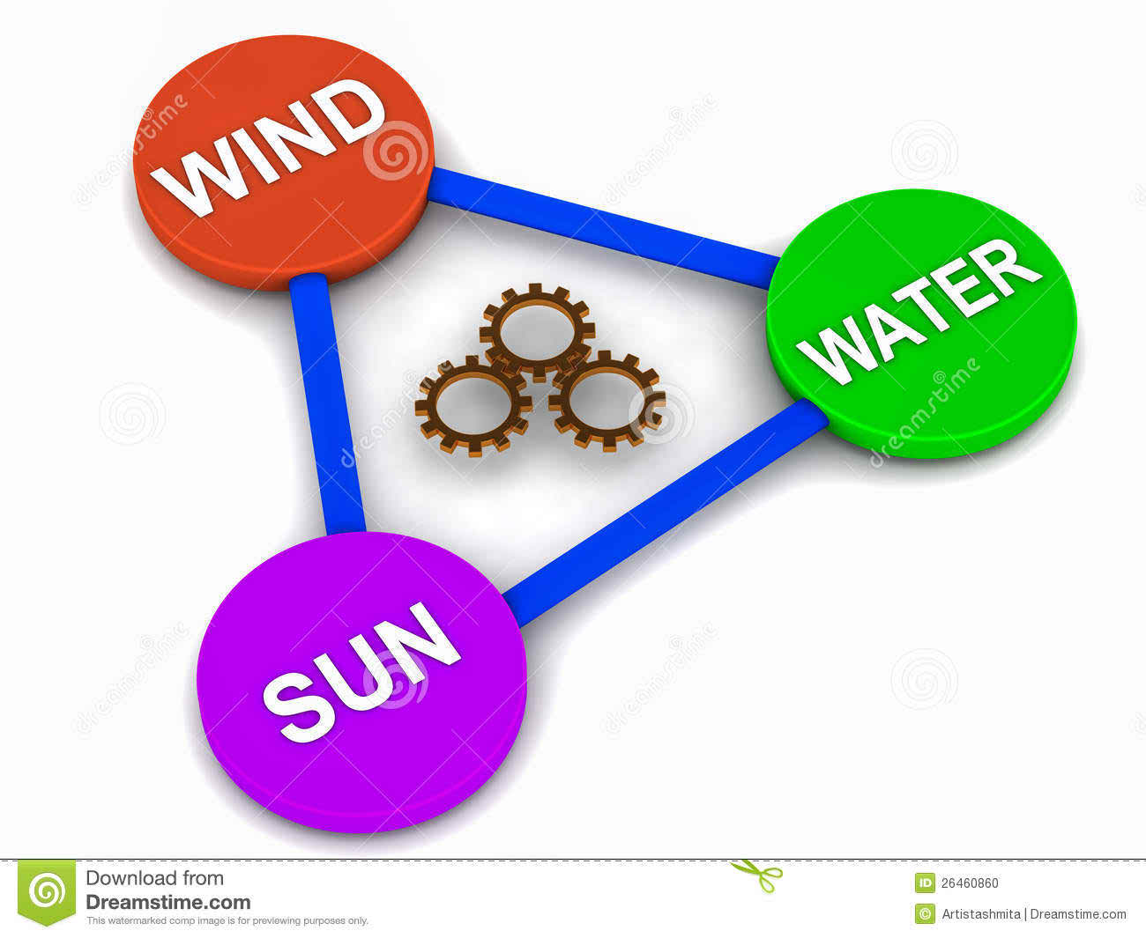
Three main sources of energy

Slide 15
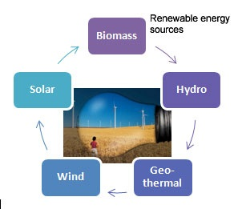
Nuclear
Oil
Coal
Gas

Slide 16
1:What do you mean by renewable energy sources?
2:What are the problems with non-renewable energy source?
3:What are the major differences between renewable and non-renewable energy sources?
Now read activity-B and answer the questions
Time:10 Minutes

Slide 17
Now listen the dialogue between Raju,a student of class ten and his uncle,Mr.Burua who works at Sangu gas field and answer the questions.
Q1:Why is renewable energy called green energy?
Q2:”Nothing is there about green energy in our text either”---Do you think this statement of Raju is correct ? Explain why yes/no.
Q3: ‘I now understand the relation between the two pictures in section A.” What does Raju mean here? What does he really understand ? Do you agree on Raju’s view here?Why?
Time:05Minutes

Slide 18
E.Two ss will come on dais and act it out.
Now complete the following dialogue taking cues from the above model.
A:What’s wind energy?
Renewable energy source.
B:It’s one of the -------------
green energy
A:Why it’s called---------------------?
it helps us to keep
B:Well, it’s green energy because----------------------the Earth green.I mean it doesn’t ---------------------------------when we produce and use it.
Emit any pollutant in the atmosphere
A:I see .Then it--------------------source of energy.
must be a clean
it’s also called
B:Exactly. And that’s why ----------------------------clean energy.
Time:05 Minutes

Slide 19
Class Work
Now write a dialogue on Hydroelectricity in the above model.
Time:15Minutes

Slide 20
Group Work
Which of the renewable energy sources mentioned in the text have you heard of before? One of those resources is used in the Chittagong Hill Tracts(CHT) to produce electricity. Browse the net in groups to find out the answers of the following issues and present them to the class.
1.What is name of the project?
2.Where in the CHT is the located?
3.When did it start operation?
4.How much electricity is being produced from here to the national grid?
5.How many units are working there?
6.What is the positive impact of the project in our national development?
Time:15minutes

Slide 21
Time:10 Minutes
Evaluation
1. What do you know about renewable energy?
2. Choose one of the renewable energy sources and write 05 sentences about it.

Slide 22
Give four examples of Renewable and Non-renewable energy sources
Renewable
01
02
03
04
Non-renewable
01
02
03
04

Slide 23
Home Work
Dhaka City Corporation is installing solar panels instead of conventional lights to illuminate roads in many areas.Write a letter to the editor of a daily newspaper appreciating this initiative and saying why this should be followed by other city authorities too.

Slide 24
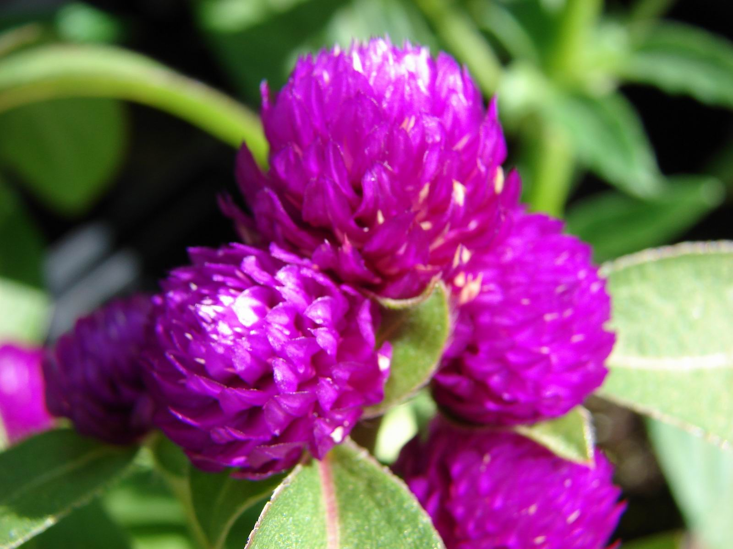
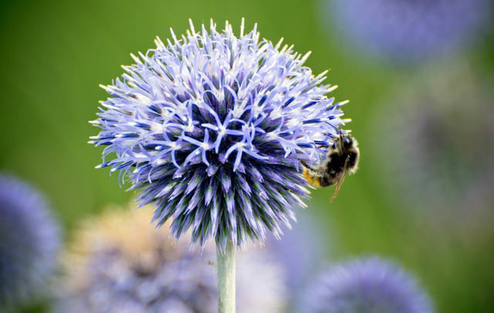
GOOD LUCK

