Slide 1
ENGLISH FOR TODAY
Class: Six
Class Duration: 40 Minutes

Slide 2
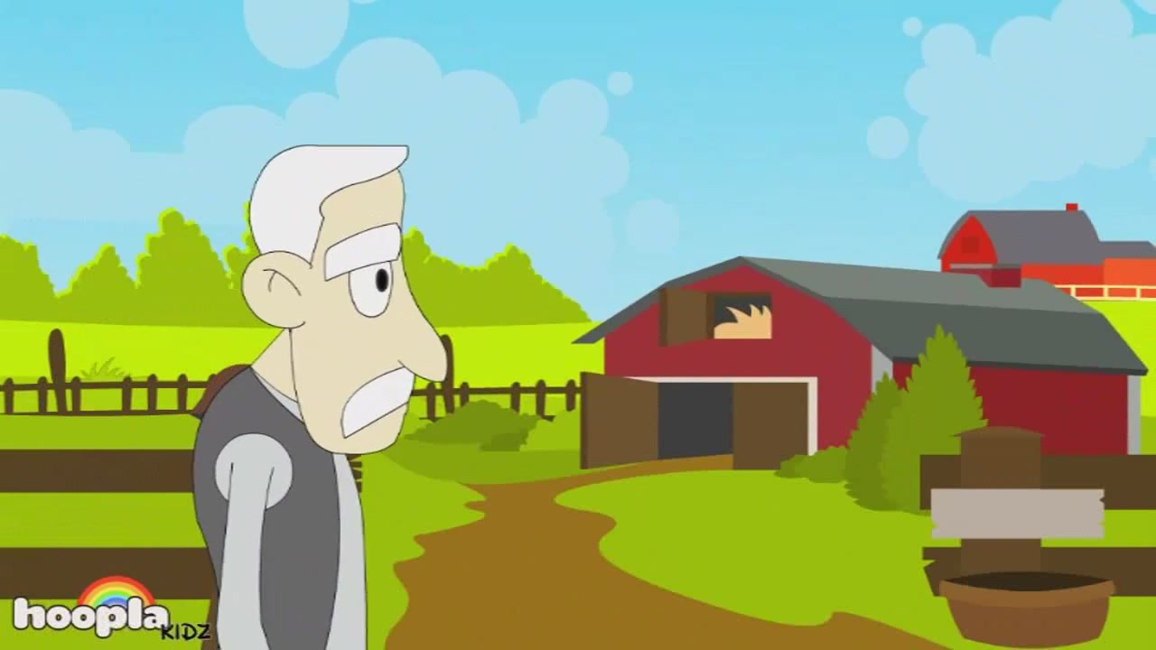
Watch the Animation

Slide 3
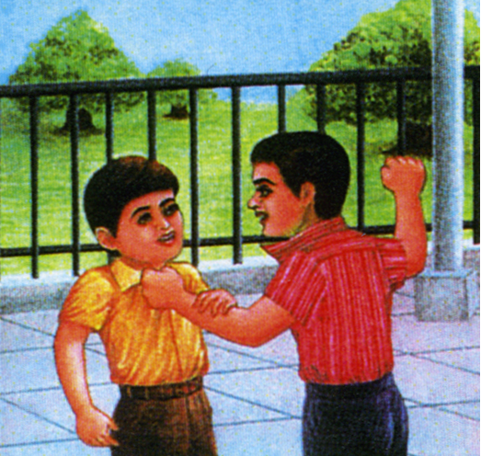

Slide 4
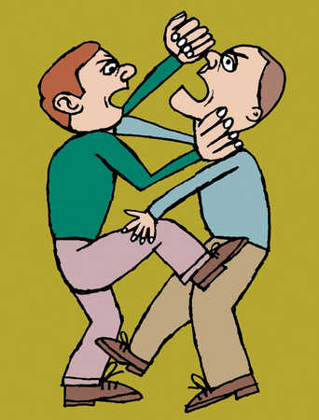
Do not quarrel:
part 1
Unit two
Lesson: 11
Page: 23, 24

Slide 5
Learning Outcomes
After the lesson students will be able to Identify, Speak and write down:
Assertive Sentences with Past Indefinite and Continuous forms of verbs.
Negative Sentences with Past Indefinite and Continuous forms of verbs.
Interrogative Sentences with Past Indefinite and Continuous forms of verbs.

Slide 6
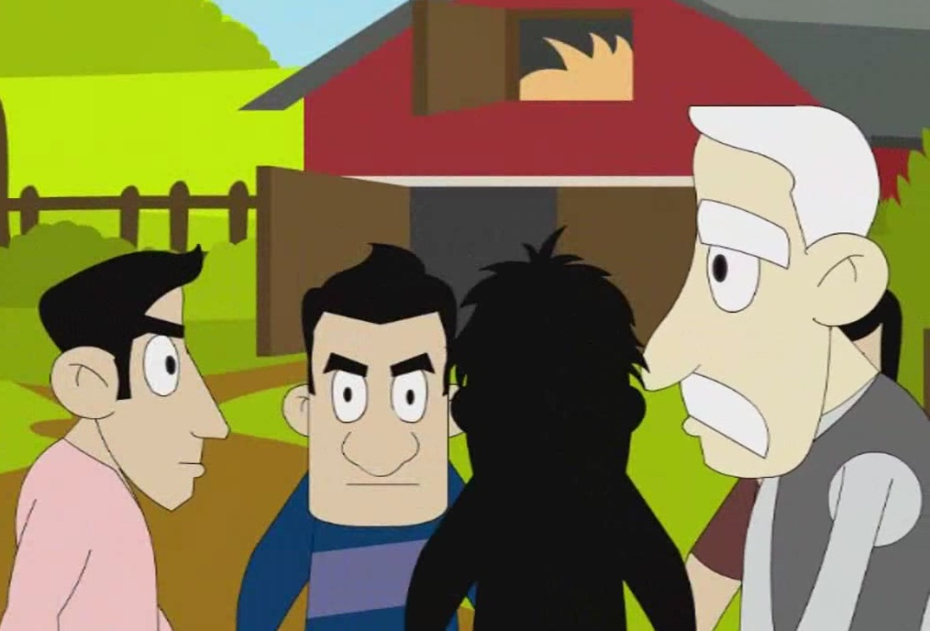
The Old Man and His Sons
Anwar Hussain told this story
to his grandchildren.

Slide 7
Once upon a time there was an old farmer.

Slide 8
He lived with his wife and three sons in a small village.

Slide 9
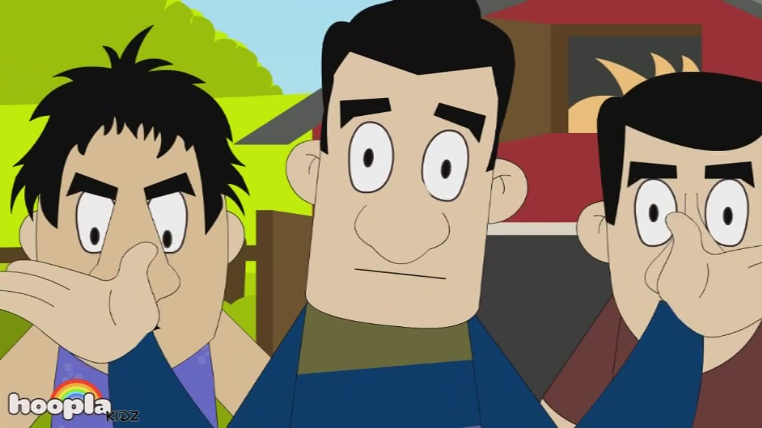
The three sons always quarreled with each other.

Slide 10
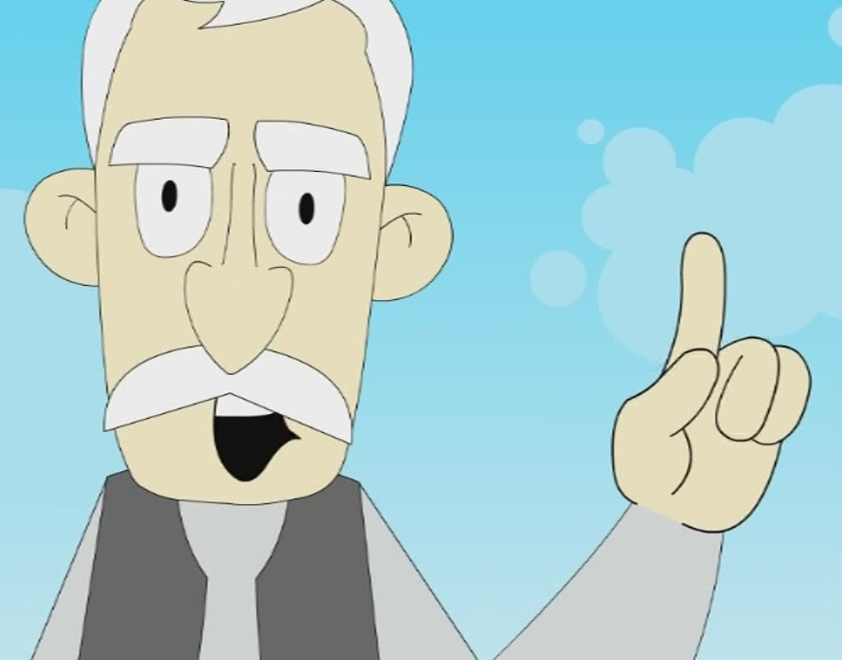
Their parents said "Stop! Don't quarrel! It's bad! But they didn't listen to their parents.

Slide 11
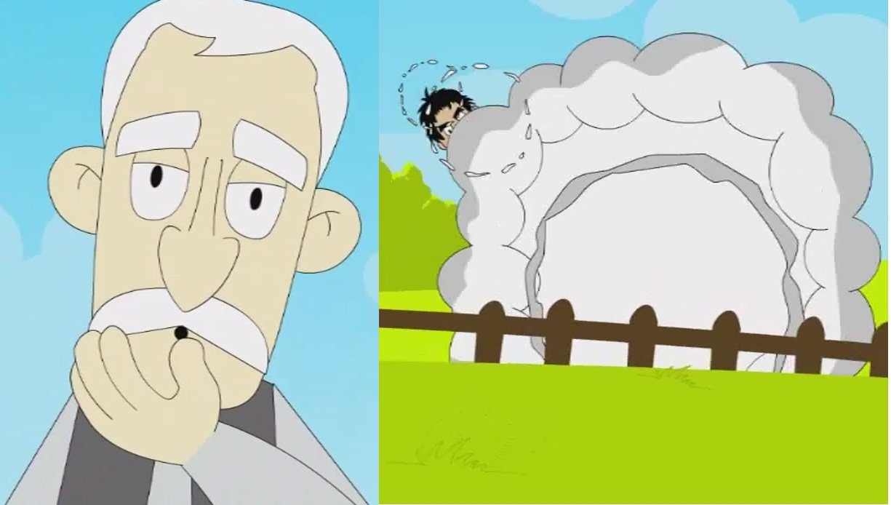
One day, the sons were quarrelling again and the old farmer heard them.

Slide 12
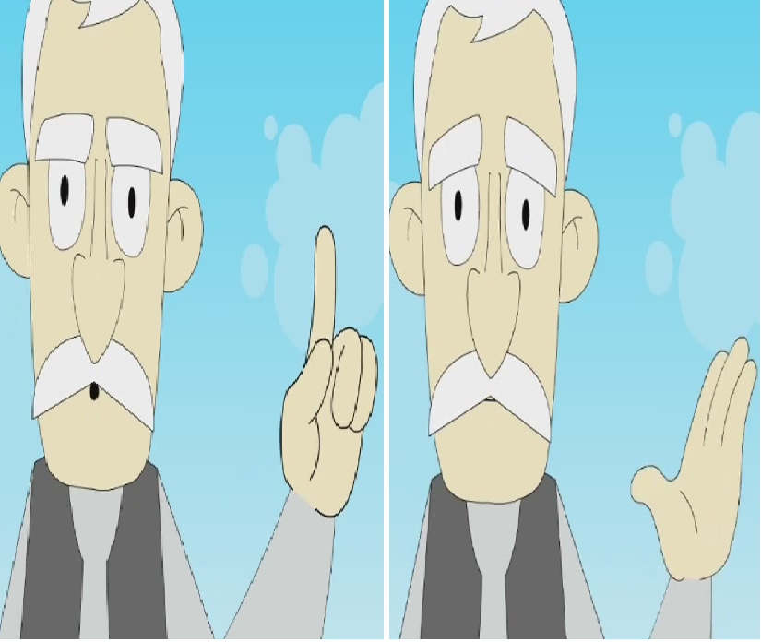
Once again he said, "Stop!“
He then asked for the five sticks and some rope.

Slide 13
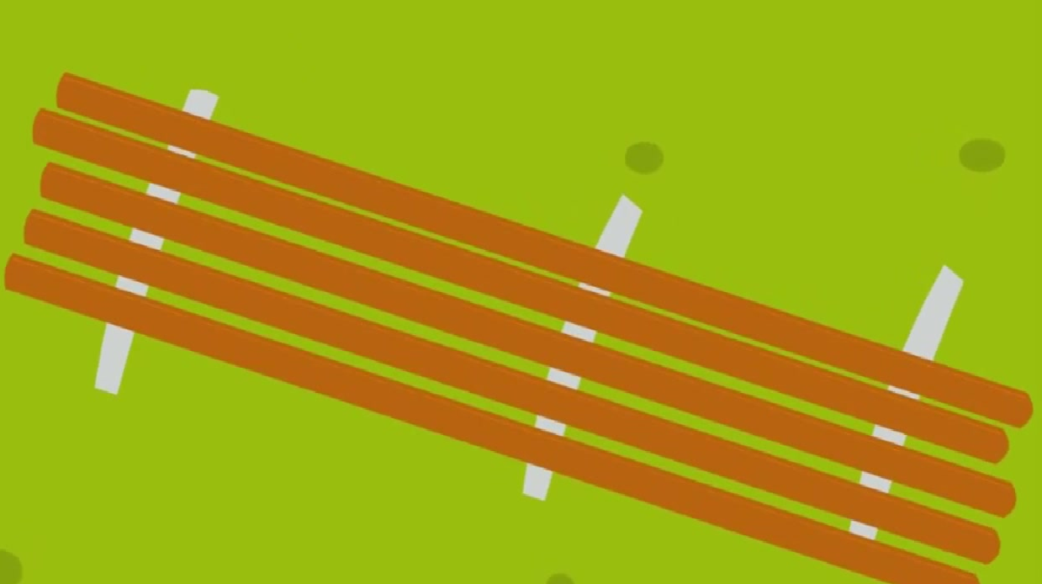
The three boys brought the
sticks and rope for their father.

Slide 14
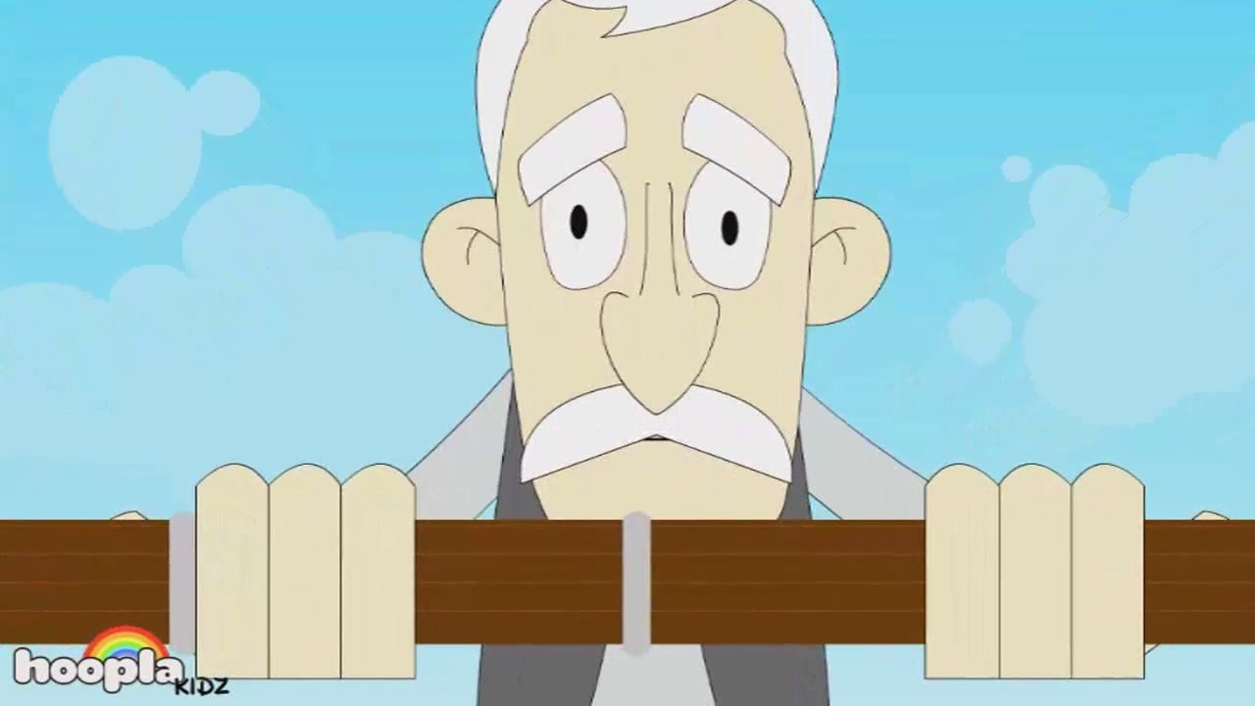
The old farmer then tied the
sticks together with the rope.

Slide 15
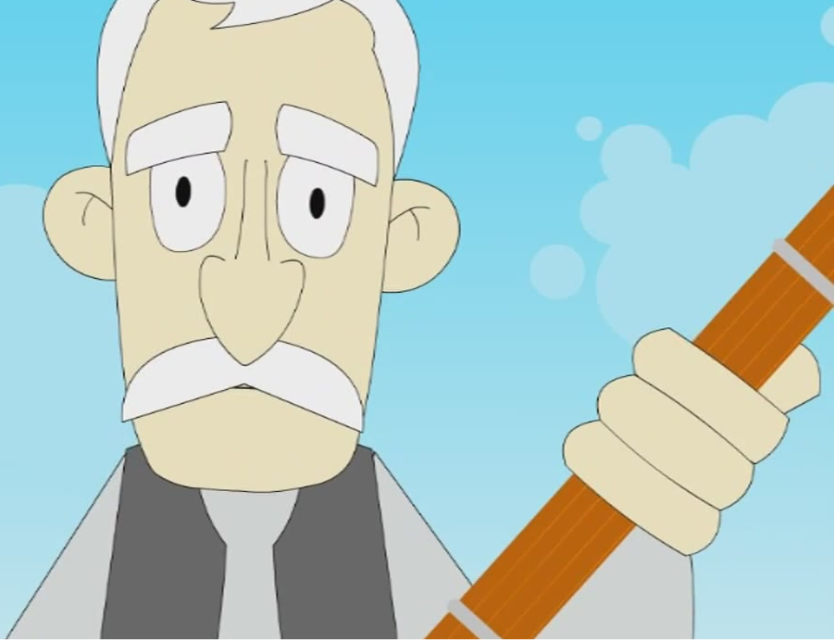
Then he said to his sons. "Now
try and break this bundle of sticks."

Slide 16
Home Tasks
Fill in the blanks using verbs from the list below. Write them in the correct form :
Enjoy, have, sit, live, be, tell, love
Once upon a time there was an old man called Anwar Hussain.
He………… with his son. He………. three grandchildren. He often………. with them.
He …………….them very much and sometimes he ……………them interesting stories. He …………… a very good story teller and many children his stories.

Slide 17
Group Work
Use the table to ask and answer questions. Where the answer is no, give the correct answer, like this :
  Example :
  Q. Did the farmer's wife like quarrelling?
  A. No she didn't. She didn't quarrel.
did | the old farmer the farmer’s wife the sons | give sticks and rope to the sons? always quarrel with each other? tie the sticks together? like quarrelling? listen to their father and mother
Yes, No, | he she They | did. didn’t.

Slide 18
Thank You

Slide 19
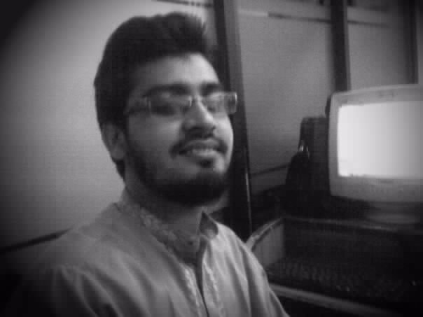
Presented by
Md. Belal Hossain
Assistant Teacher ( Computer )
Madam Bibir Hat shahjahan High School
Bhatiary,, Sitakunda, Chittagong.
Contact : 01819036681
E-mail:belalzarin@gmail.com

