Slide 1
ENGLISH FOR TODAY
Class Nine
Time: 40 minutes

Slide 2
Have you seen her before?

Slide 3
What do you know about her?

Slide 4
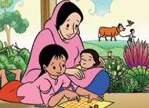
MEENA
Unit 11, Lesson 3
Page No - 119

Slide 5
By the end of the Lesson Students will be able
To learn a story,
To know about discrimination
To know the effect of illiteracy

Slide 6
Picking up the mango

Slide 7
Silent Reading

Slide 8
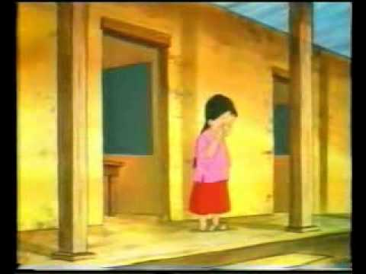
Vocabulary:
Disappoint
To become upset
To get on to top
Climb
Disagreed
Not Agreed

Slide 9
Pair Work
Why was Meena disappointed?
What was the opinion of her grandmother?
What did her father say?

Slide 10
Home Work :
Write a paragraph about Gender discrimination based on the passage

Slide 11
Presented By
Md. Belal Hossain
Senior teacher
Madambibirhat Sahjahan High School
Bhatiary,Chittagong.

Slide 12
THANK YOU

