Slide 1

welcome

Slide 2
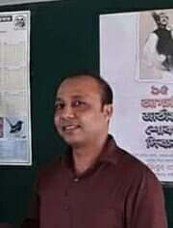


Introducing
Class : One
Subject: English
Lesson: 1 - 3
Lesson Unit: 6
Satyajit goswami
Head Teacher
Betory GPS
Sadar,Moulvibazar

Slide 3
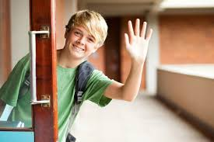

Let`s enjoy a song

Slide 4
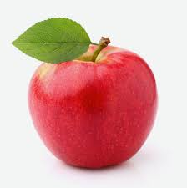
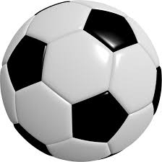
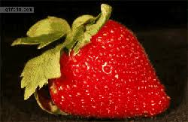
Let’s see some picture’s and count them

Slide 5
Today's lesson
Numbers

Slide 6
Learning outcomes
student’s will be able to:
2.1.1 recognige and read cardinal number up to 3.
2.1.1 write cardinal numbers up to 3 in fingers..

Slide 7
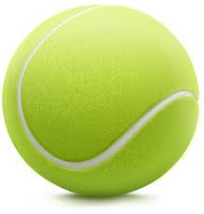
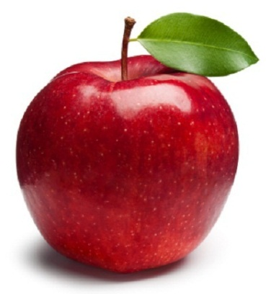

Input
How many balls and apples?
1
Ball
2
Apple
3
Ball

Slide 8
See the Numbers and count
1
2
3

Slide 9

Open your book page at 12

Slide 10
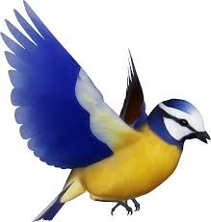
Practice
How many bird?
1

Slide 11
How many birds are there?
2

Slide 12
How many birds are there?
3

Slide 13
How many birds are there?
1
2
3

Slide 14
Write your exercise book(1-3).
1
2
3

Slide 15
Whole class work
Chain drill

Slide 16


c /L
Match the numbers with shapes
 | 2
 | 3
 | 1

Slide 17

Goodbye everybody

