Slide 1
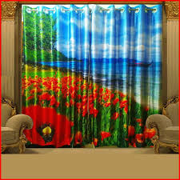

Slide 2
WELCOME

Slide 3
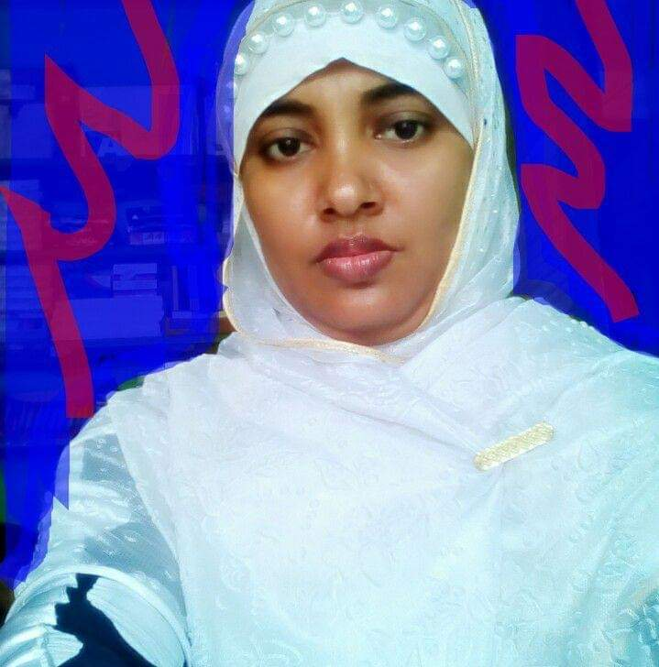
Teacher’s identity
Marina Akther
Assistant teacher
KB Govt Primary School
Begumgonj,Noakhali

Slide 4
Student will be able to :
2.1.1 write cardinal numbers
up to10 in figures.

Slide 5
Lets sing.
Number Song.

Slide 6
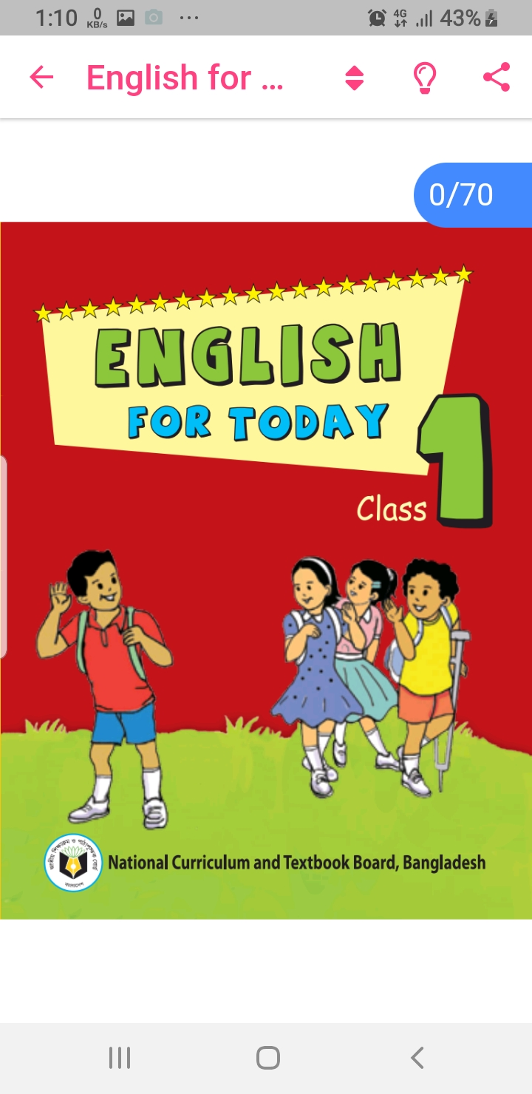
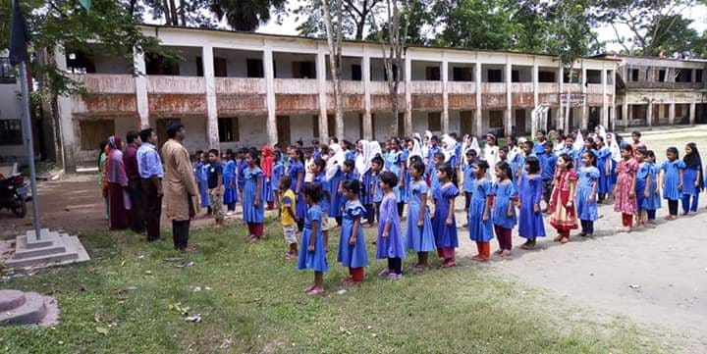
Open at page 40

Slide 7
Numbers 1-8

Slide 8
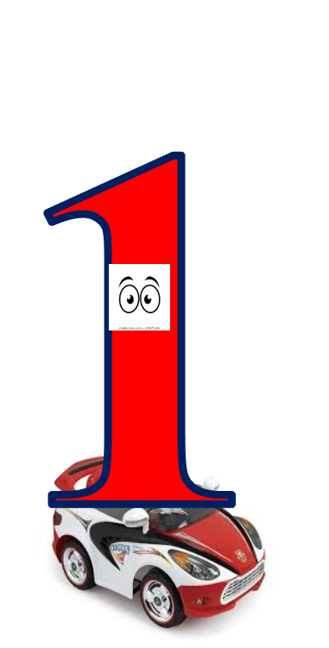
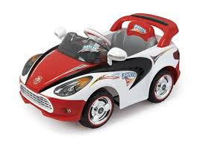
How many car?

Slide 9
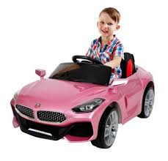

Slide 10
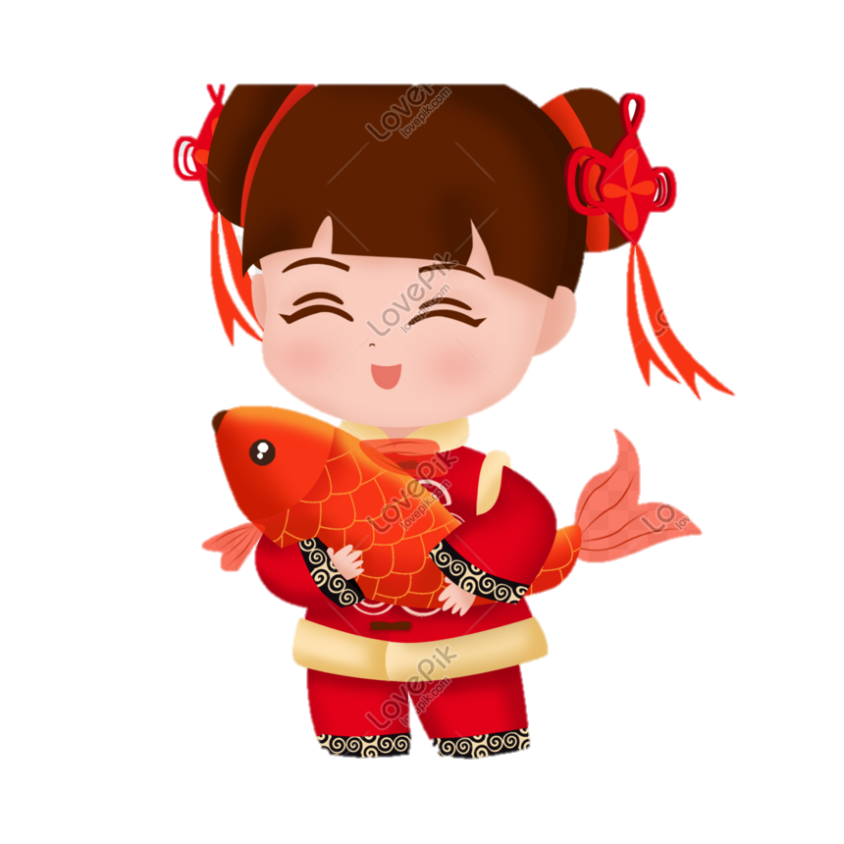
Let’s practice writing
1
2

Slide 11
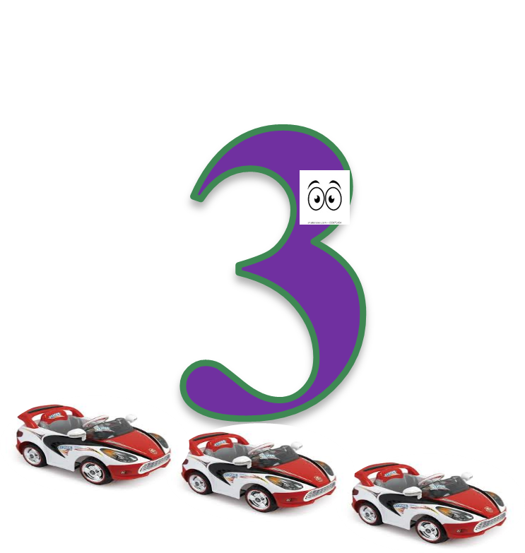
How many cars?

Slide 12
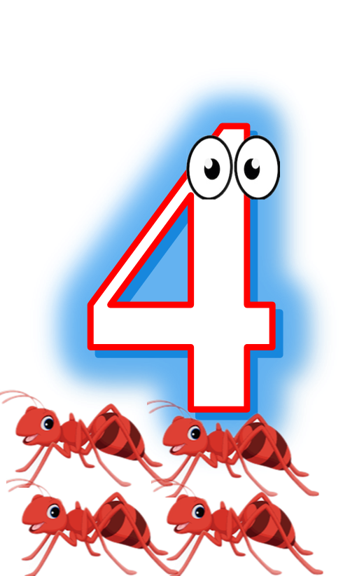
How many ants?

Slide 13
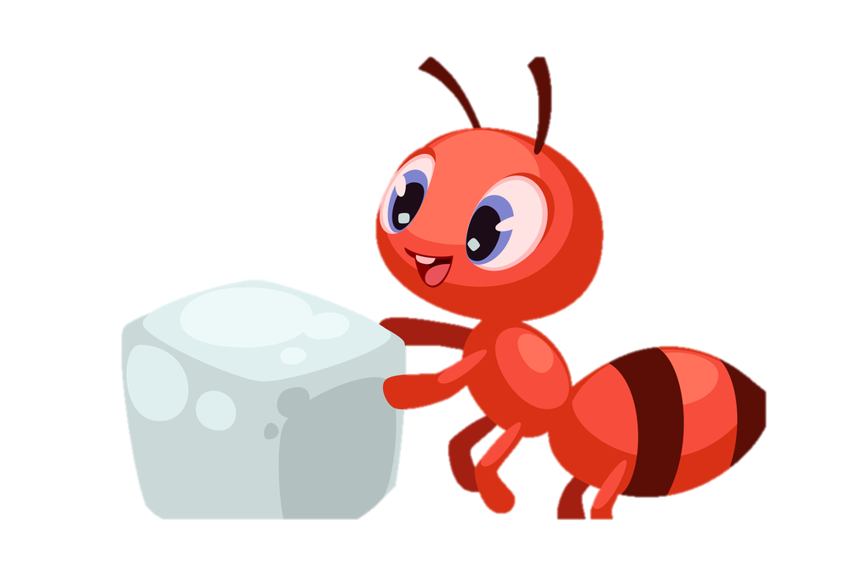
3
4

Slide 14
How many ducks?

Slide 15
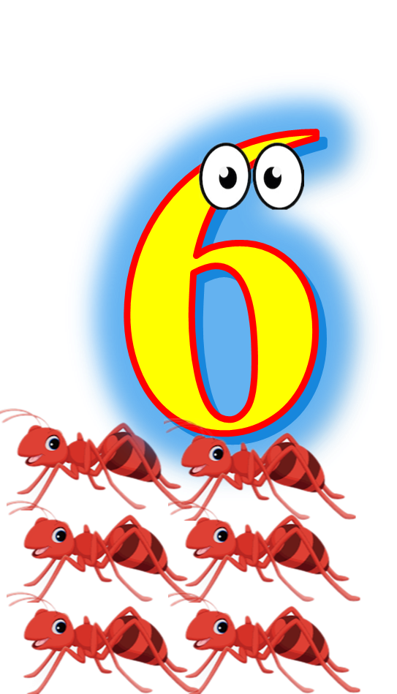

Slide 16
5
6

Slide 17
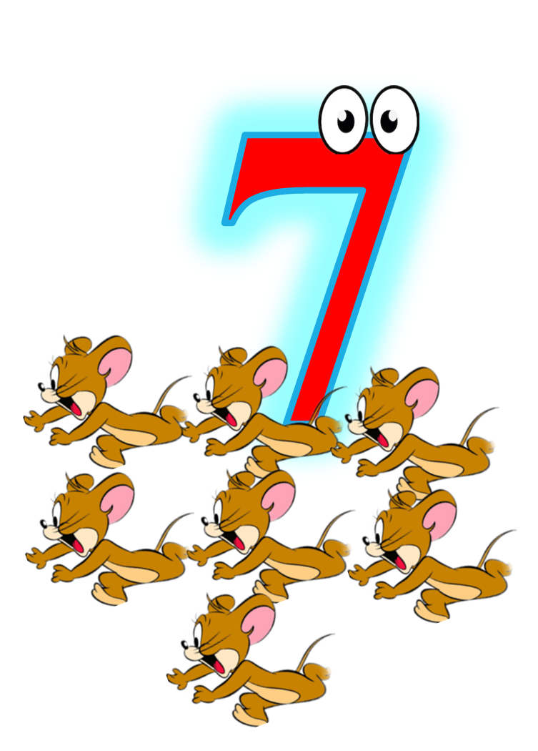
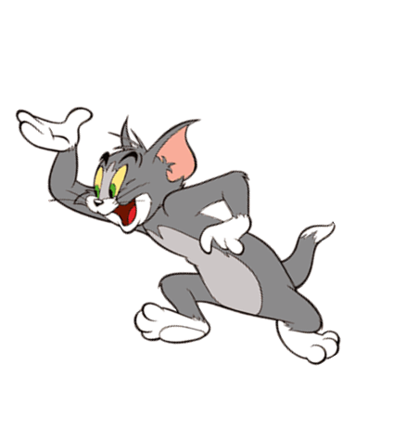
How many cats?

Slide 18
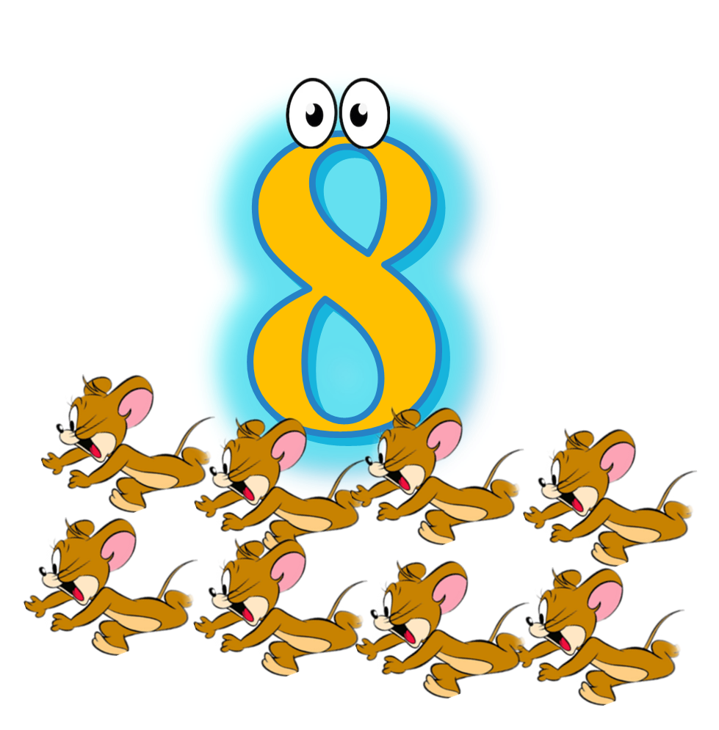
How many ants?

Slide 19
7
8

Slide 20
Count and write the numbers
1 2 3 4 5
6 7 8

Slide 21
Lets sing
Goodbye song.

Slide 22
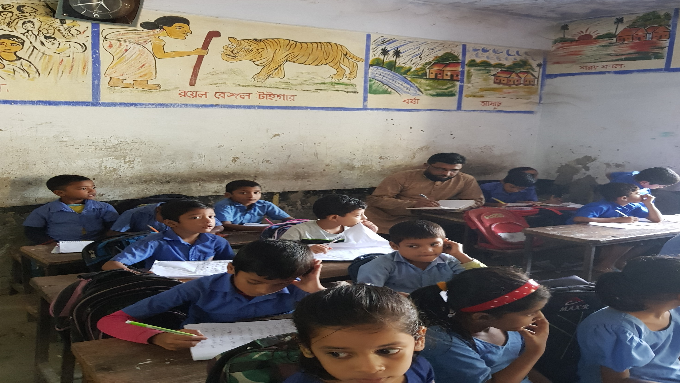
Thank you all

