Slide 1
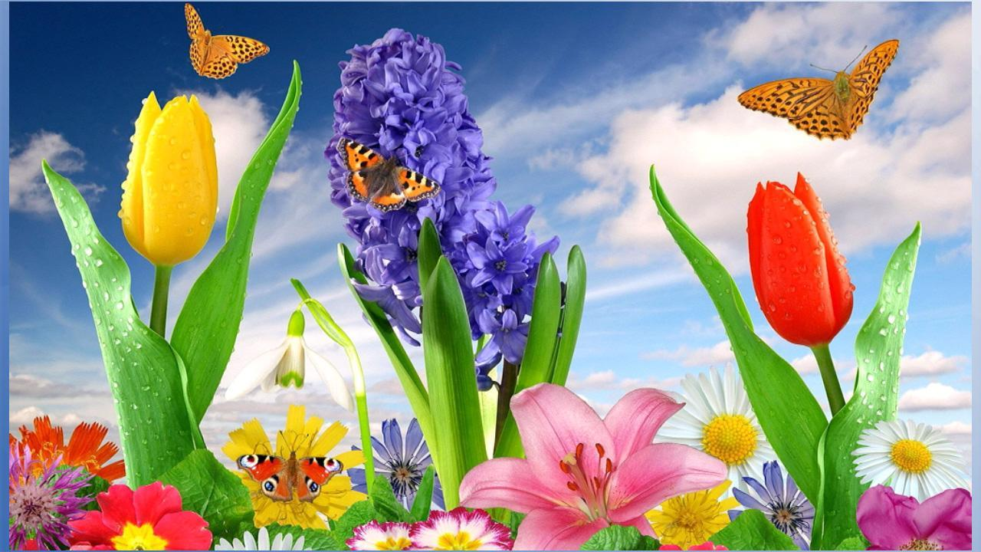
Welcome to all
WELCOME

Slide 2
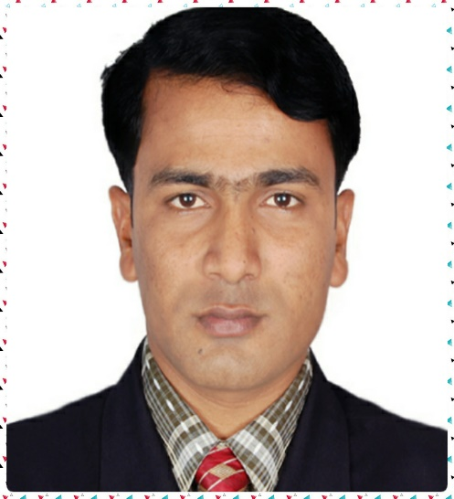
Presentation
For
Students of Class-8
Mhammed Rehan Uddin
ASSistant Teacher
Pakshail ideal high school
Barlekha,Moulvibazar
Email: mdrehanuddin17@gmail.com
Date :17/12/2020

Slide 3
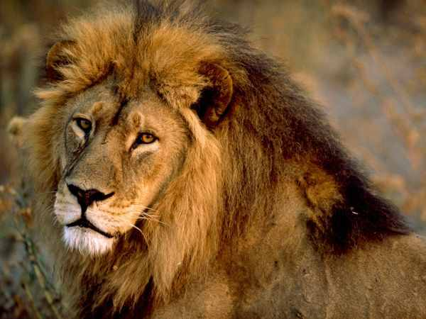
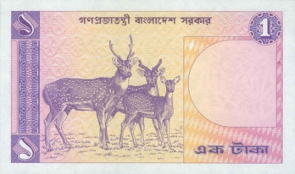
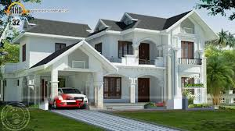
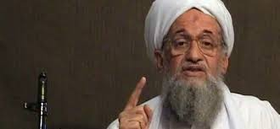
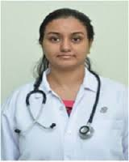
Look at the picture
A
lion
A
One-taka note
A
house
An
egg
An
honest
An
M.B.B.S

Slide 4
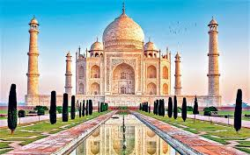
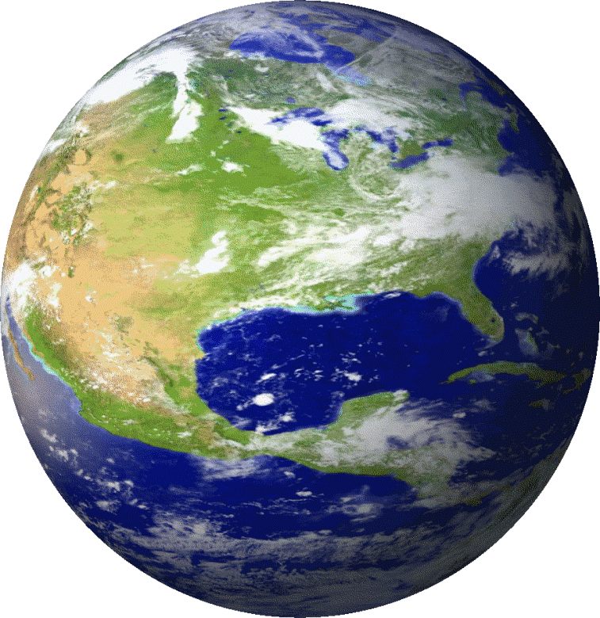
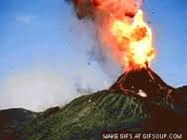
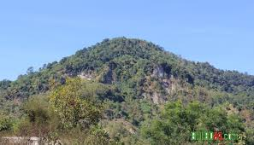
The
Quran
The
Tajmahol
The
Earth
The
Volcano
The
Hill

Slide 5
Lesson Title
Article

Slide 6
Learning outcome
Students will be able to-
What is article.
Kinds of articles.
Use of articles.

Slide 8
Articles: The three ‘a’, ‘an’ and the called articles, These are also Demonstrative Adjective.
Articles are of two types: 1. Indefinite Article
2. Definite Article.
Indefinite Article: ‘A’ or ‘An’ called Indefinite Article. They do not point out any person or object particularly. Such articles point out the nouns in general.
Definite Article: ‘The’ is termed as Definite Article. It points out any particular person or object, but not in general.

Slide 9
# What is article?
Article
# How many kinds of article?
# What is use?
Use of
Use of
1. Indefinite Article
2. Definite Article
man
moon
An
The
A
apple

Slide 10
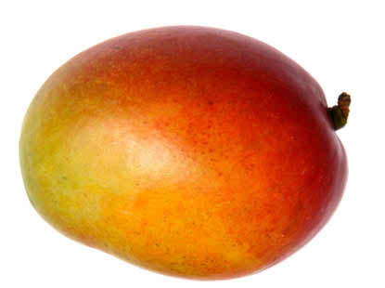
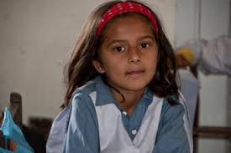
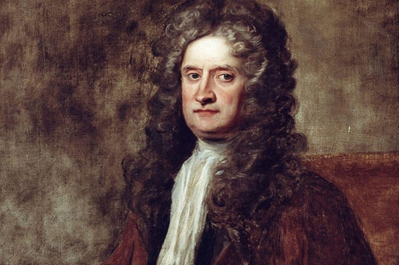
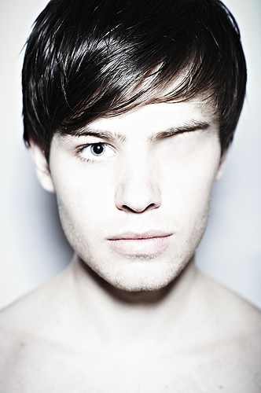
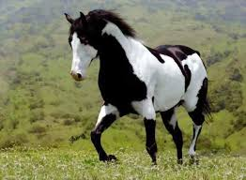
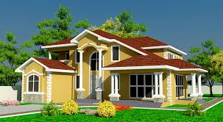
Use of ‘a’
__ mango
A
__ student
A
‘A’ is used before a word beginning with:
a consonant
__ European
A
A
vowel having the sound of ‘yu’ or ‘wa’
__ one-eyed man
sound ‘h’
__ horse
A
A
__ house
Here ‘a’ is indefinite article.

Slide 11
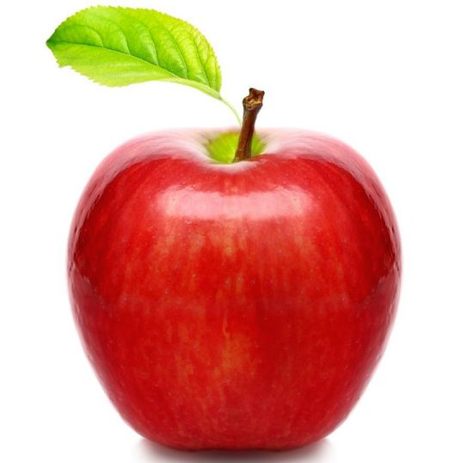
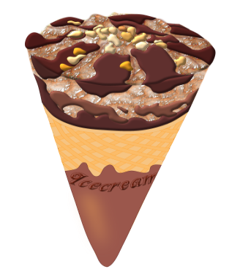
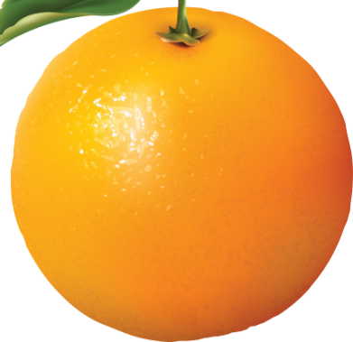
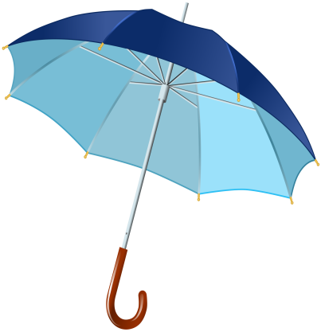
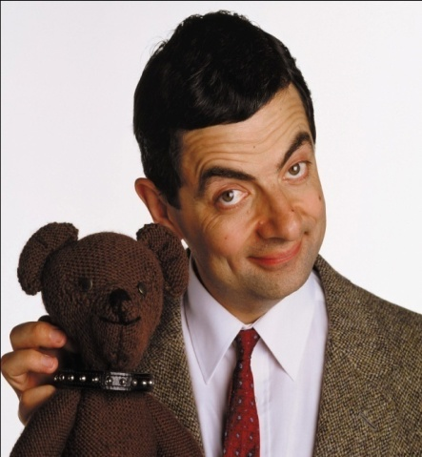
Use of ‘an’
An
___ apple
An
___ egg
___ ice-cream
An
‘An’ is used before a word beginning with:
a vowel (a, e, I, o, u)
consonant having the sound of ‘vowel
An
An
___ orange
___ umbrella
Silent ‘h’
An
An
Here ‘an’ is indefinite article.
___ M. A.
___ honourable person

Slide 12
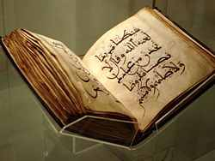
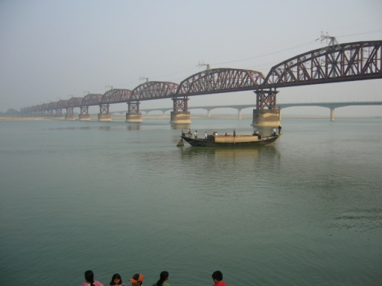
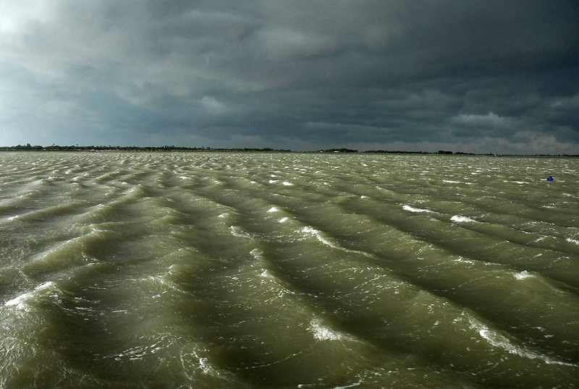
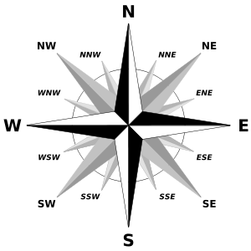
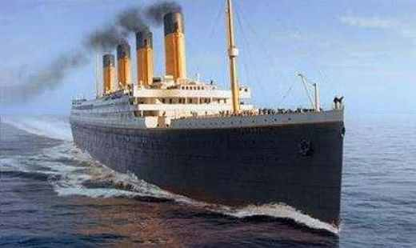
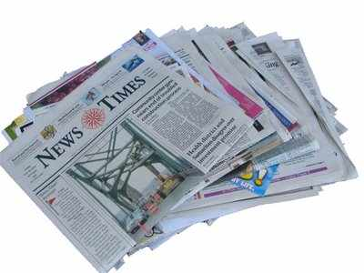
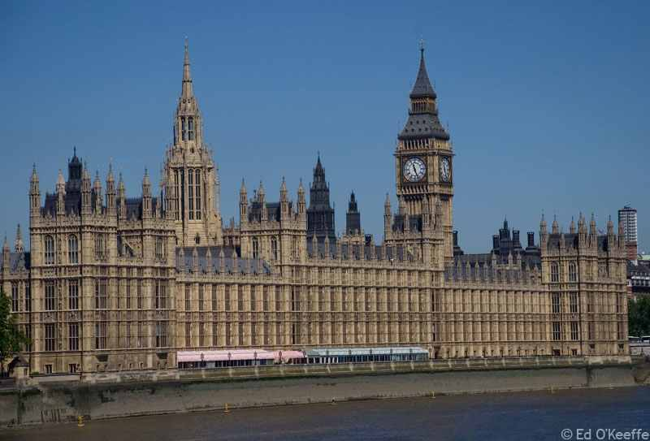
The
The
___ Quran
The
The
___ North
___ Padma
___ Bay of Bengal
The
The
___ Titanic
___ Bangladesh Times
The
___ Westminster palace
Here ‘The’ is definite article.

Slide 13
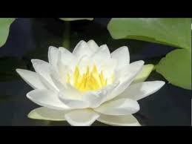
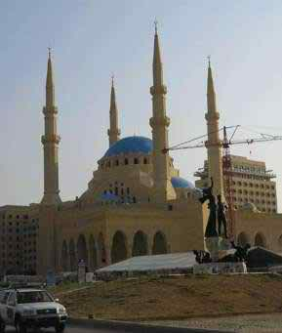
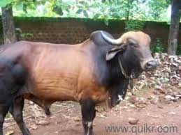
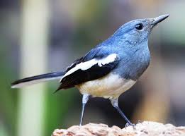
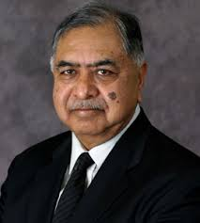
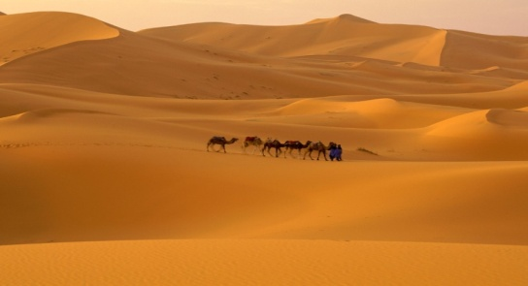
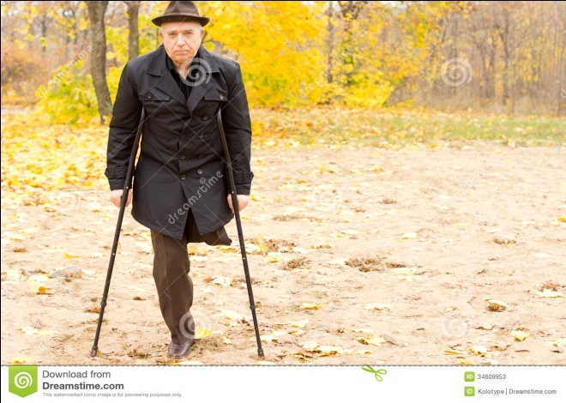
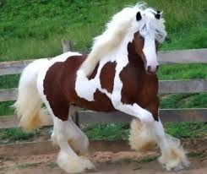
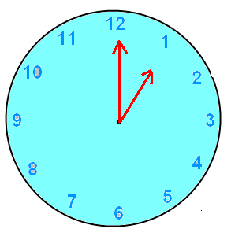
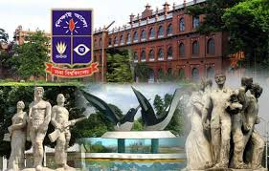
Single Work
Fill in the gaps with appropriate articles:
An
The
__ ox
The
A
___ Mosque
___ Jamuna Express
__ flower
___ Shahara
An
The
__ one-legged man
A
__ L. L. B
__ bird
A
A
The
__ horse
An
A
___ Bangladesh times
__ hour
__ university

Slide 14
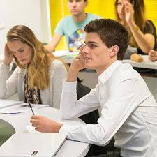
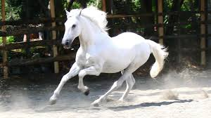
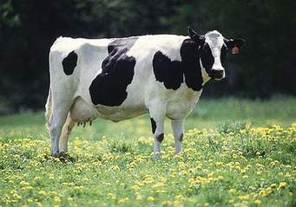
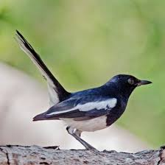
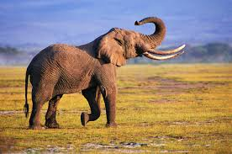
Pairs Work
___ Quran is __ holy book.
The
a
__ horse.
___ horse is __ beautiful animal.
A
The
a
A
__ cow.
___ cow gives us milk.
The
a
I saw __ bird.
___ bird is black.
The
An
___ Elephant.
___ Elephant is __ large animal.
The
a

Slide 15
Group Work
Group- A: Write the use of indefinite article:
Group- B: Write the use of definite article:

Slide 16
Use of indefinite article: A, An
Use of A
Use of An
word এর প্রথম consonant letter হলে তাহার পূর্বে a বসে।
I saw a bird.
word এর প্রথম letter vowel থাকা সত্বেও যদি ‘ইউ’ বা ‘অয়া’ -এর মত উচ্চারণ হয়, তবে তাহার পূর্বে a বসে।
She is a University.
word এর প্রথম letter ‘H’ (হ) উচ্চারিত হয়, তবে তাহার পূর্বে a বসে।
He is a historian.
word এর প্রথম vowel letter হলে তাহার পূর্বে an বসে।
I do not like an idle man.
word এর প্রথম letter consonant থাকা সত্বেও যদি vowel -এর মত উচ্চারণ হয়, তবে তাহার পূর্বে an বসে।
He is an M.A.
word এর প্রথম letter ‘H’ (হ) উচ্চারিত না হলে, তবে তাহার পূর্বে an বসে।
I can do it in an hour.

Slide 17
Use of definite article: The
নির্দিষ্ট ব্যক্তি বা বস্তু, জাতি, সম্প্রদায়, গোষ্ঠী, দল, ভৌগোলিক নাম বা স্থান, প্রসিদ্ধ প্রতিষ্ঠান, ঐতিহাসিক ঘটনা, সংবাদপত্রের নাম, তারিখ, ঋতু, দিক, প্রকৃতির নিদর্শণ ( নদী, পাহাড়), সৌরজগতের (গ্রহ, উপগ্রহ, নক্ষত্র ) জাহাজ, ধর্মগ্রন্থ ইত্যাদির পূর্বে The বসে।
1. The girl is laughing.
2. The roses a lovely flower.
3. The Quran is a holy book.
4. The sun rises in the east. etc

Slide 18
Evaluation
FIll in the blanks with appropriate article:
She is __ beauty
Give me __one-taka note.
Ferdousi is __ homer of Asia.
He is ___ unwise man.
Prity is ___ M.B.B.S.
She is ___ honours graduate.
____ Bay of Bengal is dangerous.
a
a
a
an
an
an
The

Slide 19
Home Work
Fill in the gaps of the following text with appropriate articles. Put a cross for zero article:
English is (a) __ international language. It is spoken all over (b) ___ world. So the importance of (c) __ English cannot be described in words. All (d) ___ books of higher education are written in English. Today organization need employees who can speak and write (e) _____ standard form of (f) __ English.
an
the
×
the
a/the
×

Slide 20
Read
Attentively
Thank you

Slide 21
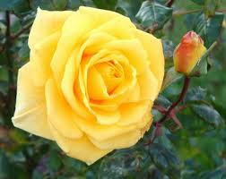
Next Class
Continue….
Please don’t show next slide.
Only for next class continue…..

Slide 22
Fill in the gaps of the following text with appropriate articles. Put a cross for zero article : [ D. R. J. C. Ch. S. B. D. B- j s c/14] .5×6= 3
1.Always speak (a) ___ truth. Never tell (b) __ lie . Nobody believes (c) __ liar. Even if he is (d) __ truthful he is considered to he (e) __ liar. Nobody in (f) ___ world is as unfortunate as he.
2. Each and every student wants to make a good result. But it is not (a) __ easy task. (b) __ student has to do something for this. From (c) ___ very beginning he must be very serious. He should read (d) ___ texts again and again. He must not make (e) __ motes from (f) __ common source.
the
a
a
×
a
the
an
A
the
the
×
a

Slide 23
an
3. A few days ago I enjoyed (a) ___ interesting football (b) __ match. It was played between (c) ___ top two teams. Argentina and Germany. On (d) ___ day of the match, I went to (e) ___ Stadium quite early. I stood in the line and bought (f) __ ticket.
4. Mr. Karim is am English (a) __ teacher. He is (b) ___ M.A. in English. He serves in (c) __ famous institution. He tries to lead (d) ___ honest life. He is (e) ___ most favorite teacher (f) __ to the students.
5. A true friend is (a) __ asset. Hje stands by his friend in time of (b) __ famger Normally he is not (c) __ greedy person. He always wishes for (d) ___ welfare of his friend. But it is (e) __ matter of fact that (f) __ ideal friend is very rare today.
×
the
the
the
a
×
an
a
an
the
×
an
×
a
the
a
an

Slide 24
An/The
×
6. (a) ______ ant is an industrious (b) __ insect. No other insect is as industrious like (c) __ ant. If we open (d) ___ pages of history, we shall see that (e) ___ men who have become great in (f) ___ world were industrious.
7. Dhaka is (a) ___ capital of Bangladesh. It is (b) __ old city people of different communities live in (c) ___ city. Their ways of life are (d) __ quite different. So, their occupations are not ( e) ___ same. Most of the people lead (f) __ very hard life here.
8. We live in an age of (a) __ science. Newspaper is (b) __wonder of modern science. Newspaper is (c) __ paper which carries news of (d) ___ whole world. It is such (e) __ important thing that we cannot go (f) __ single day without it.
an
The
the
the
the
an
the
×
the
a
×
a
a
the
an
a

