Slide 2
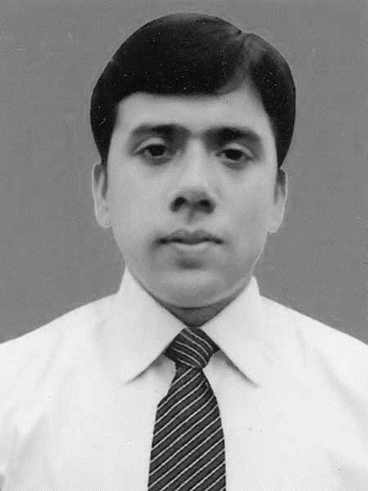
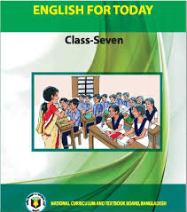
Identity
Md. Robiul Islam
Assistant Teacher English
Pioneer Girls’ High School, Khulna
ICT4E Ambassador,
Khulna Sadar , Khulna.

Slide 3
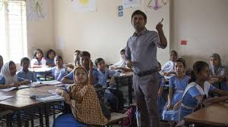
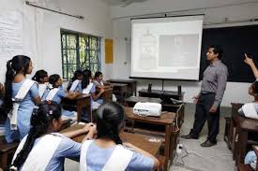

Slide 4
Where do the students and teacher locate?
They are in the classroom.

Slide 5
Today we are going to read about-
Unit- One ( Attention, please)
Lesson – One ( In the classroom)

Slide 6
After we have studied this lesson, we will be able to -
Exchange greeting.
Ask and answer questions.

Slide 7
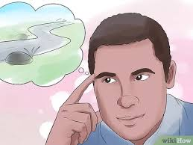
To be able to bring back a piece of information into your mind, or to keep a piece of information in your memory.
Remember
Verb
Can you remember what her phone number is?
Antonym
Forget

Slide 8
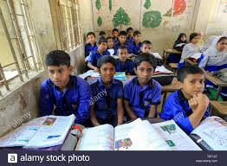
Classmate
Someone who is in the same class as you at school.
Noun
Rafsan is taller than most of her classmates.
Antonym
Be out of class

Slide 9
A. Listen and say.
Good morning and welcome everybody.
Good morning, teacher.
Are you ready for the class?
Yes, teacher.
Have you got your new books?
Yes, teacher, we have.
Good! Please remember to bring your English book every day. And speak English with me and with your classmates.

Slide 10
B. Read the conversation and act it out in pairs. Discuss this question with your partner.
What does the teacher ask the students to do?
The teacher asks the students remember to bring their English book every day. And speak English with me and with your classmates.

Slide 11
C. Now answer these questions.
1. Do you speak English with your teacher? If you do, when and how often?
Yes, I speak English with my teacher. Always in my class time I speak English with my teacher.
2. Do you speak English With your friends and classmates? How often?
Yes, I speak English with my friends and classmates. When I stay in my class I usually use English with my classmates and when I stay outside my classroom I usually use English with my friends to express our feelings and emotions.

Slide 12
3. If you speak English outside the class , where do you speak it ?
Yes, I speak English outside the class, in the play ground I use English with my friends and coach.
4. Do you watch any English program on TV? What programs do you watch?
Yes, I watch English program on TV. I watch BBC English Janala and watch news in English daily. I also watch English Debate program.

