Slide 2
W
E
L
C
O
W
E
Notes:
Greeting slide

Slide 3
Introduction
Class: Eight
Subject: English 2nd paper
Unite- 1
Lesson: 8
Time: 45 ms
Date: 03/11/2020
Md. Golam Kabir (B s s,B Ed)
Assistant teacher( Social Science )
Boalia Boirtola Dakhil Madrasah
Boalia, Gomastapur, Chapai Nowabgong
Email-golamka637@gmail.com
Mobile-01799112953
Notes:
Introduction slide

Slide 4
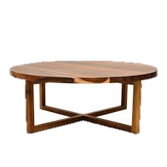
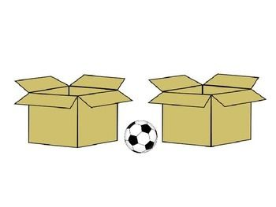
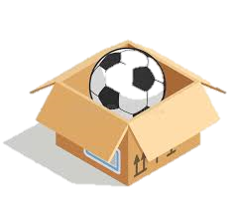
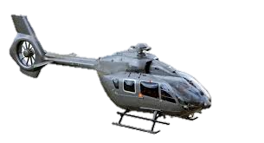
Where is the cat ?
Where is the ball ?
On
in
Under
Between
Where is flying the copter ?
Over the river
Where is the home and others scenery ?
Beside
Notes:
Preparation slide

Slide 5
Notes:
Presentation slide

Slide 6
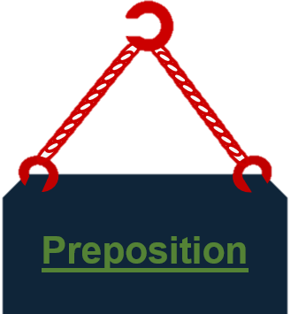
Notes:
Lesson declaration slide

Slide 7
Learning outcome
After studied this lesson the students will be able to---
state the definition of a preposition
recognize preposition and their object
recognize prepositional phrase
use prepositions to write complete sentences .
Notes:
Learning outcome slide

Slide 9
Look at the list of prepositions below
A list of Preposition
About | সম্পর্ক/প্রায় | Down | নিচে | Of | র/ এর
Above | উপরে | Due to | কারণে | Off | দূরে /বাহিরে
Across | আড়াআড়ী ভাবে | During | ঐ সময়ে | On account of | কারণে
After | পরে | Except | ব্যতীত | On behalf of | পক্ষে
Against | বিরুদ্ধে | For | জন্য | On | উপরে
Ahead | সামনে | For want of | অভাবে | Out | বাহিরে
Along | বরাবর | From | হইতে | Out of | বাহিরে
Among | অনেকের মধ্যে | In front of | সামনে | Over | উপর দিকে
Around | চারিদিকে | In | মধ্যে | Past | অতিক্রম
At | তে/প্রতি | In lieu of | পরিবর্তে | Per | প্রতি
Away | দূরে | In order of | জন্যে | Providing | সম্পর্কে
Back | পিছনে | In spite of | সত্বেও | Since | হইতে
Because of | কারণে | Instead of | পরিবর্তে | Then | চেয়ে
Before | পুর্বে/সামনে | In the back of | পিছনে | Through | মধ্য দিয়ে
Behind | পিছনে | With | দ্বারা/সাথে | Till/until | পর্যন্ত /পর্যন্ত না
Below | নীচে | in the habit of | অভ্যাস্ত | Together | একত্রে
Besides | তাছাড়া | At/in the corner | এক কোনায় | Towards | দিকে
Beside | পার্শে | Into | বাহির থেকে ভিতরে | Throughout | সম্পুর্ন্র রূপে
Between | দুয়ের মধ্যে | Like | মত | To | দিকে/প্রতি
Bottom | নিচে | Nearby | নিকটে | Top | উপরে
But | কিন্তু | Next | নিকটবর্তী | Under | নিচে
By | দ্বারা | With | উদ্দেশ্যে | upon | উপরে

Slide 10
Read the passage and note the preposition
from
of
to
Now,Match your answer.
in
with
for
Our environment comes from water, air, animals , wastes , plants , and others things that surround us. The environment is a combination of many things . All the things in the environment relate with each other to give us what we need for survival. The environment is important and we should all aim to protect it by avoiding bad practices such as pollution , cutting down of trees and any others human activities that causes the degradation of the environment ,being aware of surroundings helps us take the right steps to protect it . As living things we interact with the environment and not just live in it . Natural disasters such as earthquakes , landslides, etc , affect the environment. The environment need to be protected by all means and right measures need to be taken to lessen the damage that natural disasters cause.
by
down

Slide 11
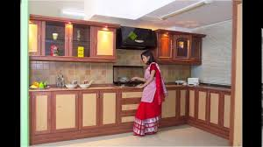
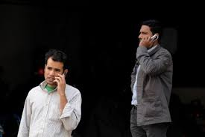
Preposition of place:
In, at, on are the most common prepositions of place
1.These preposition used to say where something or someone is or where is action takes place.
I was in the kitchen when you phoned.
I’ll be at home from seven this evening.
The keys are on the kitchen table.

Slide 12
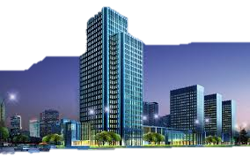
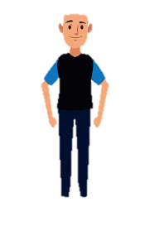
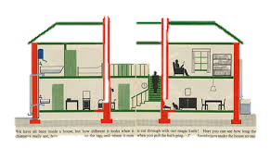
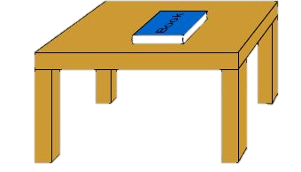
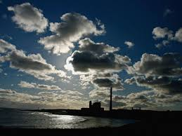
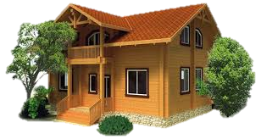
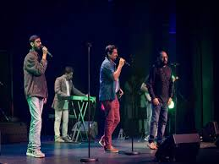
2. Look at more example about use of preposition
I was outside the building.
I could see people inside it.
Your cat is under the table.
There were clouds above us.
There is a tree in front of the house.
The drummer was behind other musicians.

Slide 13
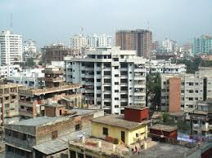
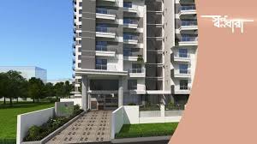
Look at the following example:
1. We use in with streets, cities districts, and countries:
.She live in Eskaton/ in Dhaka/ in Bangladesh.
We use in the with regions (the north,etc):
They live in the south of Spain.
We use at with addresses:
I live at 20, New Eskaton.

Slide 14
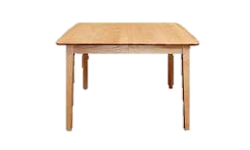
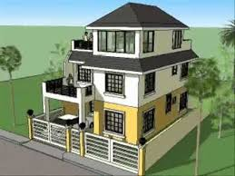
2. We use in the with room:
My mom is in the kitchen room.
We use in a / an /the/my etc. with other enclosed places:
She give me the letter in an envelop.
My dresses are in the cupboard.
We use on the with surfaces:
There was dust on the floor.
We use on the second floor, etc. to talk about part of a building:
My flat is on the third floor.

Slide 15
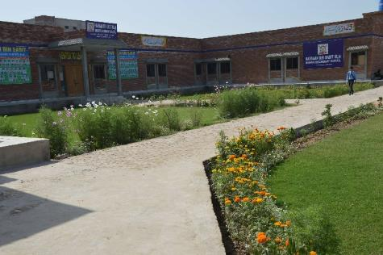
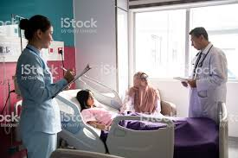
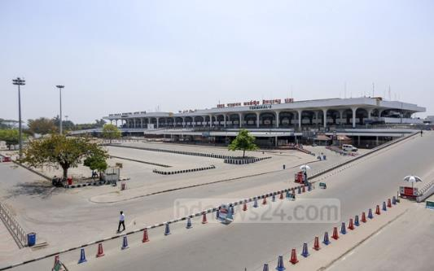
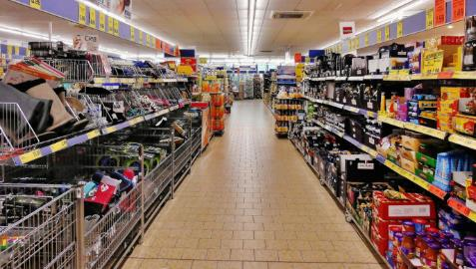
3. We use at home, at work ,at school, at university to talk about being in the place where we live, work or study
Such as example-
I was at work/ at home yesterday.
Sabit is at school an he will be taking his exams soon.
But we say in hospital, in prison to talk about a patient or a prisoner in those place:
Fatima is very ill and she is in hospital.
4. We use at the to describe being in or using a building:
Some friends meet me at the airport.
You can buy this at the super market.

Slide 16
Read the following example with your partner and try to find out the differences.
I go to work by car.
We went to home by bus.
He walked out of the house.
He got into his car.
He drove up a hill.
He drove down the hill.
He drove around the corner.

Slide 19
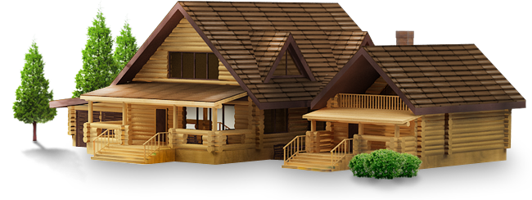
Home work
Write a paragraph to describe your home and underline the prepositions

Slide 20
Thank you for attentive

