Slide 2
Identity of Teacher
Name:Saiyatul Zannat.
Assistant Teacher
Hashimpur Mollapara Govt. Primary School.
Chirirbondor,Dinajpur.

Slide 3
Introduction of Lesson
Class:Three
Sub:English
Unit1.
Lesson:4(Introducing a student)

Slide 4
Learning Outcomes
By the end of the lesson the student will be able to-
Listening:
3.1.1-Understand simple questions about students , family and friends.
Speaking:
6.2.1-Talk about people and objects.
Reading:
1.5.1-Read simple sentence with proper pronunciation and stress.
Writing:
3.1.1-Write words , phrases and sentences using non cursive capital letters.

Slide 5
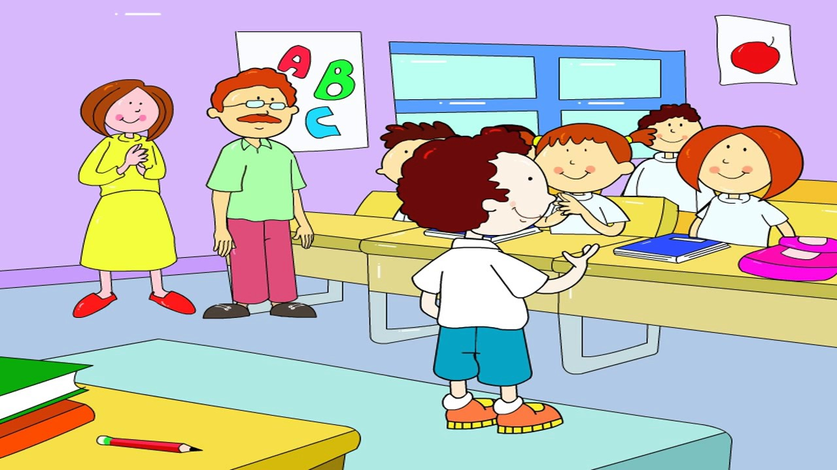
Introducing a student

Slide 6
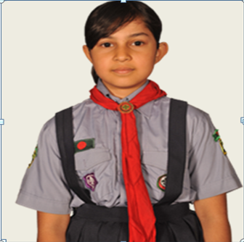
Hello ! I’m Riya Islam.

Slide 7
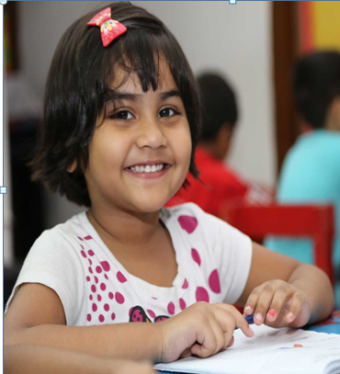
I’m 8 years old.

Slide 8
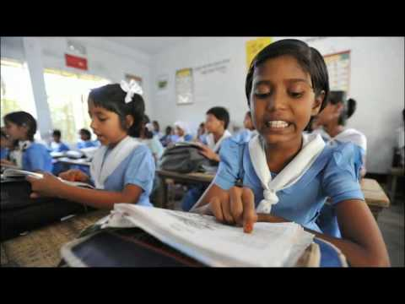
I’m a student.

Slide 9
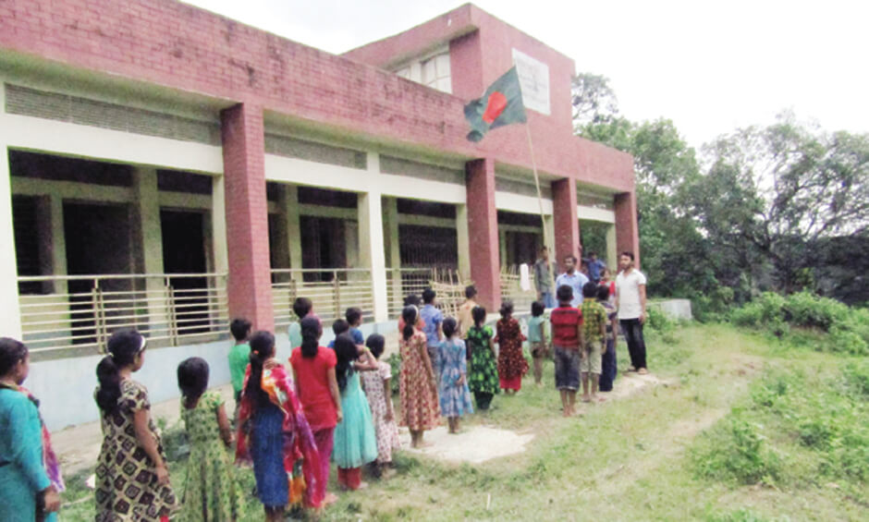
I’m in class 3 at Rajbari
Primary school.

Slide 10
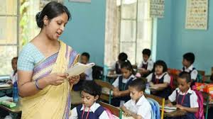
Teacher’s Reading

Slide 11
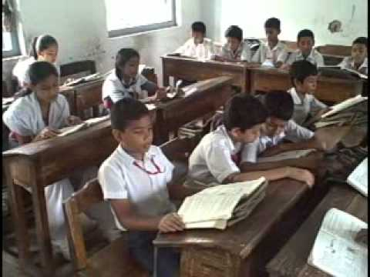
Student’s reading

Slide 12
Word meaning
Year
Twelve month
Student
Pupil
class
Category
Primary
Elementary

Slide 13
Pair Work
Students will read the text in a pair.

Slide 14
Evaluation

Slide 15
Evaluation
Write 4 sentences about yourself.

Slide 16
Thank you

