Slide 3
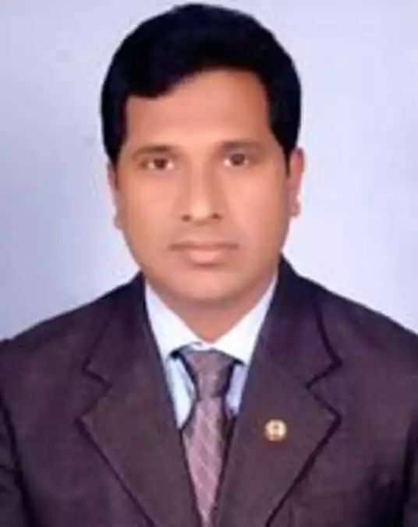
Teachers Identity
Mohammad Jahangir Alam
Senior Teacher
Kaptai Al amin Nuria Dakhil Madrasah
Master Trainer
TCG
LSBE
Teaching Science in Practical Manner
Rangamati .
Cell. 01815411762
Email. mjahangirkaptai@gmail.com

Slide 4
Lesson’s Identity
Subject :

Slide 5
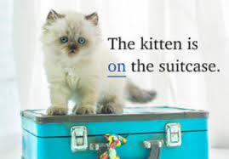

Slide 6
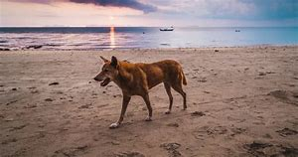
A DOG IS WALKING BESIDE A RIVER.

Slide 7
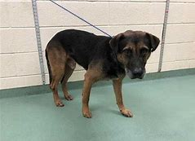
A DOG IS HOLDING WITH A CHAIN.

Slide 8
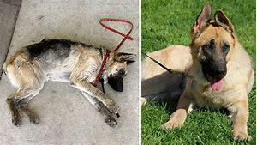
TWO DOGS ARE ON THE GROUND.

Slide 9
THE LESSON OF TODAY

Slide 10
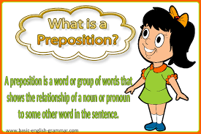
A preposition is a word or group or words that shows the relationship of a noun or pronoun to some other word in the sentence.

Slide 11
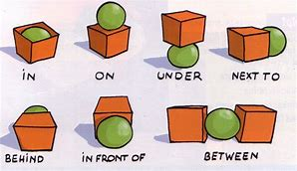

Slide 12
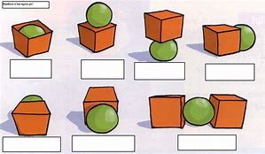
NOW ANSWER THE QUESTIONS

Slide 13
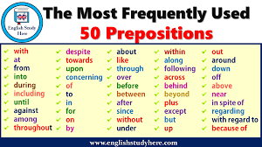

Slide 16
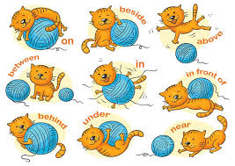
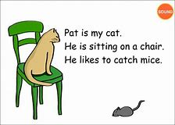

Slide 17
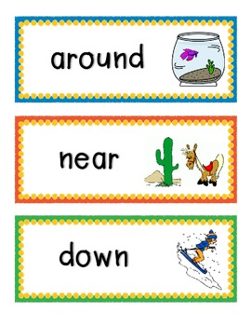
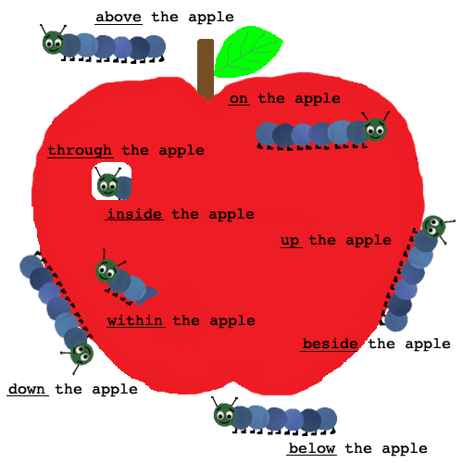

Slide 18
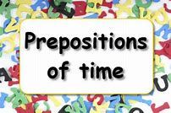
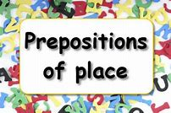
Our madrasah starts at 9 o’clock and breaks up at 3 o’clock.
In summer, it is difficult for us to stay at madrasah for so long time.
He lives at Kaptai in Rangamati. Rangamati is in Bangladesh.

Slide 19
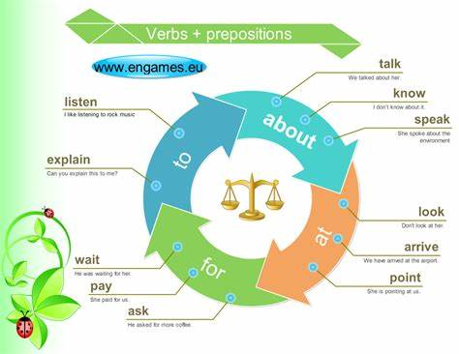

Slide 20
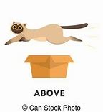
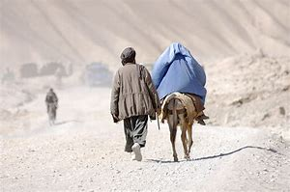
The cat is flying above high.
Which is the best among those phone?
They were walking through a forest.

Slide 21
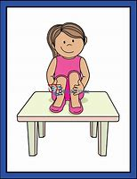
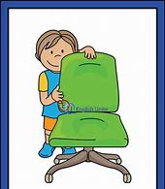
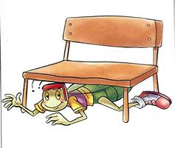
The girl is ---the table.
The baby is-----the chair.
The boy is -----the bench.

Slide 22
A
Make five sentences
use of
At /in/ on
B
Make five sentences use of
Above/ over/ among

Slide 23
1. I am waiting—you.
2. Look ---the picture.
3. Listen---me what I say.
4. Whom do you talking----?
5.When does he arrive---the station?
6. I am looking---a good job.
7. Point---the window.
8. Do you know much ---him?
9. I paid---the bill.
10. He ask---money.

