Slide 2
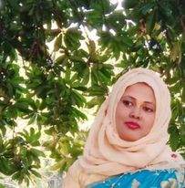
Teacher’s Introduction
Mst.Sharmin Akter
Assistant teacher
Matoin Govt. Primary School
Hajigonj, Chandpur
E-mail:
mstsharminakter1985@gmail.com

Slide 3
Lesson Identity
Class :Four
Subject : English
Lesson : 1-2(A)
Unit: 23
Time : 40 min

Slide 4
Learning Outcomes
Student’s will be able to-
Listening:1.1.1-become familiar with English sounds by listening to common English word.
Speaking:1.1.2-say simple words and phrases with proper sounds and stress.
Reading:1.4.1-read words and phrases with the help of visual clause (about 30 new words) and simple sentences.

Slide 5
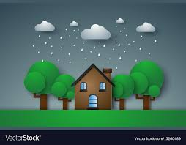
Describe the picture.

Slide 6
Todays lesson topic
Write well 1

Slide 7
Input

Slide 8
home
talk
live
run
rain
happy
N
E
W
W
O
R
D
S

Slide 9
house
home

Slide 10
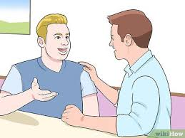
conversation
talk

Slide 11
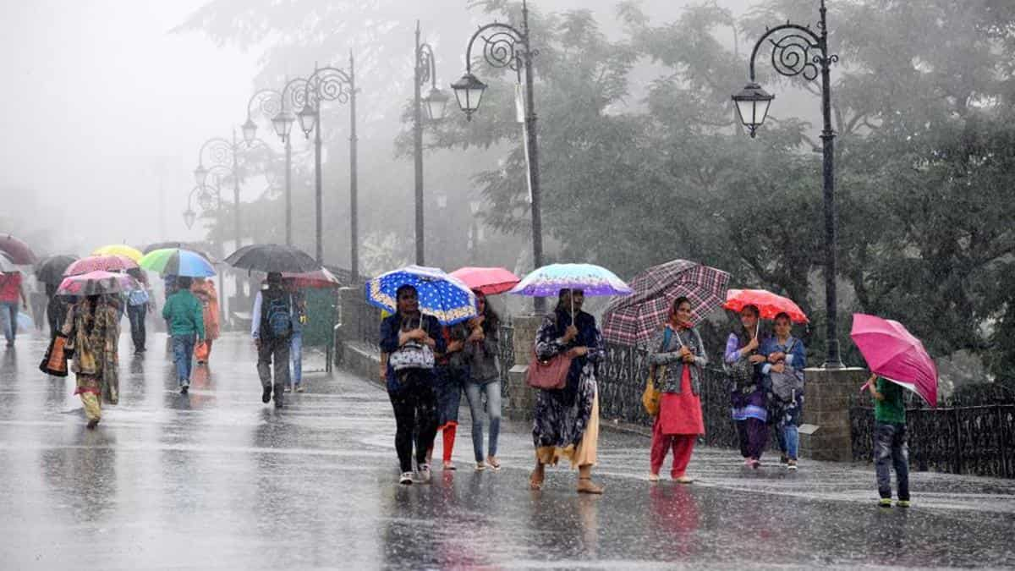
Moisture condensed from the atmosphere that falls visibly in drops.
rain

Slide 12
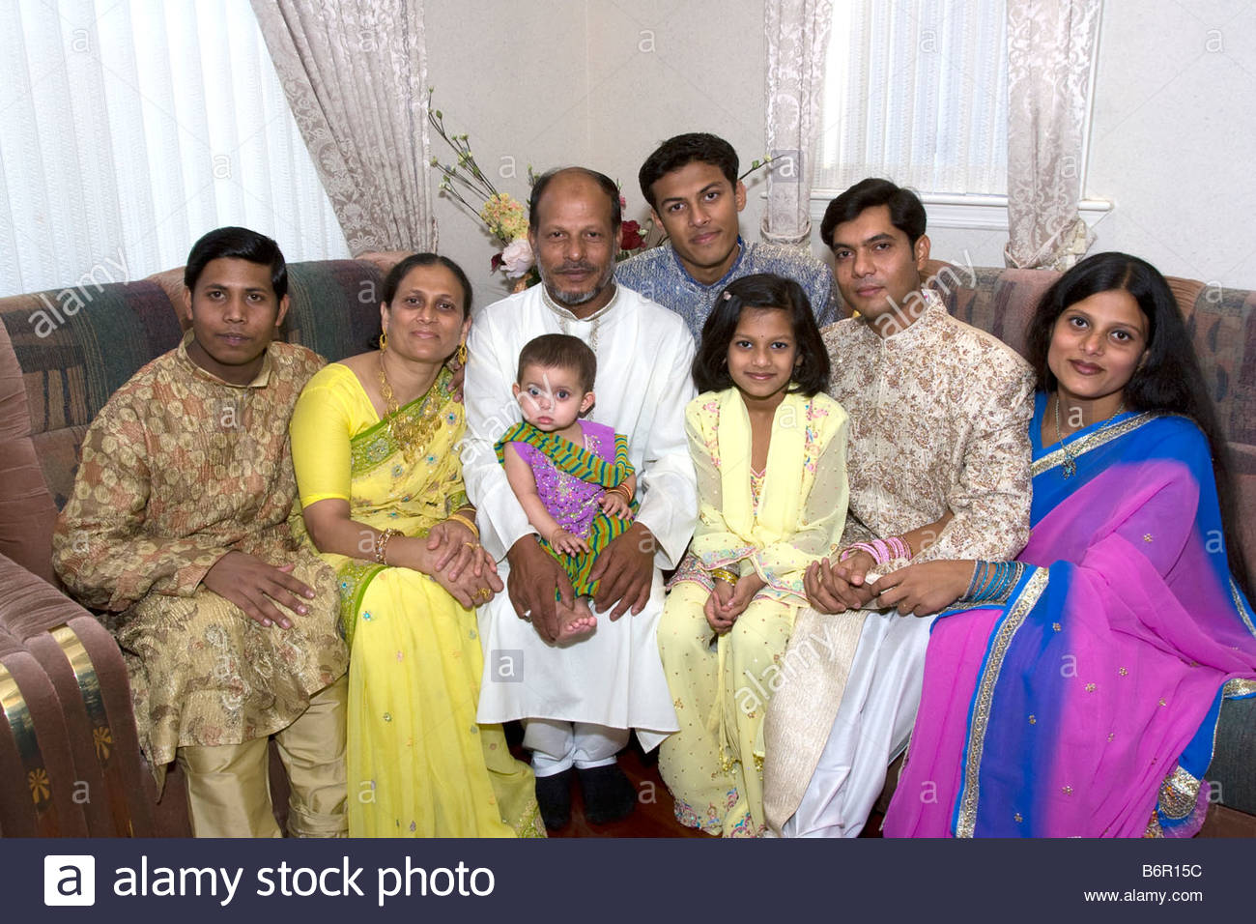
dwell
live

Slide 13
Move fast
run

Slide 14
glad
happy

Slide 15
Open your book at page 46.

Slide 16
Teacher’s reading

Slide 17
Practice

Slide 18
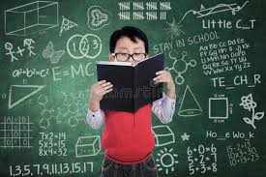
Student`s reading

Slide 19
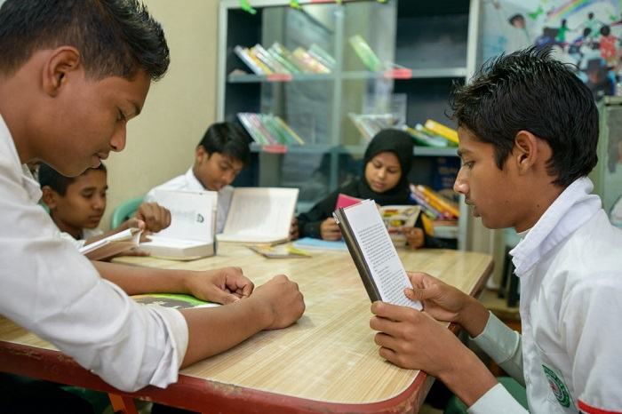
Group reading

Slide 20
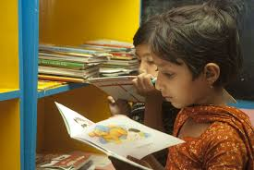
Silent Reading
5 minutes

Slide 21
evaluation

Slide 22
Questions
1.Where does Shihab live ?
2.What heppen suddenly?
3How fill is his mother?

Slide 23
Answer `s
Shihab lives in Dhaka.
2.Suddenly it starts raining.
3.His mother is very happy.

Slide 24
Now we will play “BINGO” game
live
start
close
window
run
happy
rain
home

Slide 25
task
Write five sentences about how can you help your mother?

Slide 26
thanks

