Slide 1

Welcome to all

Slide 2
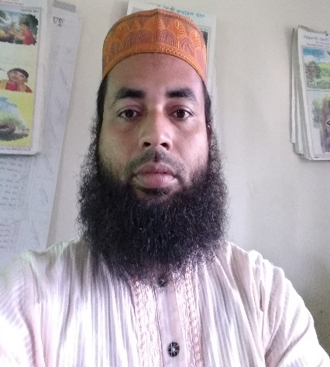
Teacher’s Identity
Md. Afzal Hossain
Assistant teacher
Kuralia Govt. Primary School
Madhupur, Tangail.

Slide 3
Lesson’s Identity
Class: Five
Subject: English
Unit: 3
Lesson: 1-2
Title’s of the Unit: Saikat’s family
Date:20-12-20

Slide 4
Learning out comes
The students will be able to-
Listening
1.1.1. recognize sound differences in the context of words.
1.2.1. recognize which syllable in a word is stressed.
Speaking
1.1.1. repeat after the teacher and say words, phrases and sentences with proper sounds, stress and intonation.
Reading
1.4.1. read, words, phrases and sentences in the text with proper pronunciation, stress and intonation.

Slide 5
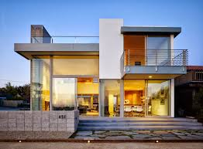
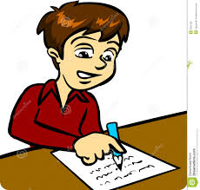
Let’s see some pictures
A family
A flat
He writes stories.

Slide 6


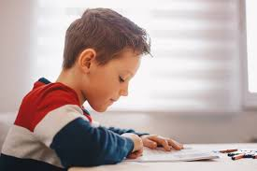
She sews.
He watches cartoons on TV.
He reads books.

Slide 7
Todays lesson
Saikat’s family

Slide 8
Open your book at page 10.

Slide 9
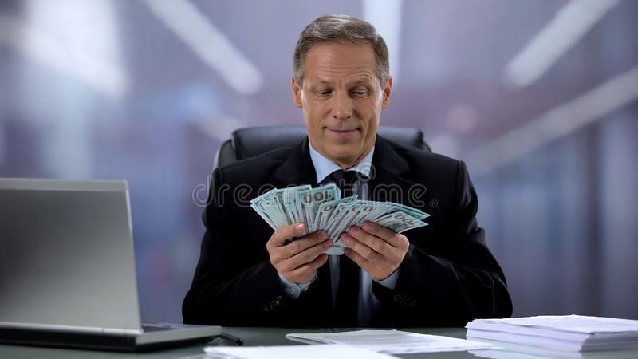
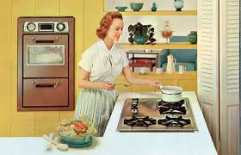
Let’s see some new words:
Flat
Living house in town.
A person who works in a bank.
Banker
House wife
Home maker.

Slide 10
Free time
Off time/ leisure time
Enjoy
Get pleasure
Neighbours
Who lives near to us.
Improve
Make better
Cartoon
A comical drawing

Slide 11
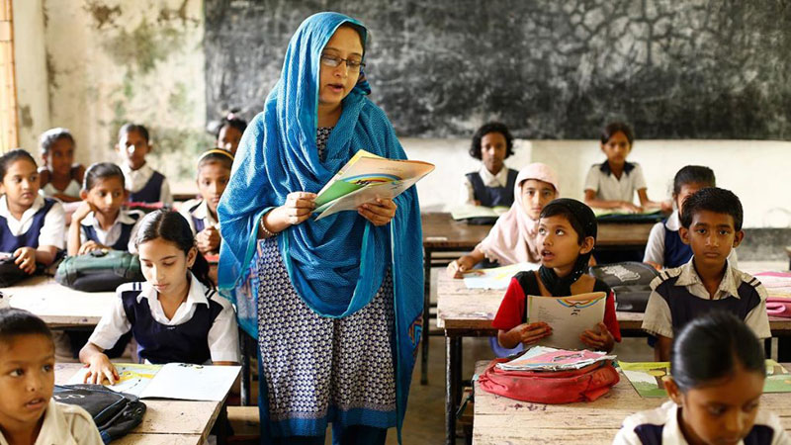
Teacher’s loud reading

Slide 12
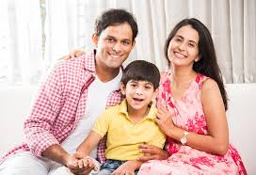
Now, read with pictures
Saikat Islam lives with his parents in a flat in Bogura.

Slide 13
His father Mr. Rashidul Islam is a banker.
But, in his free time Mr. Islam writes stories and listens to music.

Slide 14
Saikat’s mother is Mrs. Monwara Islam. She is a housewife.
In her free time she enjoys sewing. She makes dresses. She often gets orders from her friends and neighbours.

Slide 15
Saikat is a student in class 5. He is a good student. He wants to improve his English, so he watches cartoons on TV everyday.
He also reads English books. He likes books about animals, especially tigers and lions.

Slide 16
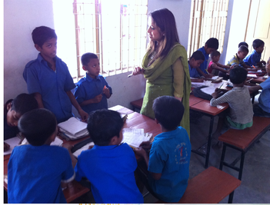
Write true or false:
G.W
1. Mr. Rashidul Islam works in a bank.
2. Saikat lives in a village.
3. Saikat’s mother is a home maker.
4. Saikat is a good learner.
5. He watches drama on TV.
6. We should try to improve our English.

Slide 17
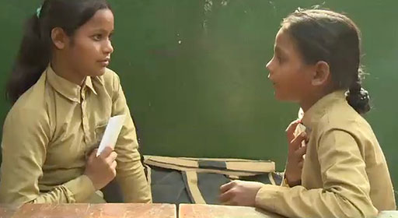
Answer the following questions:
P.W
a. Where does Saikat’s family live?
b. What is Saikat’s father?
c. What does Saikat’s mother do in her free time?
d. How is Saikat as a student?
e. How can you improve your English?

Slide 18

Home work
I.W
Write five sentences about your parents.

Slide 19

Good bye.
Bye
Bye

