Slide 1
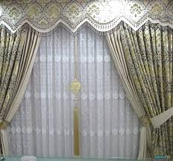
WELCOME TO All

Slide 2
শিক্ষক পরিচিতি
মঞ্জু কান্তি সেন
সহকারি শিক্ষক
বিষ্ণুপুর সরকারি প্রাথমিক বিদ্যালয়
সোনাগাজী, ফেনি।
স্বা
গ
ত
ম

Slide 3
Subject: English Class: Five
Time:40 minutes

Slide 4
Lesson: An Evening with Saikat’s Family
Today’s lesson: Saikat lives ……………make dresses

Slide 5
Learning outcomes: Student’s will be able to- 1.read the text with correct pronunciation 2. say and write some given questions. 3. make three sentences about their daily evening work
.

Slide 6
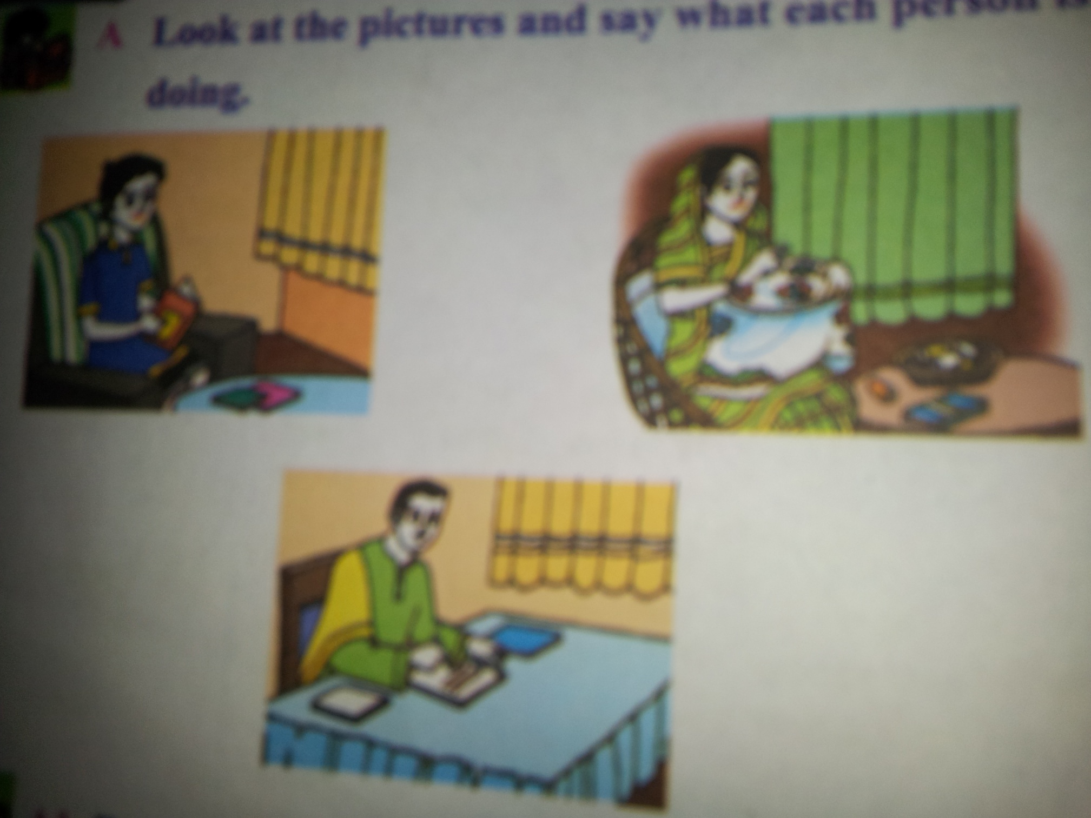

Slide 7
Lesson’s Headline:
An Evening with Saikat’s Family

Slide 8
Parents

Slide 9
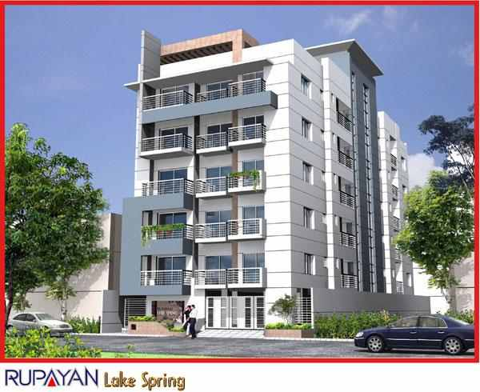
Apartment

Slide 10
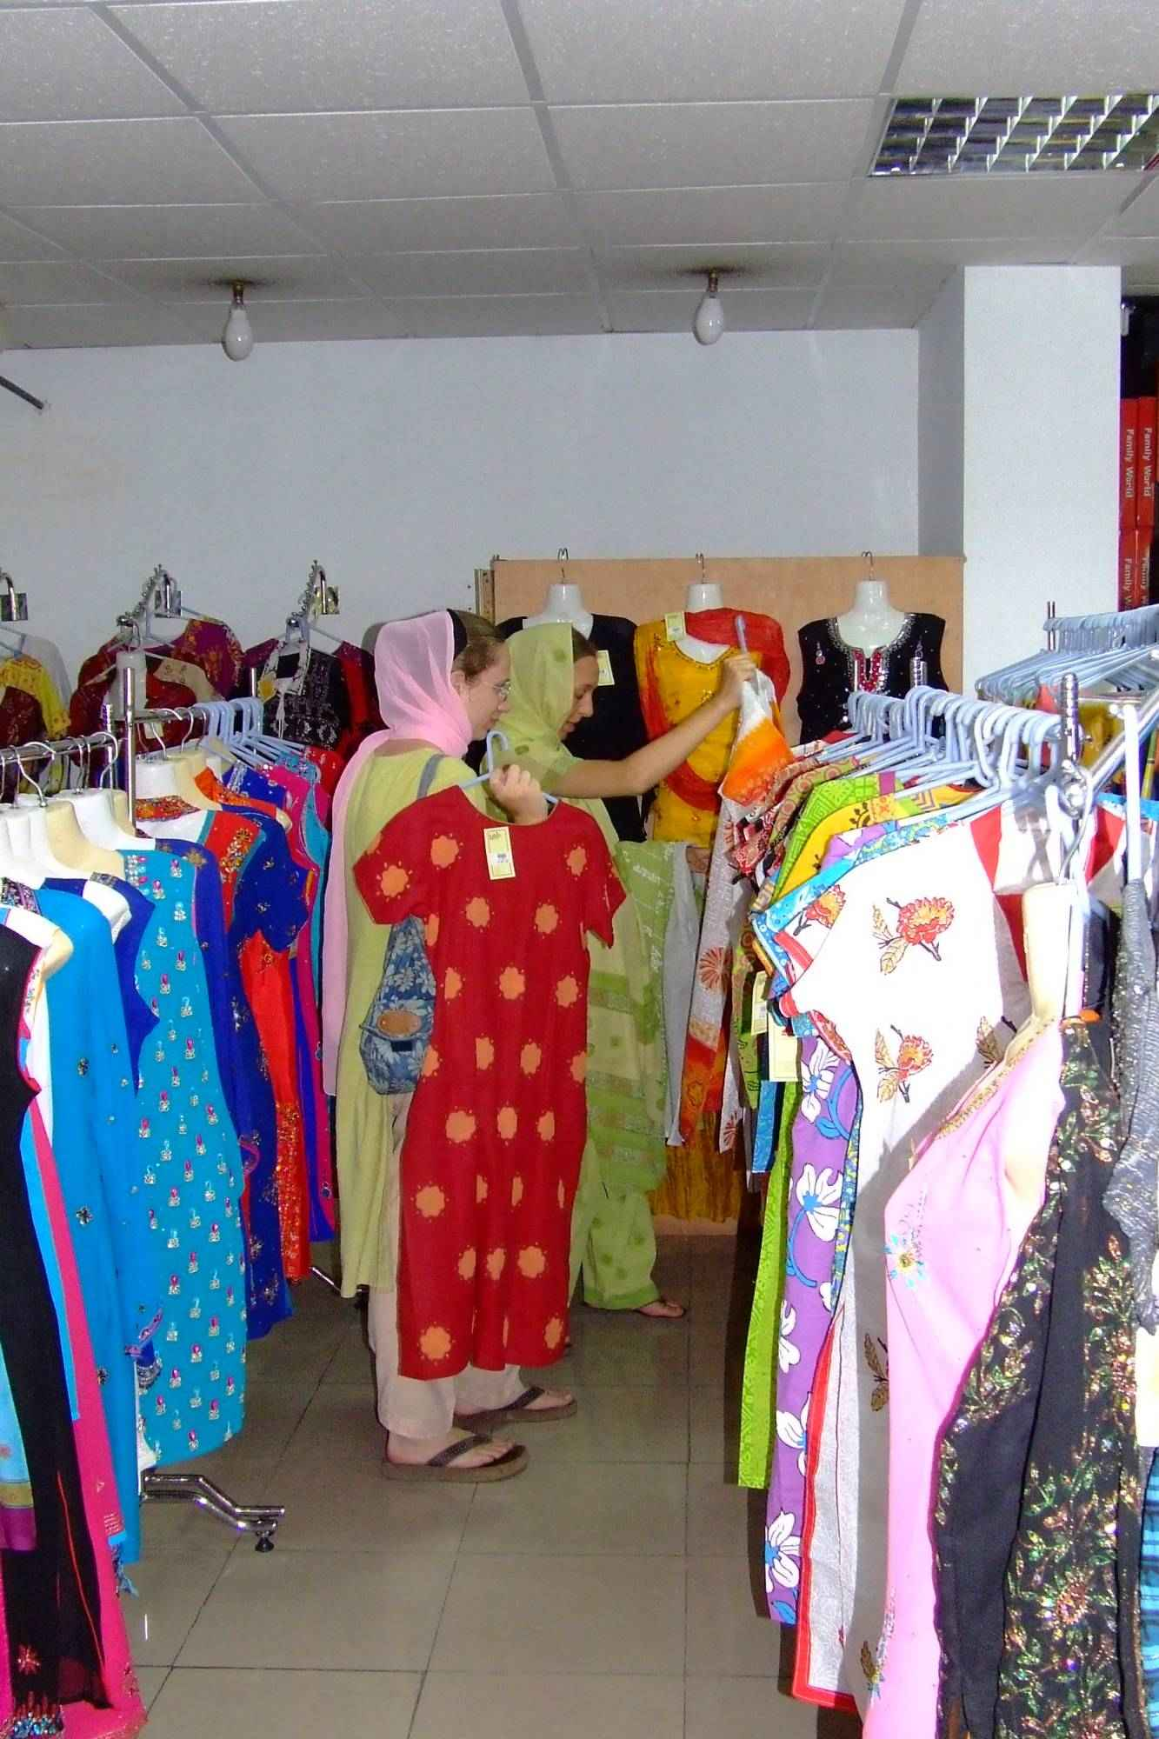
Dresses

Slide 11
Teacher’s reading

Slide 12
Student’s reading individually.
Student’s will write about saikat’s and Mom’s evening work into group

Slide 13
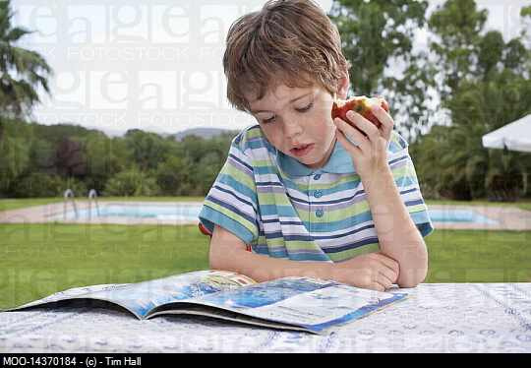
What is Saikat doing ?
Saikat is reading.

Slide 14
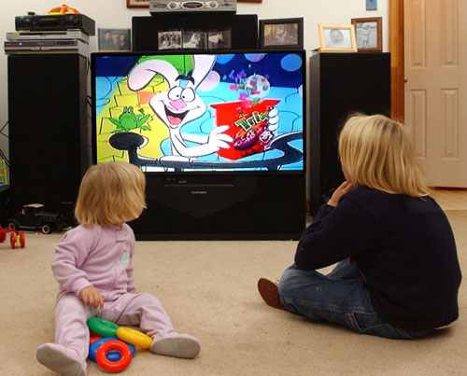
What are they doing?
They are watching TV cartoon.

Slide 15
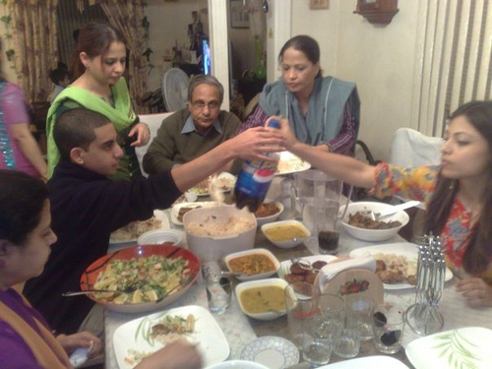
What are they doing ?
They are eating their dinner.

Slide 16
HOME WORK
Write three sentences about your evening work.

Slide 17
THANK YOU ALL

