Slide 2
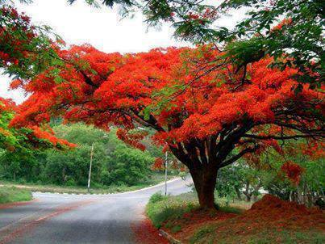
Welcome
to
all
in
my
Class.

Slide 3
Greeting
Good evening, students.
Good evening, teacher.
How are you, also ?
How are you all ?
Fine, thank you sir.
I’m also fine.

Slide 4
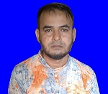
i
Teacher Introducing
Md Shamsunnoor
Head Teacher
Murergaon Govt. Primary school
Companiganj, Sylhet
Mobile : 01712-307039
Email : shadmanheya@gmail.com

Slide 5
Lesson Identity
Class : Five
Subject : English
Time : 40 minute

Slide 6
Learning outcomes
At the end of the lesson students will be able to-
Speaking
1.1.1 say words, phrases and sentences with proper sound and stress.
6.2.1 talk about people, objects, events etc.
Reading
5.1.1 read silently with understanding paragraph.
5.1.2 read silently with understanding stories.

Slide 7
Let’s we sing a song.
https://www.youtube.com/watch?v=6oXNAoF8Zzs

Slide 8
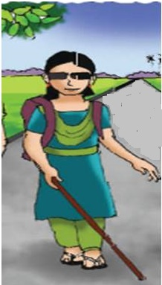
Justifying previous knowledge
Whom do you see in this picture ?
What is the girl doing in the picture ?
A girl walking in the picture.
Why Maria cannot see a beautiful day ?
The problem is called ‘ visually impaired ’.
What is the problem called ?
She is Maria.

Slide 9
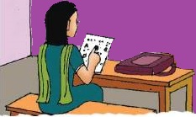
See the picture and think about it for some time.
Can she read something from the poster hanging on the wall ?
What does she read on the paper ?
What is your impression about this picture ?
What is the girl doing in the picture ?

Slide 10
Today’s lesson
Life is Beautiful!
Lessons : 1-4 (4th period)
Activity B. Read the story again and choose
the best answer.
Unit : 20
Page : 78-79

Slide 11
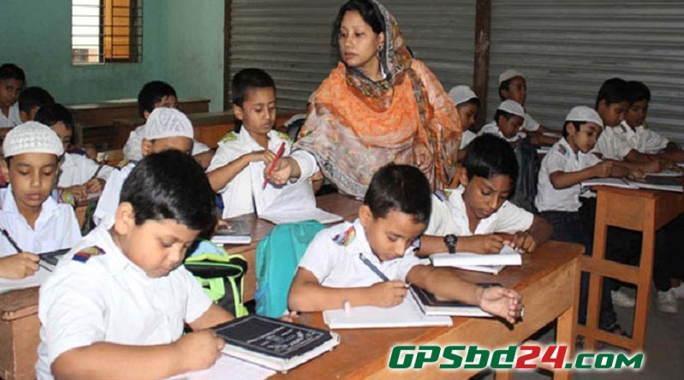
Loud reading & Learning.

Slide 12
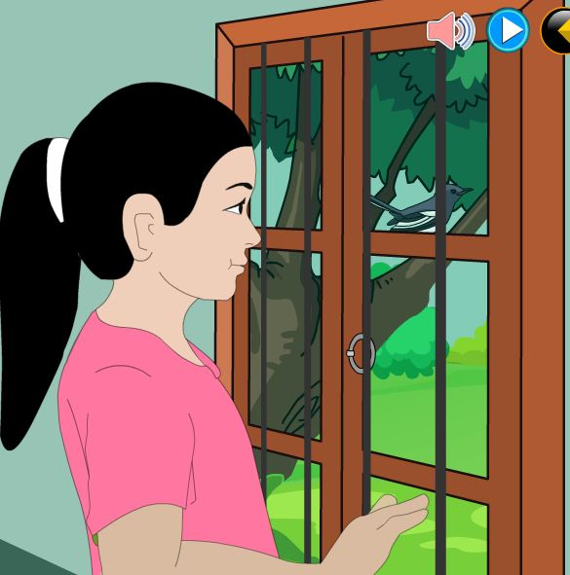
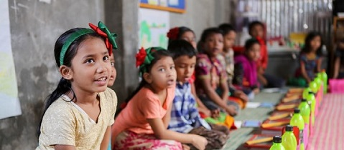
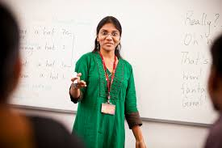
Lesson presentation :
Choose the best answer.
ii. Maria knows it is a warm day because-
i. Maria cann’t see because-
a. It is dark
b. she is visually impaired
a. The birds are singing
b. Her friends tell her.
c. she doesn’t feel well.
c. she feels the glass of the window.

Slide 13
Lesson presentation :
Choose the best answer.
ii. If she goes to university, Maria will probably study-
iii. At school, Maria learns a lot of information by-
a. science.
b. maths.
a. Having her friends read to her
c. history.
b. reading books in Braille script.
c. Listening to the teacher read.

Slide 14
4. a, good, her, opinion, she, is, teachers, learner.
1. is, unhappy, maria
Answer : Maria is unhappy.
Answer : Her teachers opinion she is a good learner.
2. poems, reading, and, she, history, enjoys,
5. that, is uses Braille a raised letters, script
Answer : Braille is a script that uses raised letters .
Answer : She enjoys reading poems and history.
3. she, Braille, reads
6. Braille, are, books, at, Maria’s, school, in
Answer : She reads Braille.
Answer : Maria’s books at school are in Braille.

Slide 15
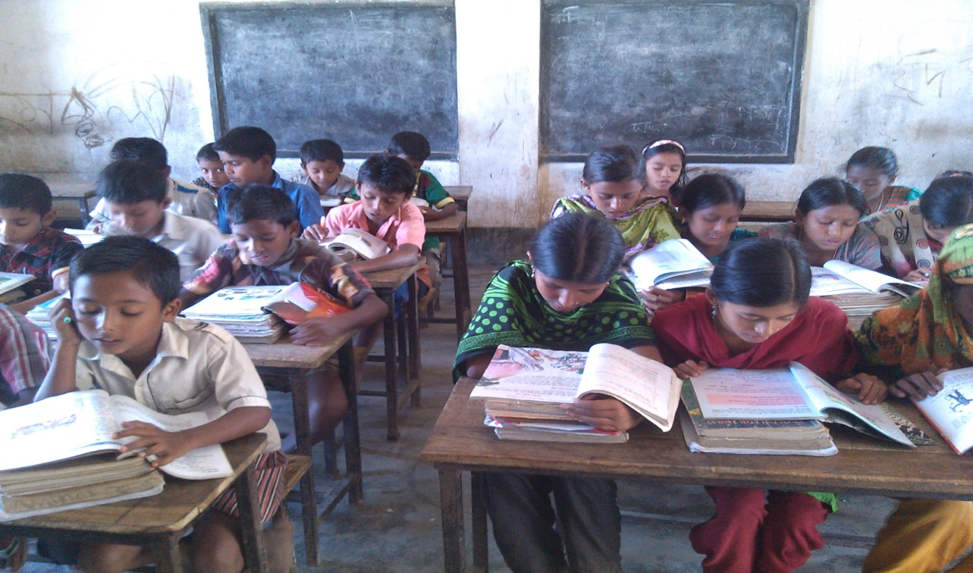
Silent reading

Slide 16
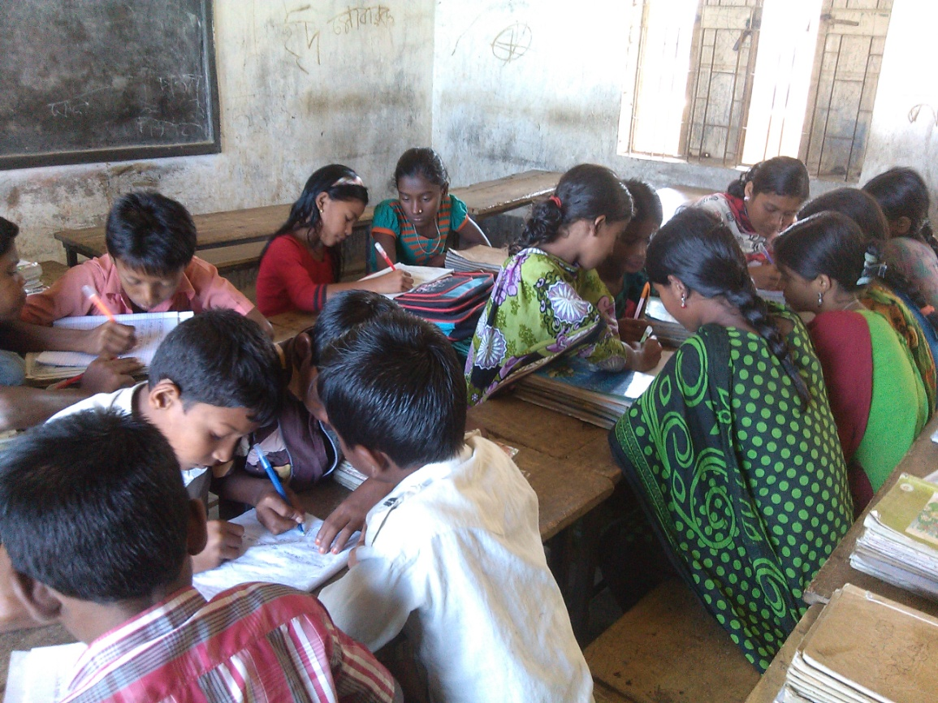
Rearrange the words in the appropriate order to make meaningful sentences.
Group work
1. is, unhappy, maria
2. poems, reading, and, she, history, enjoys
3. she, Braille, reads
4. a, good, her, opinion, she, is, teachers, learner.
5. is uses Braille a that raised letters, script
6. Braille, are, books, at, Maria’s, school, in
F

Slide 17
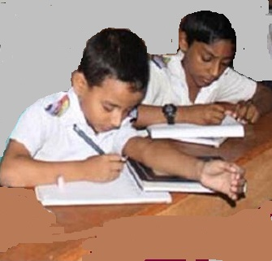
Pair work
1. day, it’s, a, spring, beautiful
4. see, Maria, cannot, the, flowers
Answer : It’s, a beautiful spring day.
Answer : Maria cannot see the flowers.
2. school, she, is, for, ready
5. island, the, is, where
Answer : she is ready for school.
3. school, to, she, district, everyday, goes
Answer : Where is the iland ?
Answer : She goes to school everyday.

Slide 18
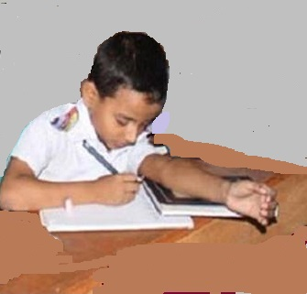
Indivitual work
Rearrange the words in the appropriate order to make meaningful sentences.
1. day, it’s, a, spring, beautiful
2. school, she, is, for, ready
3. school, to, she, district, everyday, goes

Slide 19
Answer the following questions in a sentences.
(e) Why cann’t Maria see all the beautiful things ?
(c) What is Braille ?
(d) How does Blind people read ?
(b) How does she read ?
(a) What is Maria’s favourite subjects ?
Answer : Maria cannot see all the beautiful things
as she is visually impaired.
Answer : Blind people move their fingers across the raised dots to read.
Answe : She reads Braille.
Answe : Braille is a script that uses raised dots.
Answe : Maria’s favourite subjects is poem and history.

Slide 20
Evalution
Choose the best answer and write your notebook.
1. At school, Maria learns a lot of information by-
2. If she goes to unirversity, Maria will probably study--
(a) Reading books in Braille script.
(a) history.
(b) maths.
(c) science .
(b) Having her friends read to her.
(c) Listening to the teacher read.

Slide 21
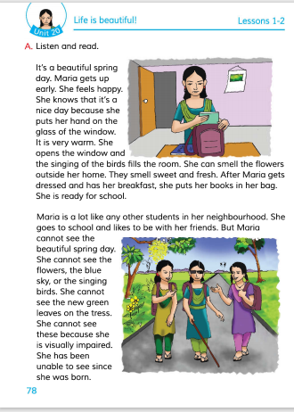
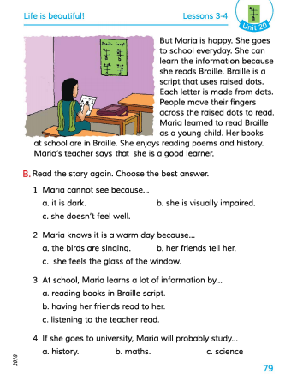
Connection with EFT Book.

Slide 22
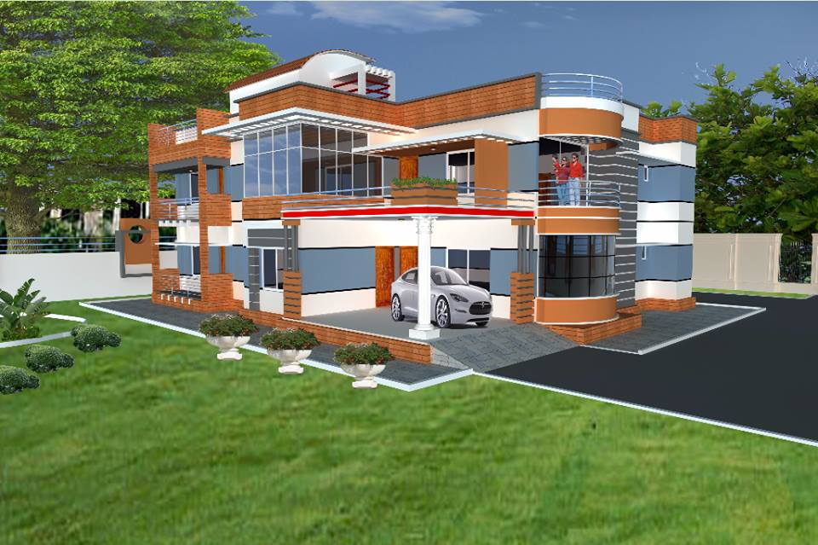
Home work
Write a short composition about ‘ The spring time‘.
(At least five sentences).

Slide 23
Thanks everybody.
See you again.
Bye Bye

Slide 24
END
OF
THE
LESSON

