Slide 1
Welcome

Slide 2
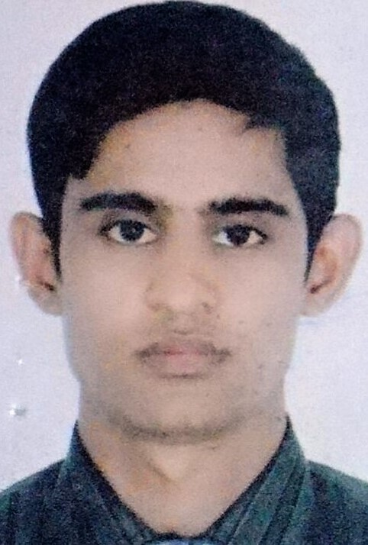
Teacher’s Idetny
Md.Babul islam
Assistant Teacher
Bhabanipur govt.primary school.
Birampur,Dinajpur.
Babul.katla@gmail.com
Mobile.01723099743

Slide 3
Lesson Introduction
Class:Two
Subject:English
Unit:6
Lesson:(1) Numbers
Time:40
Date:1.4.19

Slide 4
Learning outcomes:
Student will be able to
Listening:2.1.1Follow simple commands and Instruction.
Speaking:7.1.1Give simple commands and instruction.

Slide 5
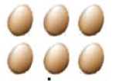
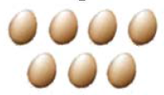
Number
5
6
7

Slide 6
8
Eight

Slide 7
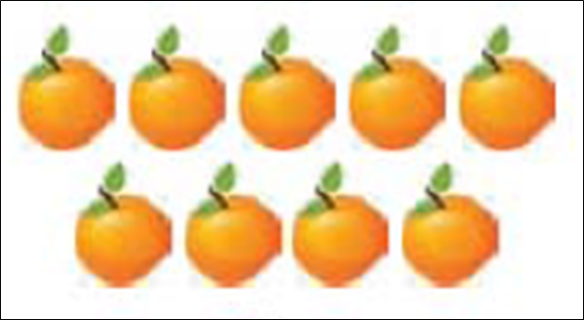
9
Nine

Slide 8
10
Ten

Slide 9
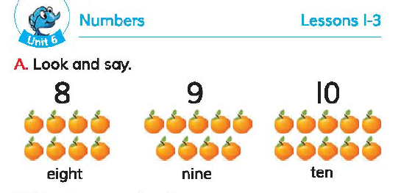
Open your English book at page- 12

Slide 10
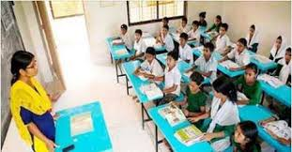
Teacher’s reading

Slide 11
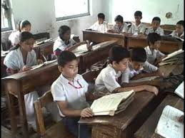
Student’s reading

Slide 12
Students activities:
Count the apples,balls and mangoes.
8
10
9

Slide 13
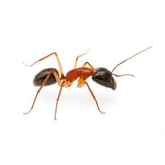
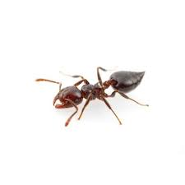
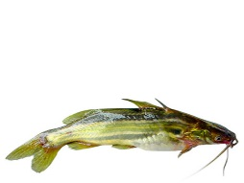
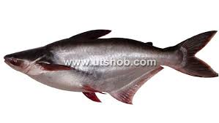
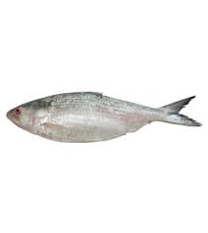
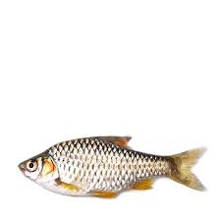
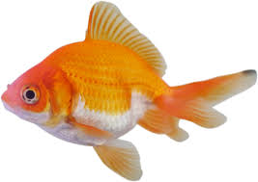
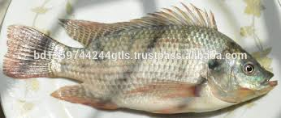
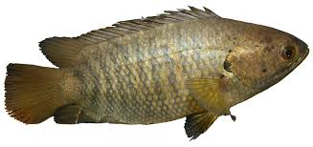
Task
1.How many ants ?
2.How many fish ?
3.How many apple ?

Slide 14
Thanks

