Slide 1
Welcome

Slide 2
Md.Altafujjaman
Assistant Teacher
Khoairpara Govt.Primary School
Birampur,Dinajpur
Class-five
Subject- English
Unite-7
Lesson 1-2
Time: 45 minutes

Slide 3
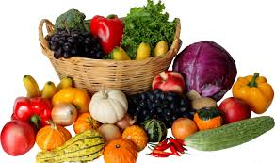
Dear students-
Now, try to say about the following pictures.
If we eat this food, we will be healthy.
Why do we eat this food?

Slide 4
Today’s our lesson is
Be healthy

Slide 5
LEARNING OUTCOMES
By end of the lesson students will be able to---
1. carry out simple commands and instructions.
2. Understand the new words and meaning them.
3.write answer the simple questions.
4. write a short and simple composition.

Slide 6
Teacher’s loud reading and discuss the lesson
Open you EFT book at page 26.

Slide 7
I am putting some chocolate on my ice-cream. Ice-cream is delicious with chocolate.
What ara you doing, Nasreen?
Sima
Nasreen

Slide 8
Well, it looks good, but you shouldn’t eat a lot of chocolate or ice-cream.
Of course! I don’t eat them regularly.
Nasreen
Sima

Slide 9
Individual work
Let’s find out the new words and meaning them.
Delicious
Tasty
Putting
Placing
Weather
Climate

Slide 10
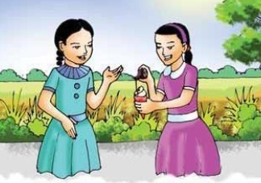
Oh, fruits and vegetables. I love pineapples and bananas. They are my favourites. I eat cucumbers and lettuce a lot, too.
What kind of food do you eat regularly?
Sima
Nasreen

Slide 11
I eat fruits and vegetables every day. Carrots and tomatoes are my favourites, but I also like strawberries and bananas.
Would you like to try some of my ice-cream with chocolate? We should eat it quickly. It will melt soon in this hot weather.
Ok,! Thanks
Sima
Nasreen

Slide 12
Pair work
Answer the questions:
1. What is Sima’s favourite food?
2. What does Nasreen eat a lot?

Slide 13
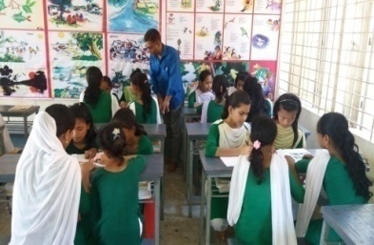
Group work
All groups work is same.
Group -1
Group -2
Group -3
Write a short composition‘on healthy food’ at least in five sentences.

Slide 14
Student’s loud reading help by teacher

Slide 15
Fill in the blanks.
Matching
Is putting
a. Nasreen some chocolate on Sima’s ice-cream.
b. It good.
c. It is , too.
d. But none should a lot of chocolate or ice-cream.
e. Sima tells Nasreen not too much chocolate or ice-cream.
looks
delicious
eat
to eat

Slide 16
Home work
Tomorrow you will be write 5 items name of healthy food.

Slide 17
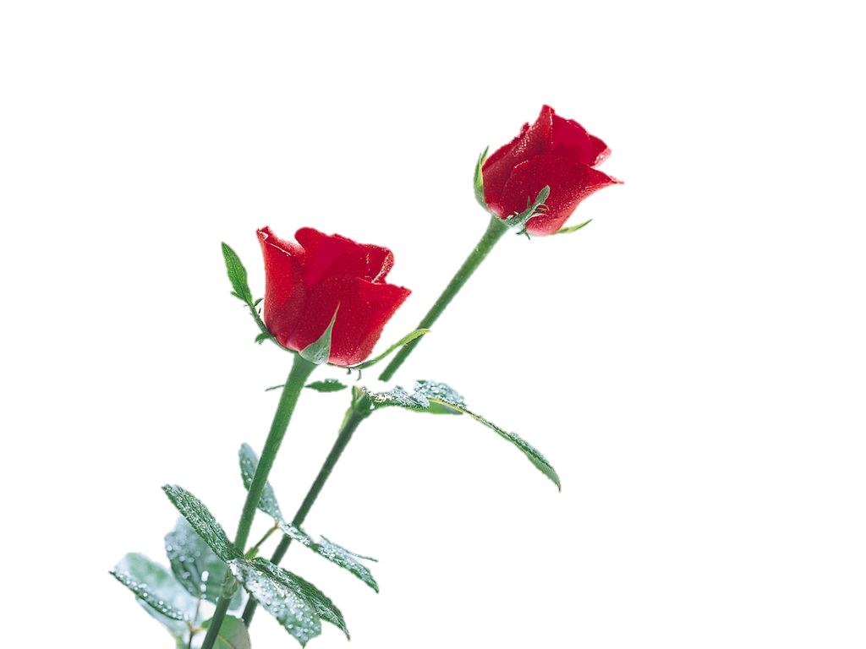
THANKS

