Slide 1

Welcome to the multimedia class

Slide 2
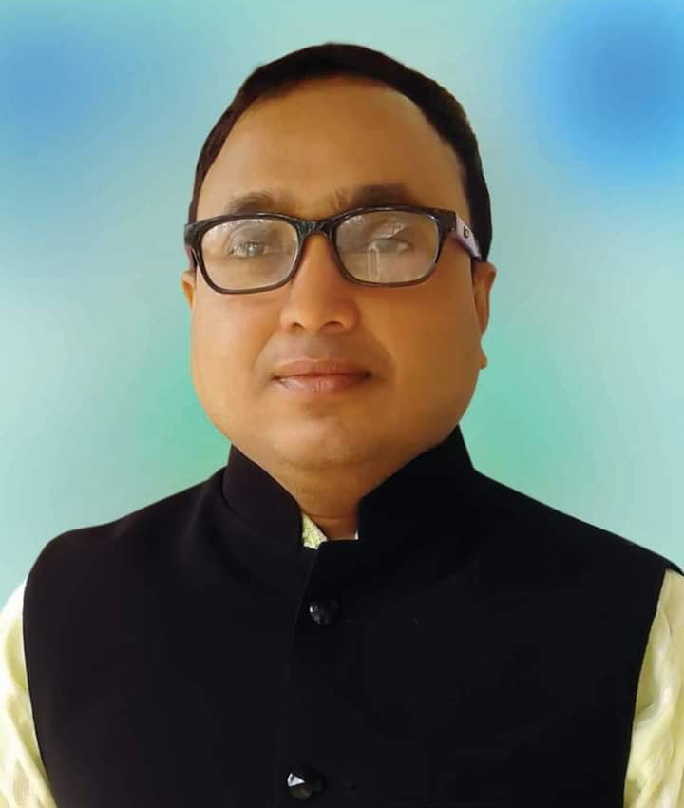
Introduction of the teacher
Md. Nurul Islam
Assistant teacher
Moishashi Govt. Primary School
Balagonj, Sylhet

Slide 3

Introduction of the lesson
Class: 1
Subject: English
Unit: 2, Lesson 4-6 (Alphabet)

Slide 4

Learning Outcome
After the lesson students will be able to:
1.1.1 become familiar with English sounds by listening to common English words.
1.1.1 say simple words and phrases.
1.2.1 recognize and read the alphabet both small and capital ( non-cursive).
1.2.1 write non cursive capital and small letters.

Slide 5

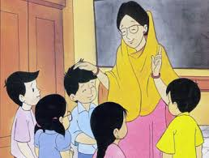
How are you, students?
Fine
Thank you

Slide 6


a
Lesson Declaration
Alphabet(Aa)

Slide 7
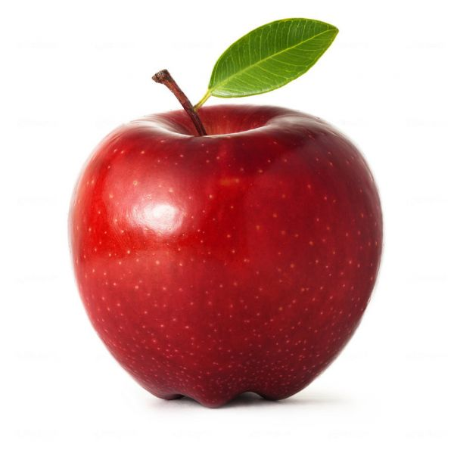
I
N
P
U
t
A
pple
a
pple
a
A

Slide 8
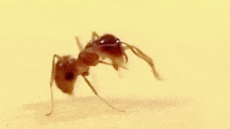
I
N
P
U
t
A
nt
a
nt
a
A

Slide 9
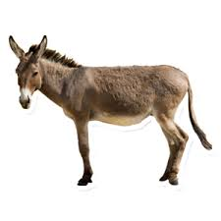
I
N
P
U
t
A
ss
a
ss
A
a

Slide 10

I
N
P
U
t
A
lbum
a
lbum
A
a

Slide 11

I
N
P
U
t
A
rrow
a
rrow
A
a

Slide 12
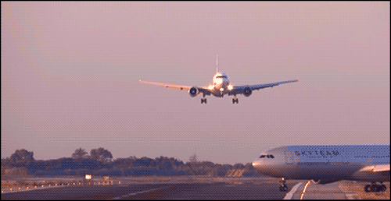
I
N
P
U
t
A
irplane
a
irplane
a
A

Slide 13

How to write A & a
A
P
R
A
C
T
I
C
e

Slide 14

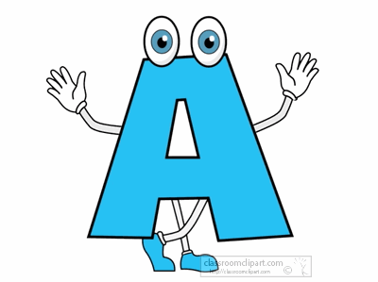

Pronunciate the letter with me
a
P
R
A
C
T
I
C
e
Capital letter
Small letter

Slide 15



Look, listen and say
A
P
R
A
C
T
I
C
e

Slide 16


Look, listen and say. Trace in the air.
P
R
A
C
T
I
C
e

Slide 17

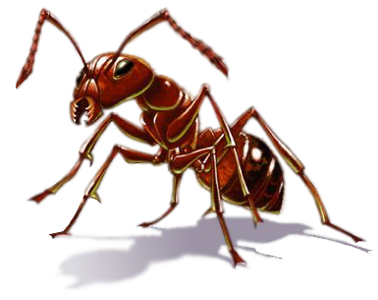

Look, listen and say
PRACTICE

Slide 18


Look, listen and say. Trace in the air.
P
R
A
C
T
I
C
e

Slide 19

Open at page-5

Slide 20
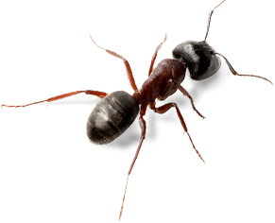
Loud reading by the teacher
WCW
A
apple
ant
A

Slide 21




Group work
Match the pictures with the letters:
Apple
Task
A

Slide 22


Say and read. Trace and write.
WCW
A
A
A
A
A
Task
Shaheen Ahmed, Ast teacher, Singraoli GPS, Sylhet, Mob: 01712332117
24/05/18
Page-23

Slide 23

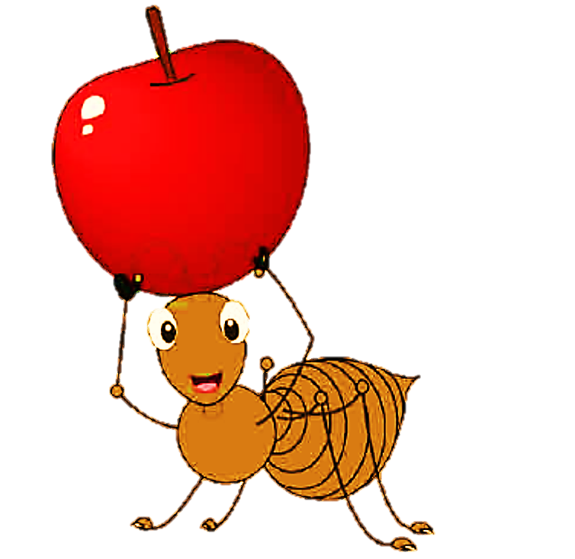


Individual work
_pple
A
A
Say, trace and write.
A
_pple
Task
_nt

Slide 24

Evaluation
Write non cursive small letter “ ”.

Slide 25
Thank you

